Slide 1
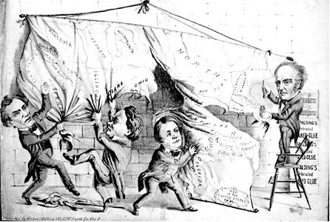
Events Leading to the Civil War
“Dividing the National Map”

Slide 2
3 Causes of the Civil War
(3 S’s)
Slavery: During the 1800s radical abolitionists (mostly in the North) intensified their opposition to slavery at the same time that slavery was becoming even more essential to the economy of the South.

Slide 3
3 Causes of the Civil War
States’ Rights: The old debate over federalism had never really died. Because of its higher population growth, the North would increasingly dominate the federal government. The South responded by claiming that the individual states should have more power to make decisions over issues such as slavery.

Slide 4
3 Causes of the Civil War
Sectionalism: As the North began to industrialize, it became increasingly reliant on wage laborers. As demand for cotton exploded with the creation of the cotton gin, the South became even more reliant on slave labor. The North and South were becoming separate “sections” of the country, each with distinct cultures, economies, and social systems.

Slide 5
Missouri Compromise of 1820
There were an even number of slave states and free states in the United States.
Missouri was being admitted to the Union as a slave state
No slave states above 36 degrees 30’N
This would disrupt the balance of power in Congress giving the slave states more power.
Maine would come into the U.S. as a free state and Missouri would come in as a slave state.

Slide 6
Significance
This compromise helped keep the peace until 1850. Was it succesful?
Demonstrates how westward expansion would increase tensions between North and South

Slide 7
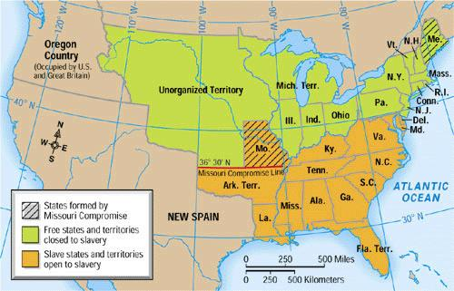
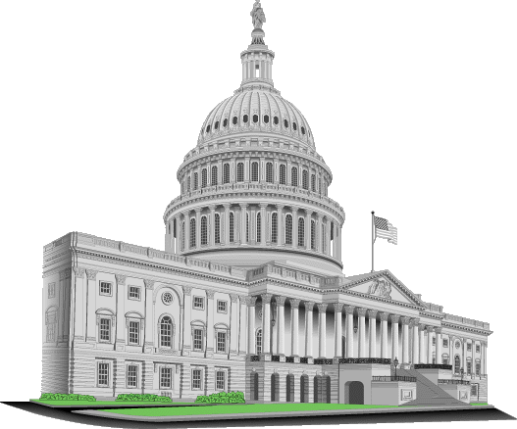
The Missouri Compromise (1820)
Free
?
Future Free
States
Slave
Senate=
12 Free
12 Slave
Future Slave
States
South
North
Congress bans Slavery in the Louisiana Territory North of Missouri’s southern border.
Balance in the Senate is preserved (Missouri=Slave, Maine=Free).
State’s Rights
Federalism

Slide 8
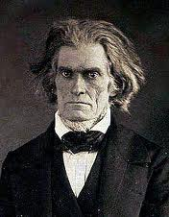
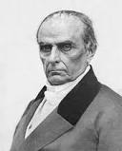
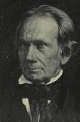
California Divides the Country
John C. Calhoun
(South Carolina)
Daniel Webster
(Massachusetts)
Henry Clay
(Kentucky)

Slide 9
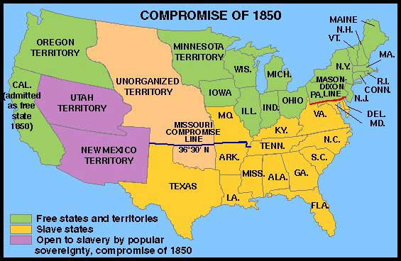
The Compromise of 1850
California?
?
California admitted into the Union as a free state.
South
North
State’s Rights
Federalism

Slide 10
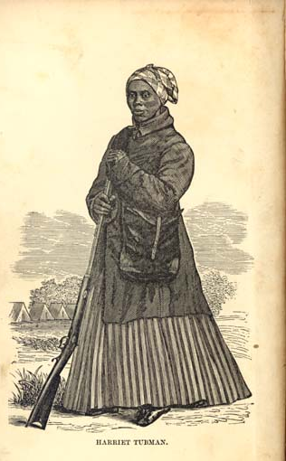
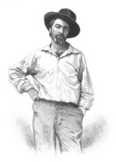
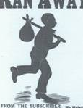
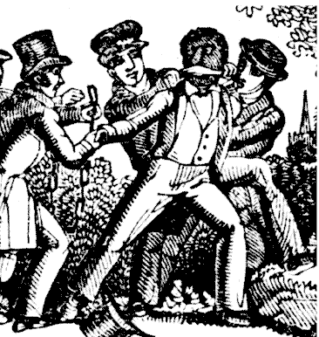
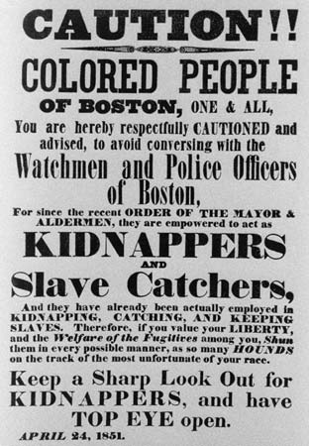
The Compromise of 1850
The Fugitive Slave Law
The Slave
Catcher
The
Abolitionists!
The
Fugitive
Slave
The Fugitive
Slave
“The Fugitive Slave Law stated that every citizen was responsible for helping to recover, punish, and return fugitive slaves; so any white person from the North or South could be, and were expected to be, a fugitive slave catcher”.
South
North
The Underground Railroad
Guaranteed the right of southern slave holders to pursue and recover their property on Northern soil.
Congress passes the Fugitive Slave Act.
State’s Rights
Federalism

Slide 11
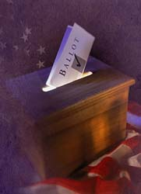
The Compromise of 1850
Popular
Western
Slavery
?
Question?
Popular Sovereignty: A vote of the people living in the Western Territories was to be used to decide the Slavery question.
Sovereignty
South
North
Territories?
State’s Rights
Federalism

Slide 12
Provisions of the Compromise of 1850
California will be admitted as a free state.
Utah and New Mexico may decide on the issue of slavery through popular sovereignty (the voters living in the state will decide whether it enters the Union as a slave state or a free state).
The slave trade (though not slavery itself) was banned in Washington, D.C.
The Fugitive Slave Act was passed, which forced Northern states to assist in the return of escaped slaves.

Slide 13
Significance of the Compromise of 1850
Fugitive Slave Act angered many northerners because by law they were forced to help the slave catchers.
Increased tensions between north and south.
Less successful than the Missouri Compromise.

Slide 14
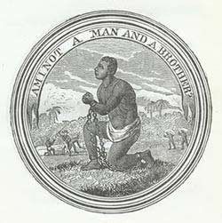
The Abolitionist Movement
1833, American Anti-Slavery Society was founded to push for abolition of slavery.
1839, The Society split between Gradualist & Immediatist Factions

Slide 15
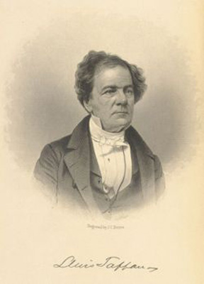
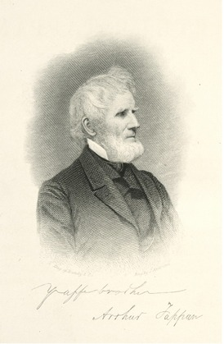
Gradualists
Gradually phase out slavery… possibly w/ compensation for slave owners.
Done successfully in most northern states.
Would minimize economic disruption.
American & Foreign Anti-slavery (est.1840)
Noted Gradualists included… Arthur & Lewis Tappan, James Birney
Lewis Tappan
Arthur Tappan

Slide 16
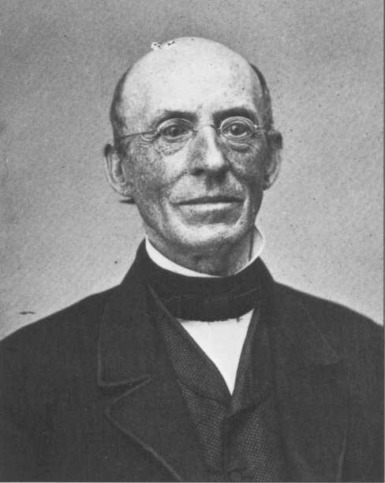
Immediatists
Wanted to immediately end slavery, generally without compensation to slave owners.
Generally employed legal/peaceful methods (speaking tours, newspapers, lobbying, etc.)
“I will be as harsh as truth, and uncompromising as justice... I am in earnest, I will not equivocate, I will not excuse, I will not retreat a single inch, and I will be heard.”
-William Lloyd Garrison
The Liberator (1831)
William Lloyd Garrison
“The Liberator”

Slide 17
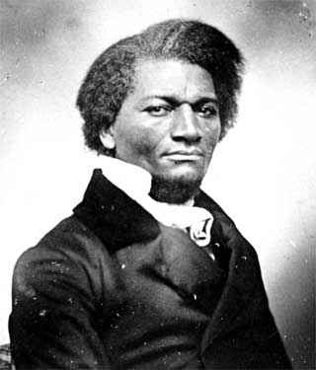
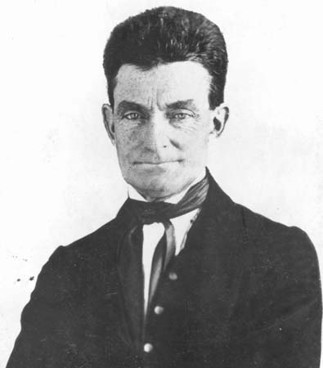
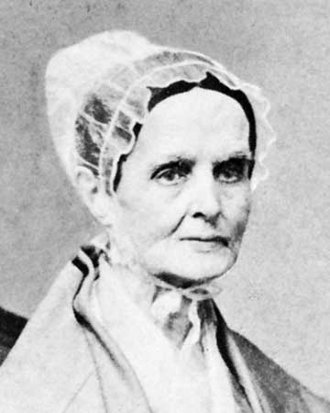
Other Immediatists
Frederick Douglass
Fugitive Slave, Abolitionist Speaker, Writer of 3 Autobiographies,
Editor of antislavery newspaper, The North Star
John Brown
Radical Abolitionist
Pottawamie Massacre (1856)
Raid & attempted slave rebellion in Harper’s Ferry , VA (1859)
Lucretia Mott
Quaker Abolitionist
Founder of Philadelphia Female Antislavery Society (1833)
Women’s Rights Leader

Slide 18
Uncle Tom’s Cabin (1852)
Written by the abolitionist Harriet Beecher Stowe.
Told the story of Uncle Tom, an enslaved African American and his cruel master, Simon Legree.
The novel emphasized the cruelty of slavery.
Significance: It helped change the way many northerners felt about slavery.
Slavery was now a moral problem/issue, intensifying anger between the North and South.

Slide 19
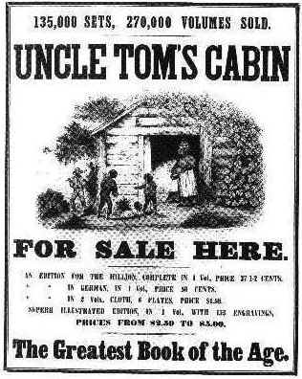
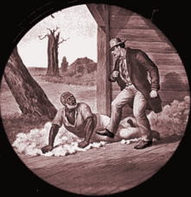
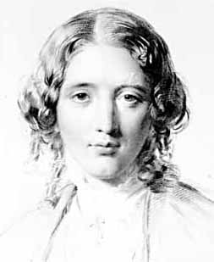
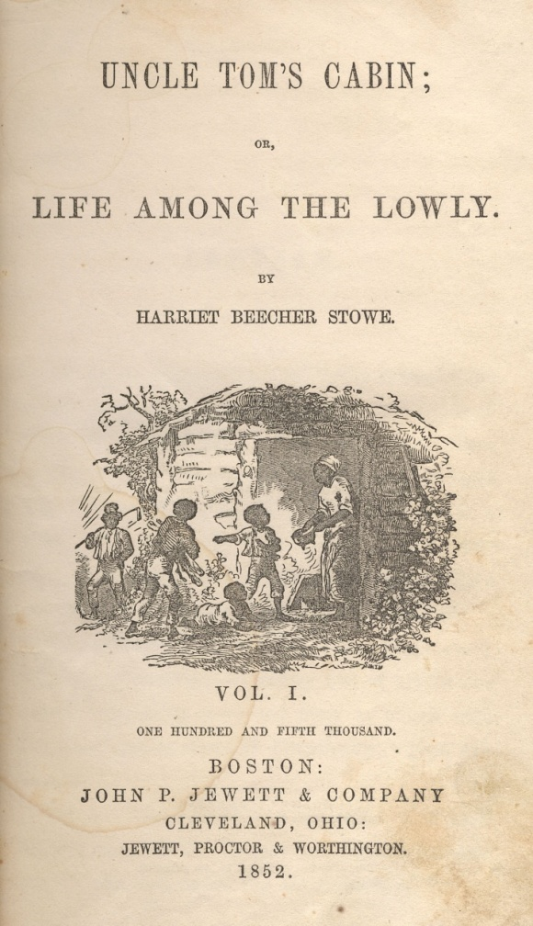
South
North
Harriet
Beecher Stowe
State’s Rights
Federalism
Bestselling book written by Abolitionist Harriet Beecher Stowe.
Focused the nation’s attention on the evils of slavery.

Slide 20
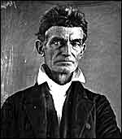
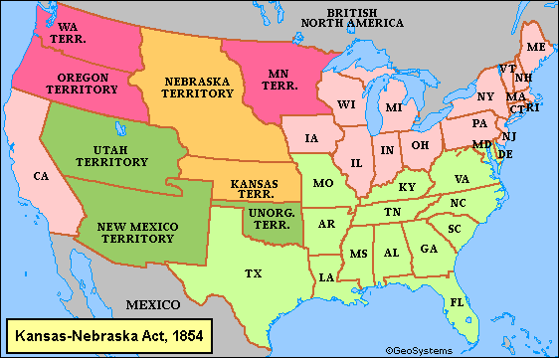

Kansas Nebraska Act (1854)
The fifth victim floated nearby as John Brown and his men washed blood from their swords in Pottawatomie Creek. Brown said that the killings had been committed in accordance to "God’s will," and that he wanted to "strike terror in the hearts of the proslavery people." His killings would provoke fear and reprisals -- pushing America one step closer to an all-out civil war.
popular
Sovereignty
South
North
The issue of slavery would be decided by popular sovereignty.
State’s Rights
Federalism

Slide 21
Kansas Nebraska Act (1854)
Kansas and Nebraska would be divided into 2 territories – Kansas and Nebraska.
The settlers of the new territories would decide (popular sovereignty) whether they would be slave or free.
Significance: Southerners supported the act, while Northerners felt it was a betrayal. Violated the 36 30’ line of the Missouri Compromise. Led to violence in Kansas.

Slide 22
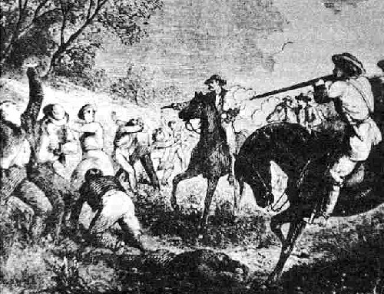
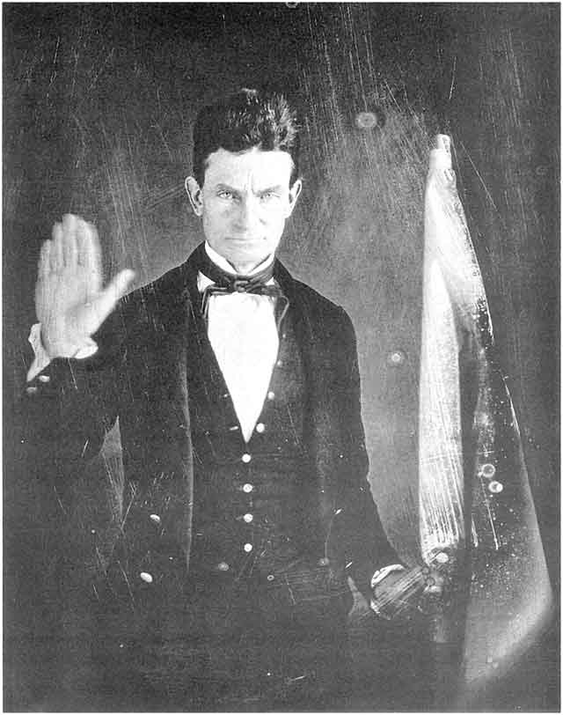
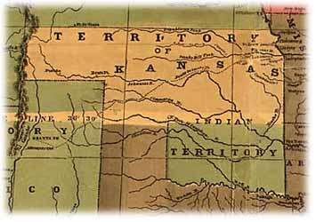
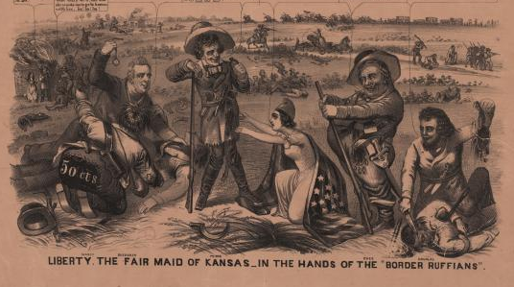

Kansas Nebraska Act
“The fifth victim floated nearby as John Brown and his men washed blood from their swords in Pottawatomie Creek. Brown said that the killings had been committed in accordance to "God’s will," and that he wanted to "strike terror in the hearts of the proslavery people." His killings would provoke fear and reprisals -- pushing America one step closer to an all-out civil war”.
Border Ruffians
(Pro-Slavery)
John
Brown
Free-Soilers
(Anti-Slavery)
Pottawatomie Creek Massacre
Bleeding Kansas
South
North
Result: “Bleeding Kansas”. Border Ruffians (Pro-Slavery) and Free Soilers (Anti-Slavery) waged a violent conflict for control of the territory.
Video
State’s Rights
Federalism

Slide 23
Bleeding Kansas
Popular sovereignty led to violence in Kansas. 2 governments were set up in Kansas. One anti-slavery, and one pro-slavery.
Abolitionists flocked to Kansas to try to make it a free state.
Proslavery supporters also crossed over from Missouri to vote for proslavery candidates and harass abolitionists.

Slide 24
Significance of Bleeding Kansas
Shows that popular sovereignty wasn’t an effective way to deal with the slavery issue.
Widespread violence erupted over the issue of slavery.
President Franklin Pierce tried to get Kansas admitted as a slave state but Congress refused. Kansas didn’t come into the Union until 1861 after the war had started. It came in as a free state.

Slide 25
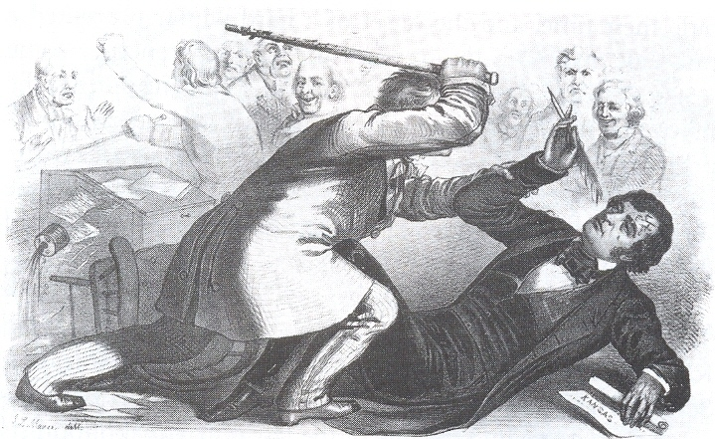
The Beating of Charles Sumner

Slide 26
Beating of Charles Sumner (1856)
Representative Preston Brooks vs. Sen. Charles Sumner (Mass)
Brooks beat Sumner with a cane in Congress in retaliation for a speech Sumner made that advocated Kansas enter the Union as a free state.
Brooks became a hero in the South and Sumner became a martyr in the North.
Represents the breakdown of “reasoned discourse”

Slide 27
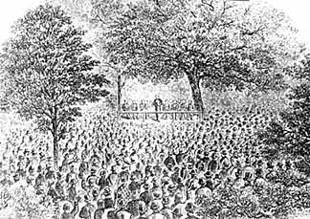
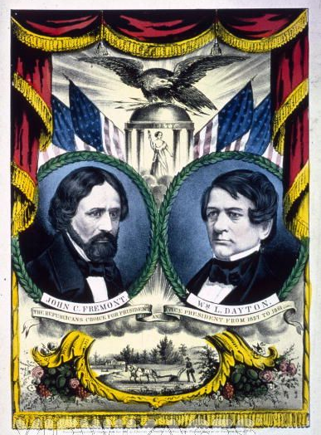
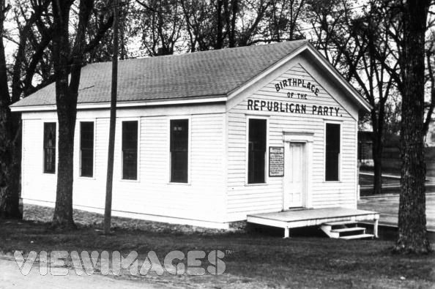
Formation of the Republican Party
The Republican Party was born in the early 1850's by anti-slavery activists and individuals who believed that government should grant western lands to settlers free of charge.
The name "Republican" was chosen because it alluded to equality and reminded individuals of Thomas Jefferson's Democratic-Republican Party.
In 1856, the Republicans became a national party when John C. Fremont was nominated for President under the slogan: "Free soil, free labor, free speech, free men, Fremont.”
South
North
The Republicans were the party of free working white men; they were opposed to the spread of slavery because they did not want to compete against unpaid labor in the lands opening in the West. They were no particular friends of the blacks, slave or free. Their plan was to gain complete political control in the North; if they did, they would have sufficient electoral strength to elect a president.
State’s Rights
Federalism
1856
The Republican Party was founded to oppose the spread of Slavery.
The Republicans were a sectional rather than a national party.

Slide 28
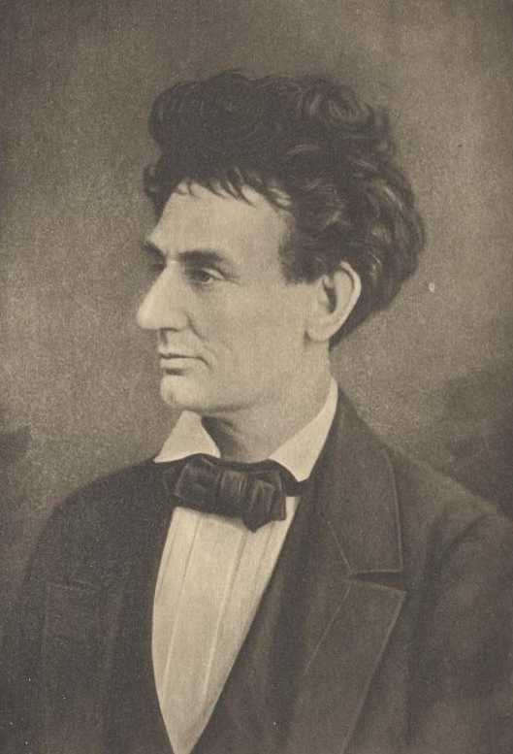
A House Divided Speech
“ A house divided against itself cannot stand." I believe this government cannot endure, permanently half slave and half free. I do not expect the Union to be dissolved — I do not expect the house to fall — but I do expect it will cease to be divided. It will become all one thing or all the other. Either the opponents of slavery will arrest the further spread of it, and place it where the public mind shall rest in the belief that it is in the course of ultimate extinction; or its advocates will push it forward, till it shall become alike lawful in all the States, old as well as new — North as well as South.”
South
North
1858
State’s Rights
Federalism
Lincoln rose to national prominence with his famous “House Divided Speech”.

Slide 29
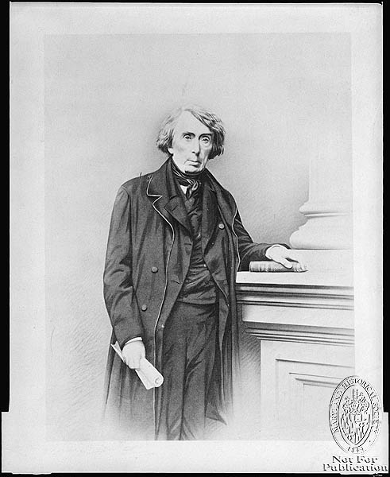
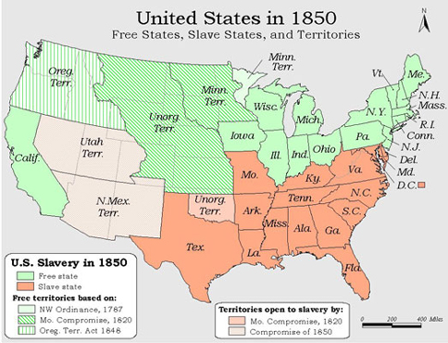
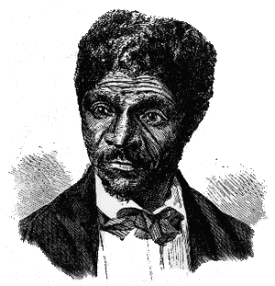
The Dred Scott Case of 1857
They (Slaves) had for more than a century before been regarded as beings of an inferior order, and altogether unfit to associate with the white race, either in social or political relations, and so far unfit that they had no rights which the white man was bound to respect." — Justice Roger Taney
1857
South
North
The Supreme Court ruled that African-Americans were property not people and therefore not entitled to constitutional protection.
Also ruled that Congress did not have the right to ban Slavery in any territory
State’s Rights
Federalism

Slide 30
Significance
The issue of slavery reaches a boiling point.
Dred Scott v. Sanford helped turn slavery into a moral issue in the North and a constitutional issue in the South.
This signaled that there was no more room for compromise between either side.

Slide 31
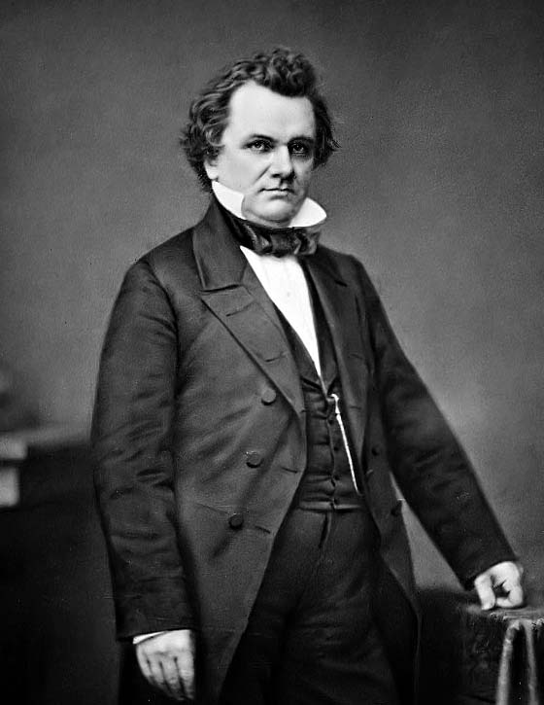
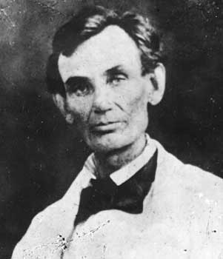
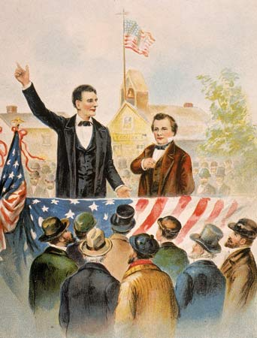

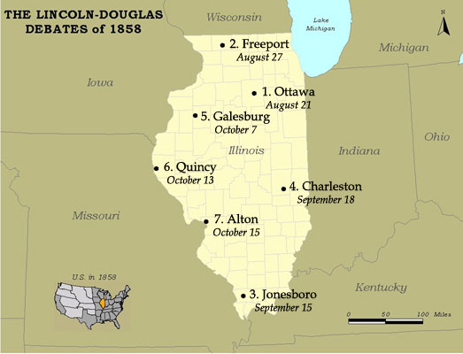
Lincoln-Douglas Debates
Lincoln and Douglas held a series of debates during the Senate races in 1858. Both were anti-slavery.
1858

Slide 32
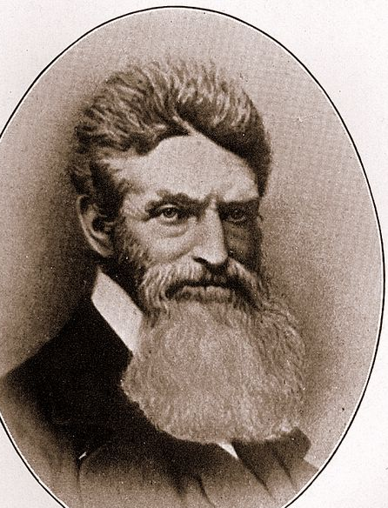
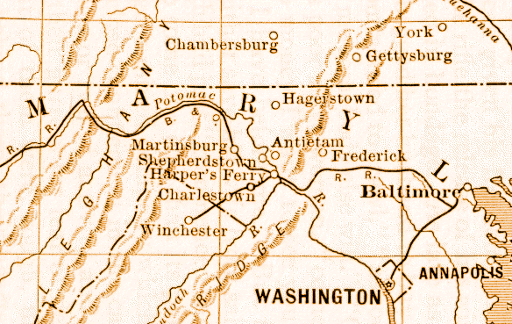

John Brown’s Raid on
1859
Brown’s plan was to seize weapons from the Federal Arsenal at Harper’s Ferry to start a Slave revolt in the South.
Harper’s Ferry

Slide 33
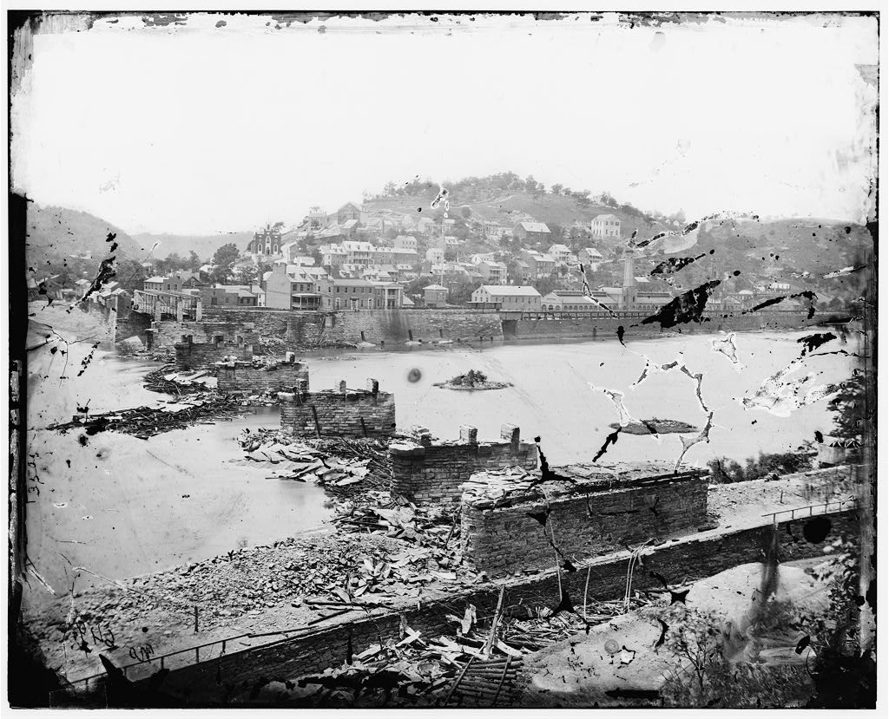
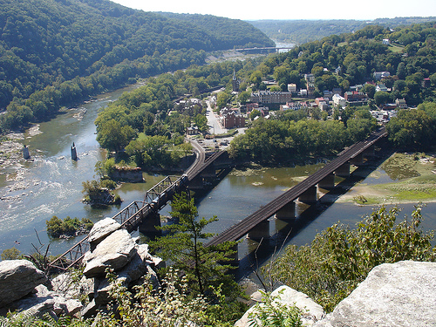
John Brown’s Raid on
1859
Harper’s Ferry

Slide 34
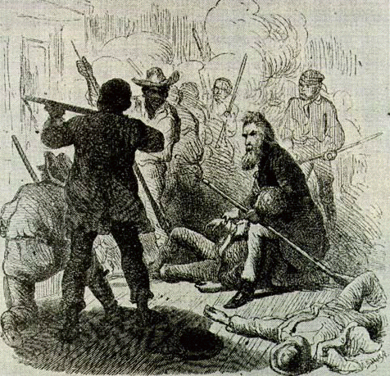
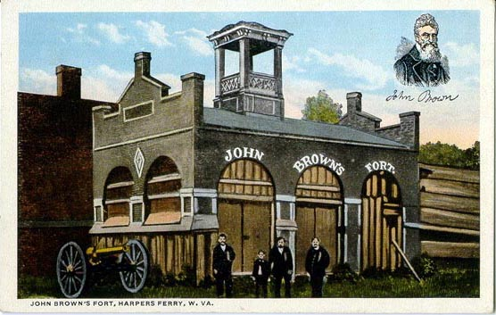
John Brown’s Raid on
After seizing the weapon’s Brown and his men were chased into a small building that became known as John Brown’s Fort.
Harper’s Ferry

Slide 35
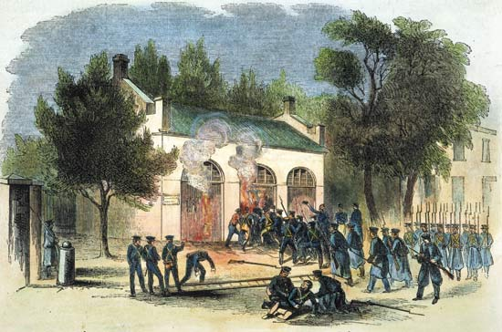
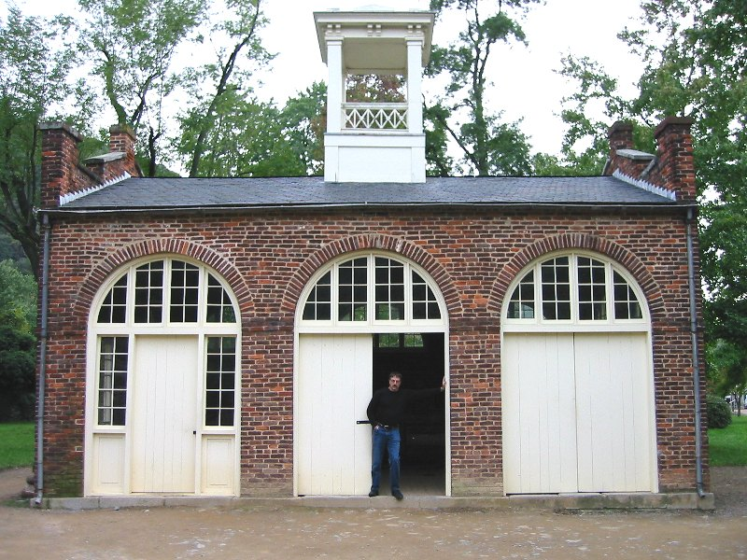
John Brown’s Raid on
Virginia troops seized the fort and arrested Brown. He stood trial in Federal Court for treason against the United States.
Harper’s Ferry

Slide 36


John Brown: Hero?
To His
Execution

Slide 37


John Brown: Villain?
South
North
To Northerners Brown was a martyred hero, to southerners he was a criminal who deserved his execution.
State’s Rights
Federalism

Slide 38






Brown was hanged at Charles Town on Dec. 2, 1859, with four of his men, after handing a prophetic note to his jailer on his way to the gallows:
“the crimes of this guilty land will never be purged away; but with Blood."
"I John Brown am now quite certain that the crimes of this guilty land: will never be purged away; but with Blood."

Slide 39


Election of Lincoln
1860
South
North
Lincoln (Republican) wins the presidential election of 1860
Lincoln’s opposition to the spread of Slavery causes many Southern States to threaten secession from the Union.
State’s Rights
Federalism

Slide 40






Seeing Lincoln’s election as intolerable the Southern States secede from the Union and form the Confederate States of America in 1861.
Southern
South
North
Secession
South Carolina on December 20, 1860
Mississippi on January 9th, 1861
State’s Rights
Federalism
Florida on January 10th, 1861
Alabama on January 11th, 1861
Georgia on January 19th, 1861
Louisiana on January 26th, 1861
Texas on February 1st, 1861
Virginia on April 17th, 1861
The Confederate
States
of America
Arkansas on May 6th, 1861
North Carolina on May 20th, 1861
Tennessee on June 8th, 1861
Border Slave States:
Delaware Kentucky
Maryland Missouri
West Virginia
1860-1861

Slide 41






Fort Sumter
Union Actions:
No surrender! Do not fire until fired upon.
Following a Confederate bombardment, the Union surrenders the fort. The Civil War had begun!
Confederate Actions:
Surround the Fort and demand surrender.
April 12, 1861

Slide 42

The Civil War (1861-1865)

