Slide 1
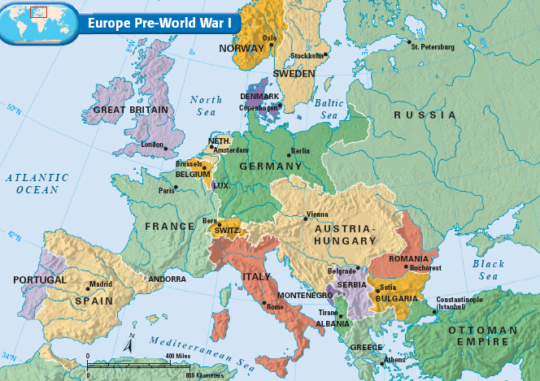
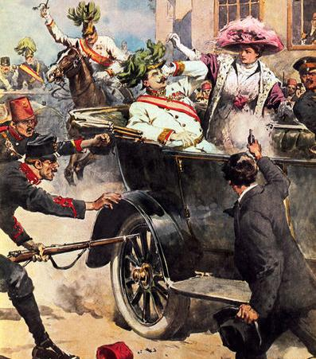
From 1870 to 1914, the growth of militarism, alliances, imperialism, & nationalism increased tensions increased among European nations
Nationalism among Slavs in the Balkans led to the assassination of Archduke Franz Ferdinand in 1914

Slide 2
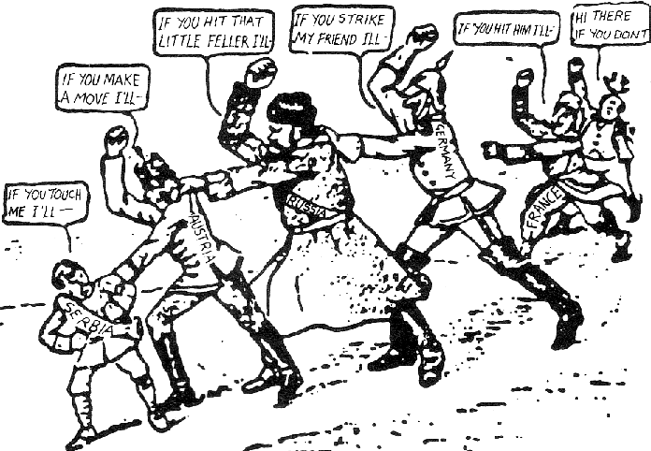
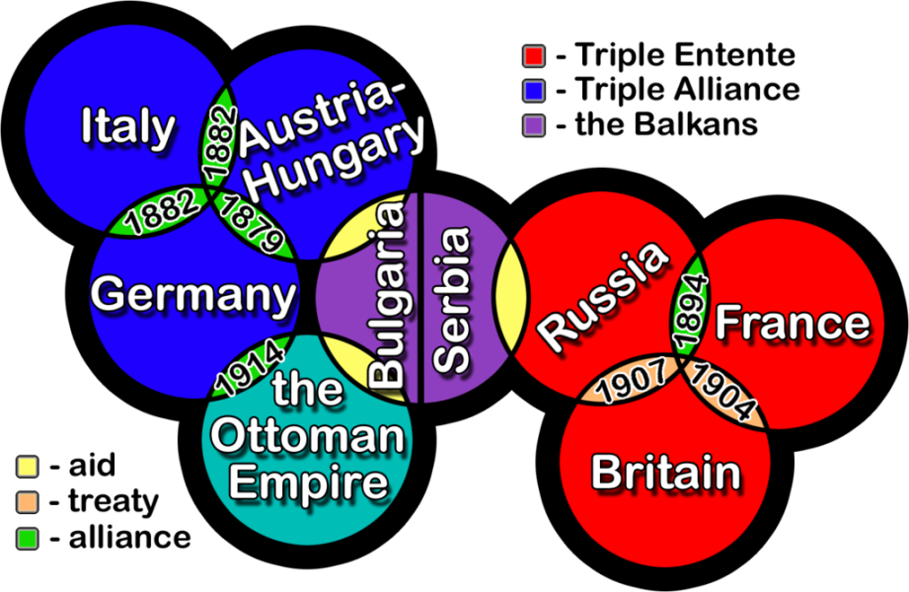
The conflict between Serbia & Austria-Hungary triggered alliances and started World War I

Slide 3
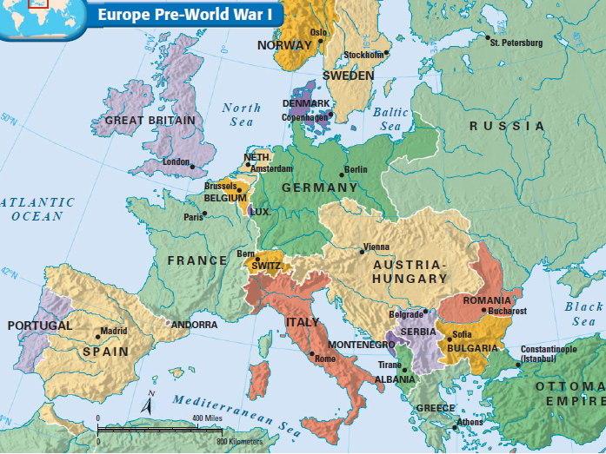
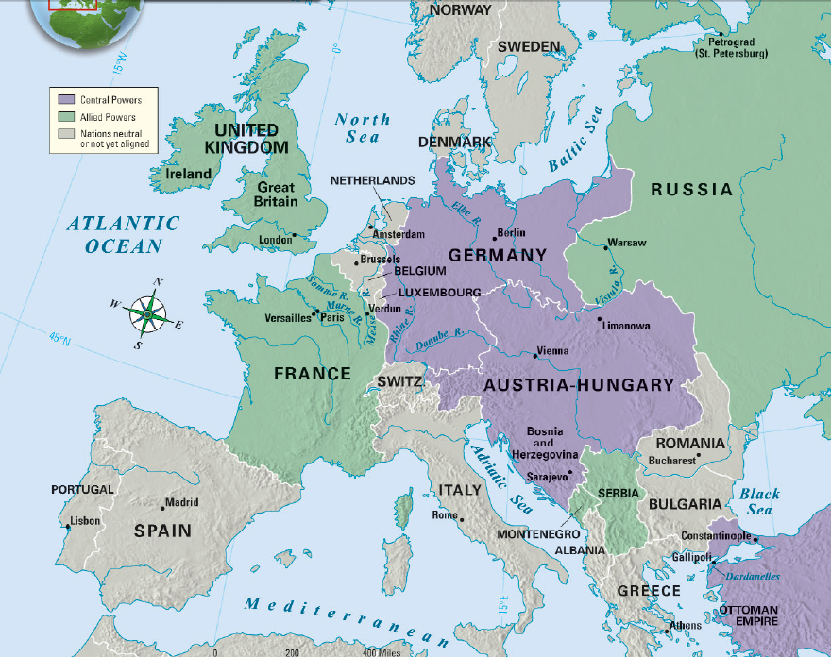
Europe before the war
Europe at the outbreak of World War I
The Central Powers
Text
The Allied Powers

Slide 4
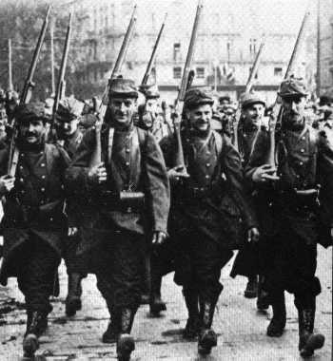
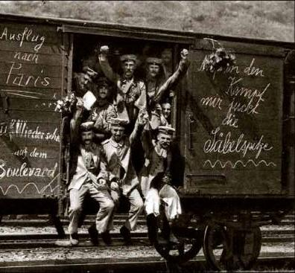
When the war began in August 1914, Europeans were enthusiastic about fighting
Most people anticipated that the war would be over by Christmas 1914….they were wrong
French Recruits
German Recruits

Slide 5
When the war began, Germany’s biggest problem was the potential of fighting on two fronts
Germany’s solution was the Schlieffen Plan which involved quickly defeating France in the West…
…then sending troops to the East before Russia was fully mobilized for war

Slide 6
The Schlieffen Plan seemed to be working when the German army marched through Belgium & France, within miles of Paris
…Meanwhile, Russia mobilized faster than expected, so Germany had to divert troops from France
But, English & French troops saved Paris at the Battle of the Marne…

Slide 7
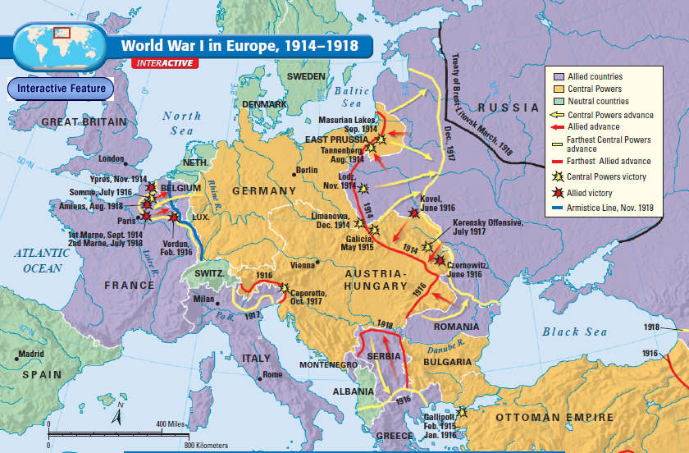
Because the Schlieffen Plan failed, the Central Powers were forced to fight a two-front war
The fighting between Germany & France was known as the Western Front
The fighting between Germany & Russia was known as the Eastern Front
By 1915, the war settled into a stalemate as each side fortified their positions with trenches

Slide 8
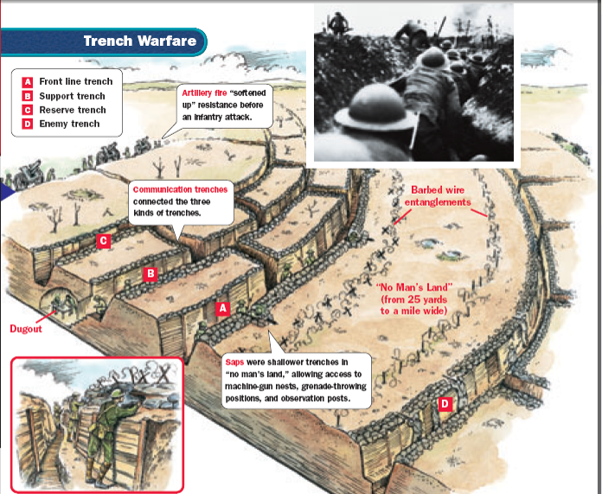

Slide 9
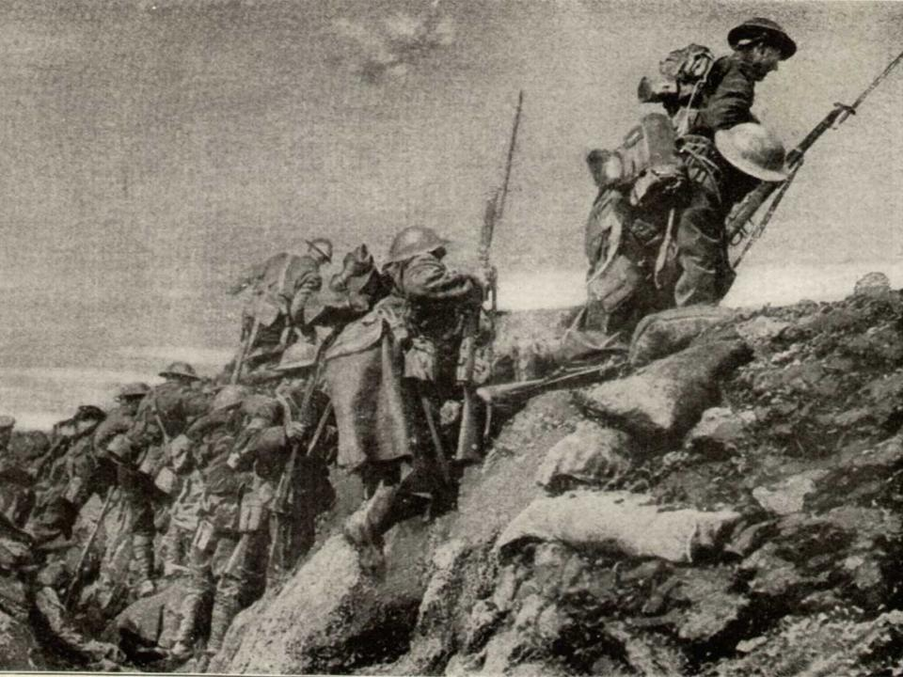
Soldiers going “over the top”

Slide 10
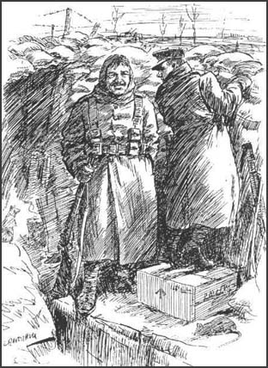
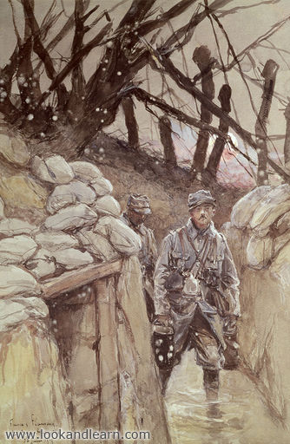
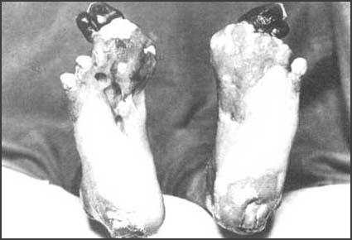
The soldiers had very little decent food, and what food they had was often attacked by rats.
These rats were the size of small rabbits and badgers because they had fed on the decomposing bodies of dead soldiers.
Trench Foot

Slide 11
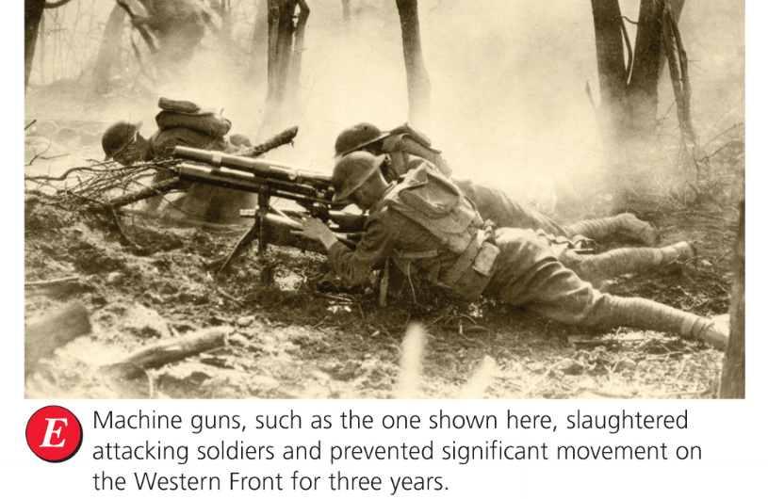
New weapons were invented to try to gain an advantage & win the war
Machine guns

Slide 12
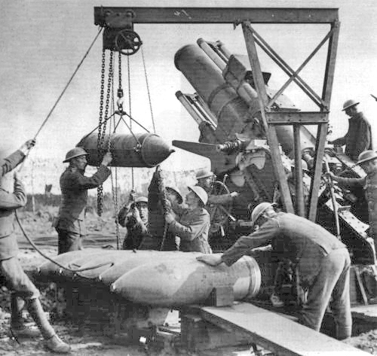
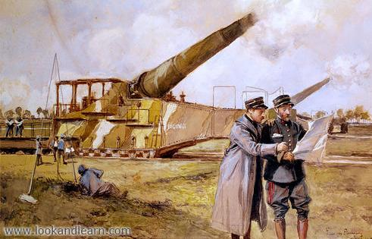
New weapons were invented to try to gain an advantage & win the war
Long-range artillery

Slide 13
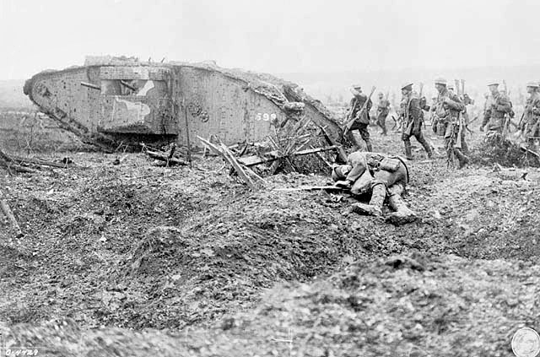
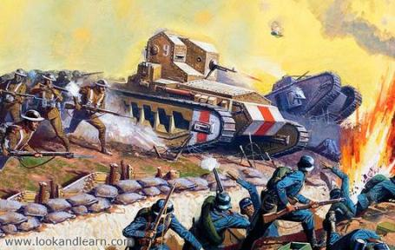
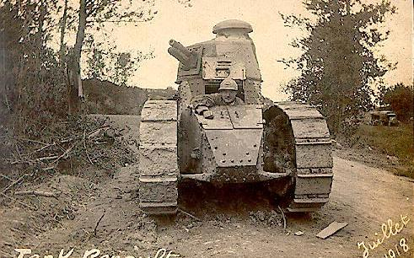
New weapons were invented to try to gain an advantage & win the war
Tanks

Slide 14
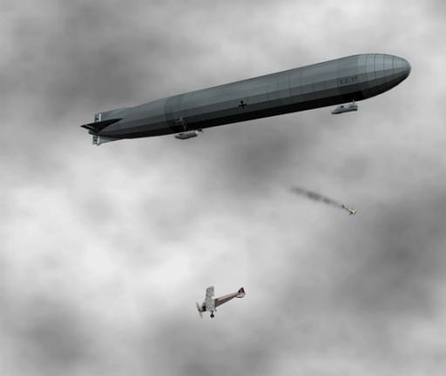
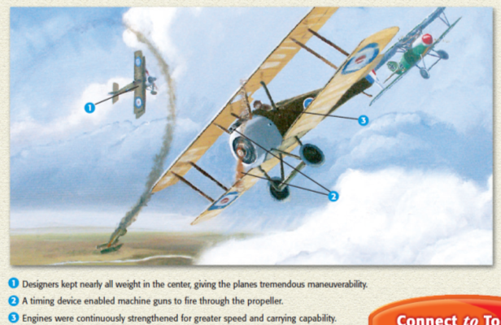
New weapons were invented to try to gain an advantage & win the war
Airplanes & zeppelins

Slide 15
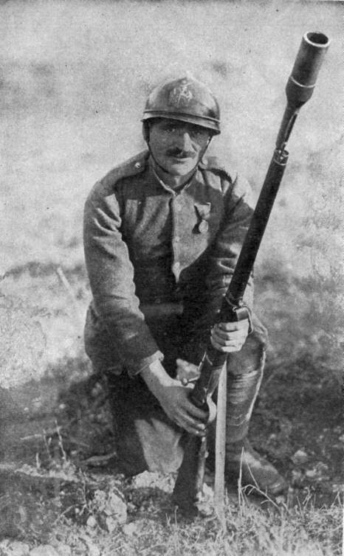
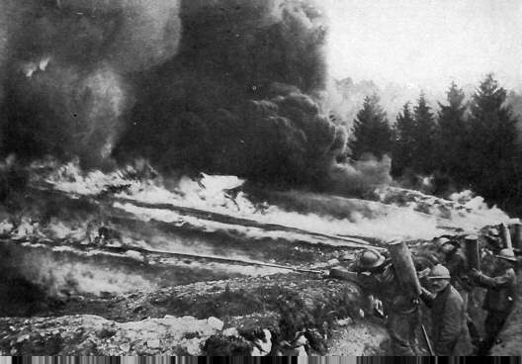
New weapons were invented to try to gain an advantage & win the war
Flamethrowers & grenade launchers

Slide 16
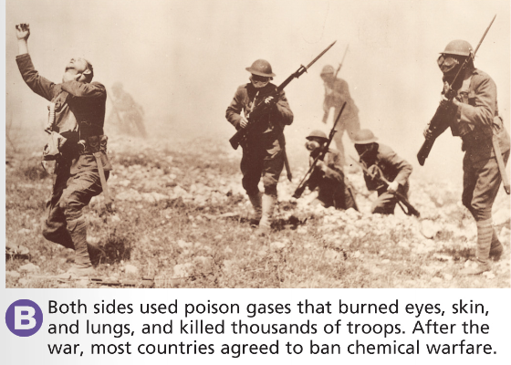
New weapons were invented to try to gain an advantage & win the war
Poison gas

