Slide 1
Fighting WWI – Part II

Slide 2
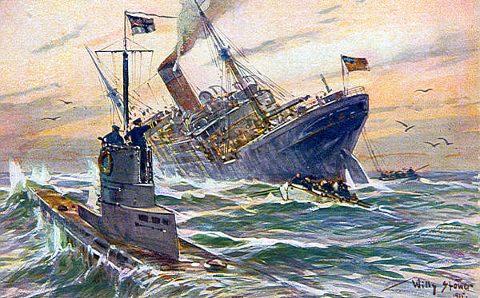
New weapons were invented to try to gain an advantage & win the war
Submarines

Slide 3
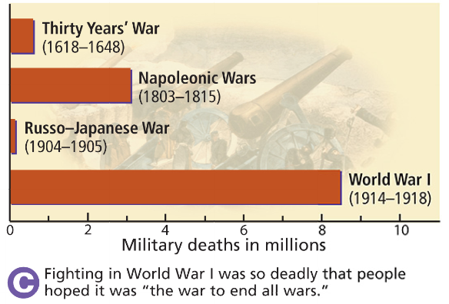
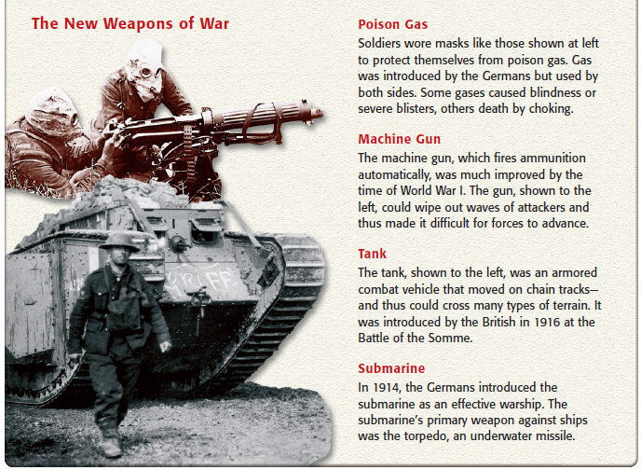
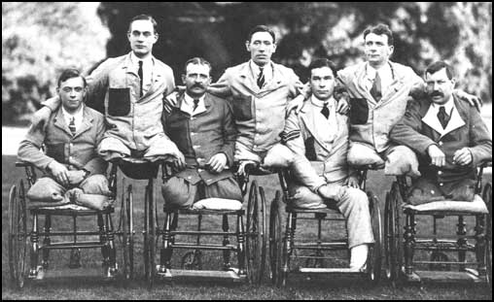
New weapons killed soldiers more effectively; During World War I, 8.5 million soldiers died & 21 million were wounded.
Most also suffered from shell shock .

Slide 4
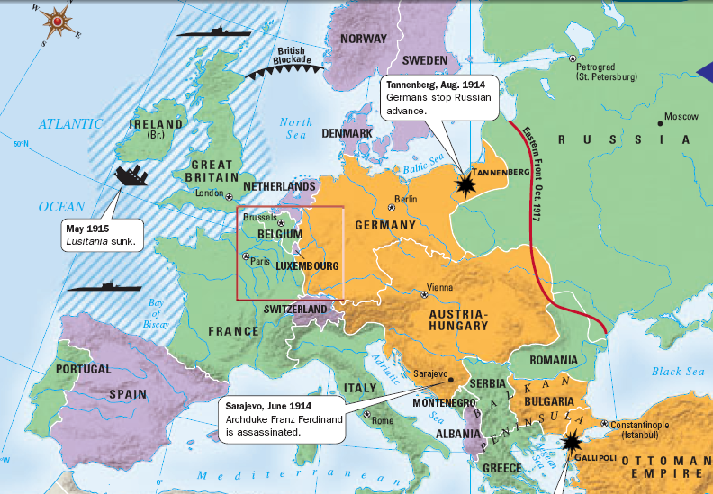
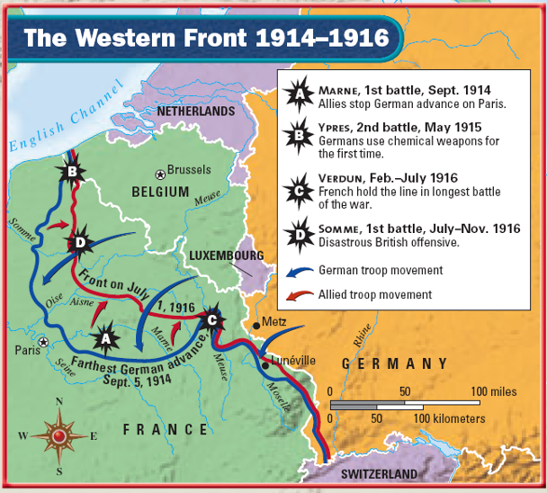
Fighting on the Western Front slowed to a stalemate as neither side could gain an advantage
During the 10 month Battle of Verdun in 1916, 1 million soldiers were killed or wounded
Another 1 million soldiers were killed or wounded at the Battle of Somme
Despite the deaths, neither the Allies nor Central Powers gained an advantage after these battles

Slide 5
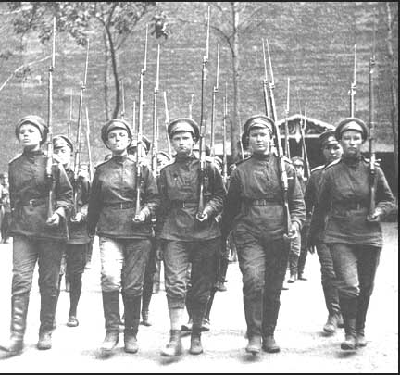
On the Eastern Front, the Russian army was struggling to hold on against the German military
Russian women training for combat
Millions of Russian soldiers & civilians died during the war
By 1917, Russia was on the brink of collapse
Russia was not as industrialized as the rest of Europe & failed to produce enough weapons or food

Slide 6
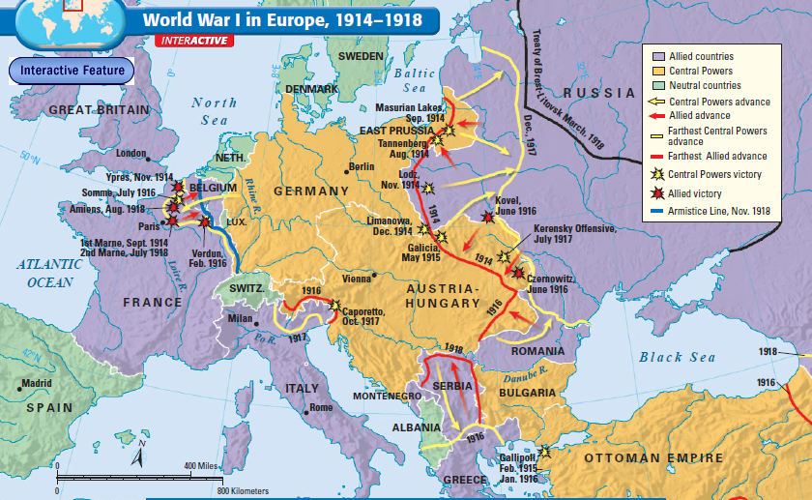
The stalemate on the Western & Eastern Fronts turned World War I into a war of attrition where each side tried to out-produce & outlast the enemy

Slide 7
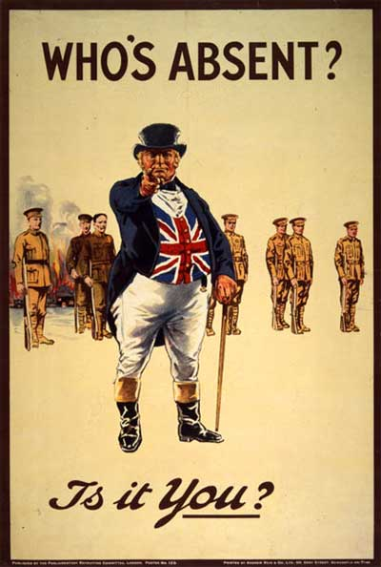
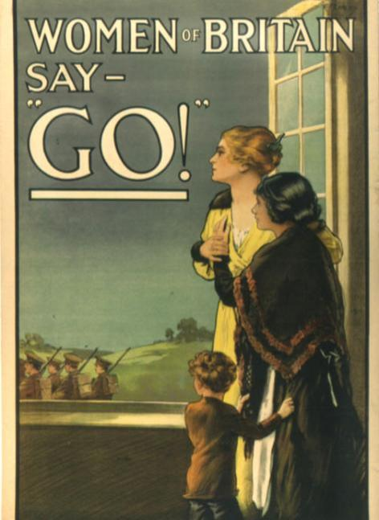
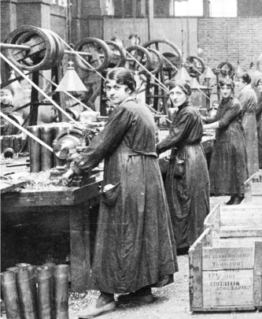
Nations committed to total war to win World War I
Factories were converted to make war equipment
Industrial resources were rationed in order to prioritize military needs
Governments used conscription to draft civilians into the military
Propaganda was used to maintain civilian support for the war
Overseas colonies were used to gain resources or additional soldiers

Slide 8
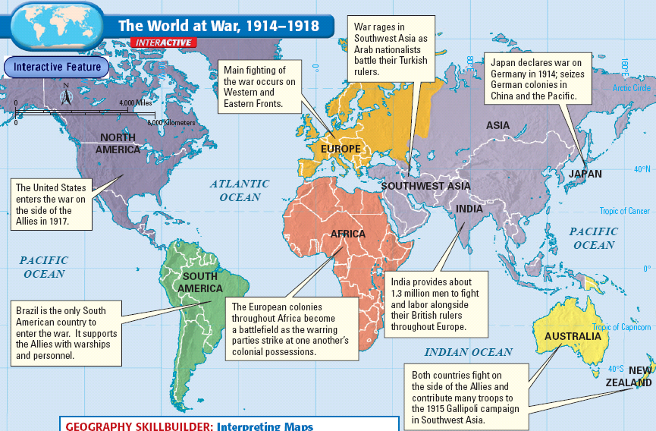

Slide 9
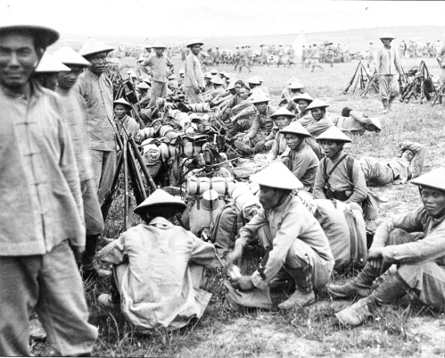
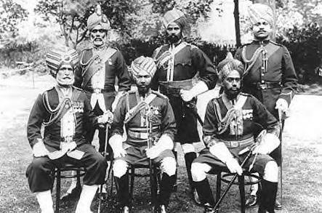
Sikh British Soldiers in India
Chinese Soldiers
Turkish Cavalry

Slide 10
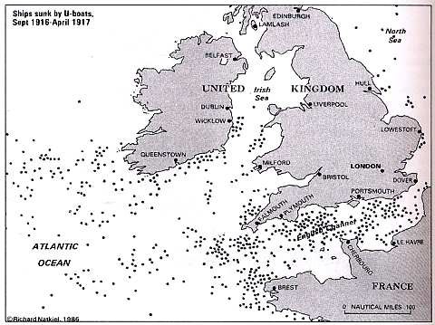
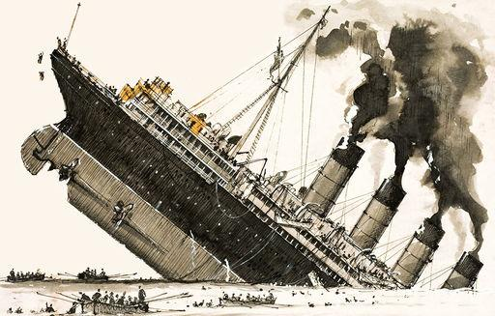
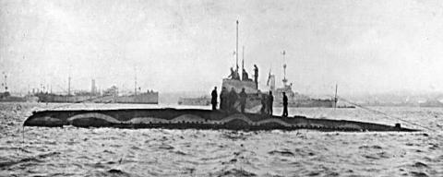
To keep Germany from trading with other nations, Britain used its navy to blockade Europe
German u-boat attacks played a role in bringing the USA into World War I
Germany responded by using unrestricted submarine warfare to attack the British Navy & any merchant ships supplying the Allies

Slide 11
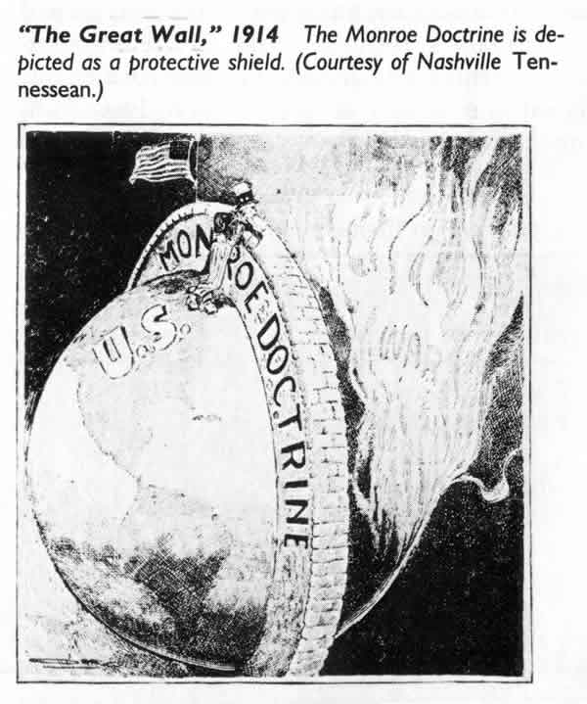
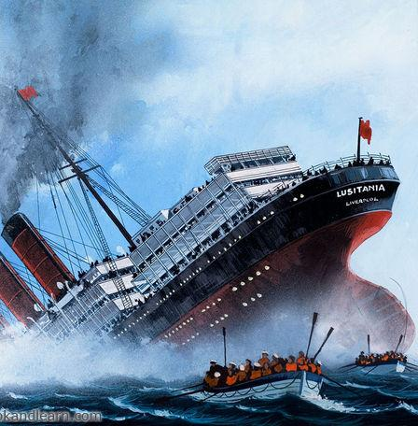
When World War I began in 1914, the United States remained neutral…
…But, the USA was pulled into the war by 1917
As a neutral nation, the USA was trading with the Allies during the war
Germany’s policy of unrestricted submarine warfare led to attacks on U.S. merchant ships & British passenger ships
President Woodrow Wilson demanded “freedom of the seas” but Germany refused

Slide 12
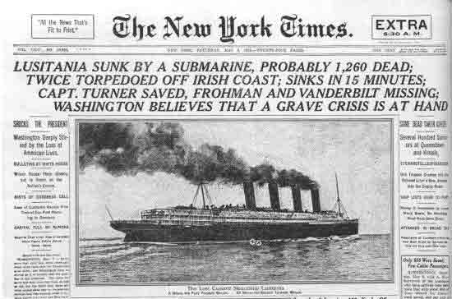
Americans were outraged in May 1915 when a German u-boat sank the British ship Lusitania killing 1,200 people including 128 Americans

Slide 13
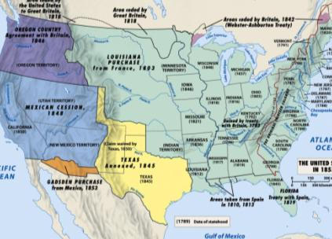
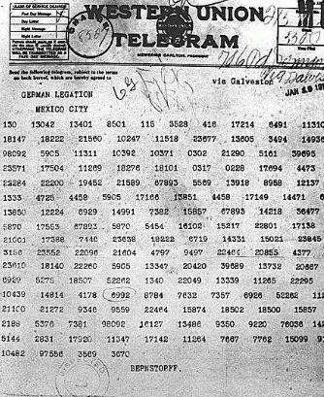
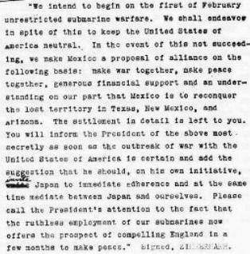
America’s anger with Germany increased in 1917 after the discovery of the Zimmerman Telegram
Germany knew that u-boat attacks would eventually bring the USA into war
Germany proposed that Mexico attack the USA in exchange for the return of Texas, New Mexico, Arizona
Americans were outraged

Slide 14
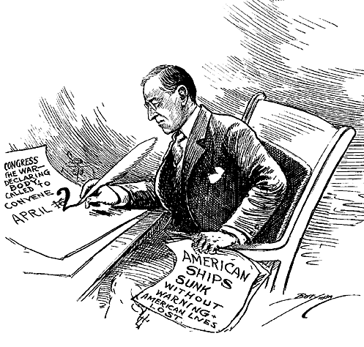
On April 2, 1917, the United States declared war on Germany & entered the war

Slide 15
The arrival of millions of American soldiers in 1918 gave a boost the Allies
But in November 1917, Russia signed a peace treaty & exited the war

Slide 16
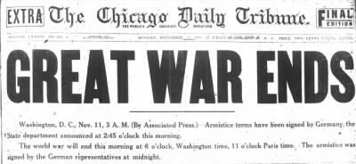
By 1918, the Central Powers were running out of supplies & tried a massive attack into France
But, the Allies halted the attack & pushed back
Bulgaria, Ottoman Empire, & Austria-Hungary surrendered in October 1918
On November 11, 1918 Germany agreed to an armistice (ceasefire) & World War I finally came to an end

Slide 17
