Slide 2
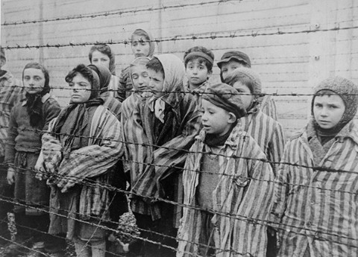
The Holocaust
Outcome: The Final Solution

Slide 3
Constructive Response Questions
Generalize the role propaganda played in Hitler’s quest to rid Europe of it’s Jewish population.
Describe how the Nazis systematically removed 6 million Jews from Europe.

Slide 4
What Will We Learn?
Nazi propaganda
The Nuremberg Laws
Kristallnacht
The ghettos
Concentration camps/death camps
Positive and negative effects

Slide 5
The Final Solution
Setting the Stage
Adolf Hitler made several promises to the German people as his power grew:
Will return Germany to its former glory
Will give people jobs
Will get rid of the “Jewish Problem”
In the late 1930’s to early 1940’s, the Nazis had rounded up and killed over 1 million Jews, but “The Final Solution,” the plan to exterminate all Jews from Europe, was not decided upon until 1942

Slide 6
The Final Solution
Stages of Genocide
Nazi Propaganda against the Jews
Propaganda is information, ideas, or rumors deliberately spread widely to help or harm a person, group, movement, institution, nation, etc.
Joseph Goebbels was head of Nazi propaganda; close associate of Hitler
The Nazis blamed the Jews for Germany’s problems during the Depression
Jews were made to look like deviants and even rapists
Anti-Semitism was not only common, but it was growing; Hitler was loved

Slide 7
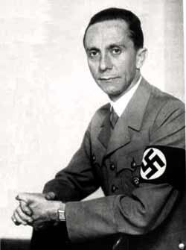
Joseph Goebbels

Slide 8
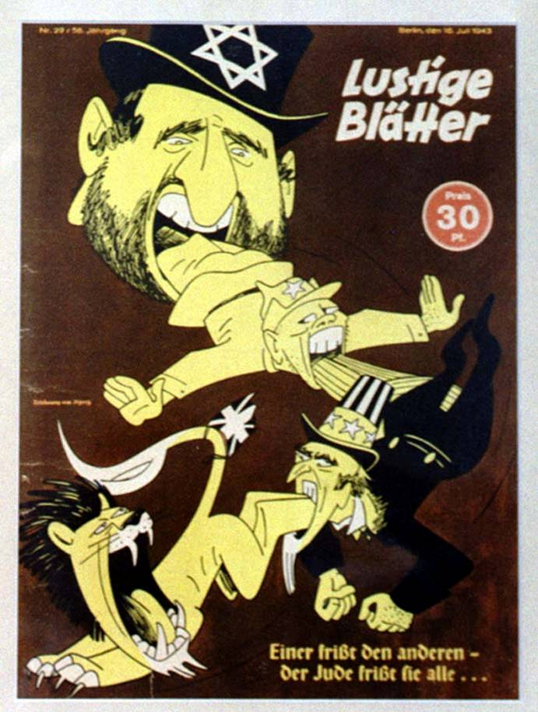
Nazi Propaganda

Slide 9
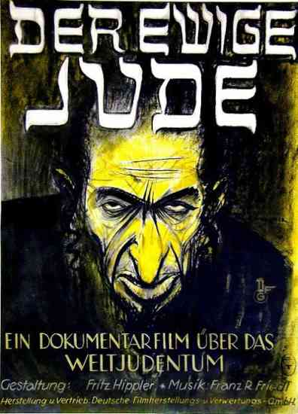
Nazi Propaganda

Slide 10
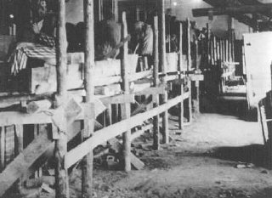
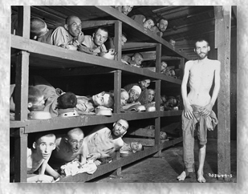
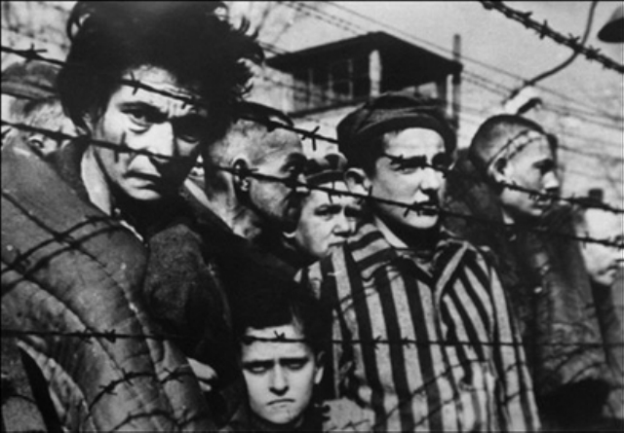
Nazi Propaganda

Slide 11
Propaganda

Slide 12
The Final Solution
The Nuremberg Laws
Laws were passed in Germany called the Nuremberg Laws, which allowed for legal discrimination & terrorism against Jews. Examples:
Jews were stripped of German citizenship (could no longer vote)
Marriage between Jews & Germans was forbidden
Jews were excluded from public office, practicing law, medicine, teaching
Jews had curfews, had to wear yellow Star of David for public ID

Slide 13
The Final Solution
Kristallnacht
The Night of Broken Glass- Anti-Semitic riots in Germany and Austria.
30,000 Jews rounded up and taken to concentration camps
Homes, businesses, and synagogues destroyed

Slide 14
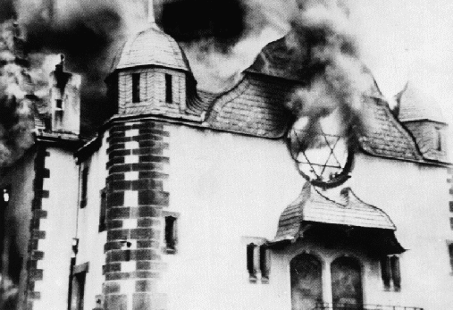
Kristallnacht

Slide 15
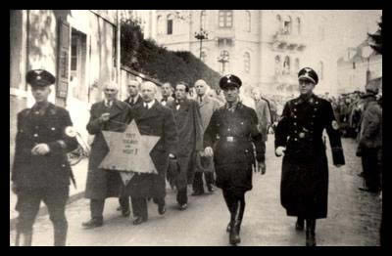
Kristallnacht

Slide 16
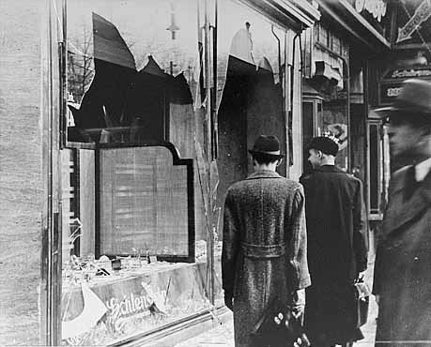
Kristallnacht

Slide 17
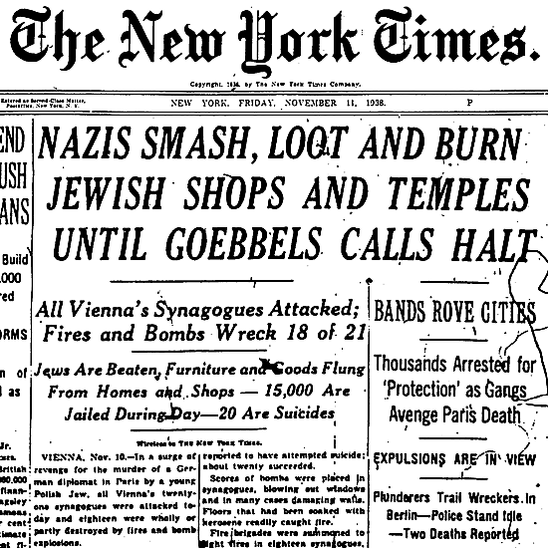
Kristallnacht

