Slide 1
The Final Solution
Separation into Ghettos
The Nazis wanted to create more “lebensraum” or living space
Jews were rounded up and sent to walled off sections of cities called ghettos
Multiple families occupied small, cramped, dirty apartments
Jews were allowed to leave the ghettos for work but had strict curfews
The Nazis took most of the property left by the Jews for their own profit

Slide 2
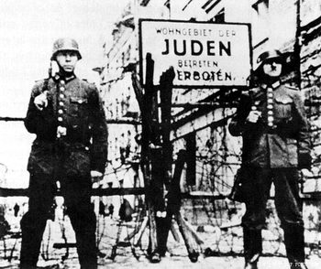
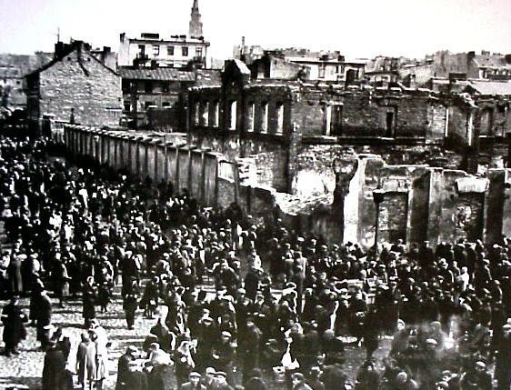
Ghettos

Slide 3
The Final Solution
Concentration Camps
Thousands of Jews were transported to work camps around Poland, Austria, and Germany to work as slave labor for the Nazis
Railroad boxcars were filled with people with no food or water as transport
Thousands starved, worked to death, or were killed in these camps
Plaszow camp in Poland is the main camp in the film Schindler’s List

Slide 4
The Final Solution
Death Camps (The Final Solution)
Once the Final Solution was decided upon, many camps became extermination camps aimed solely at killing Jews
Heinrich Himmler & Adolf Eichmann were the chief engineers and overseers of the Final Solution
At first bodies were buried in shallow graves; the stench could be smelled for miles --> neighboring Germans were either ignorant or ignored the atrocity
The Nazis forced Jews to transport dead bodies, exhume bodies, and even kill

Slide 5
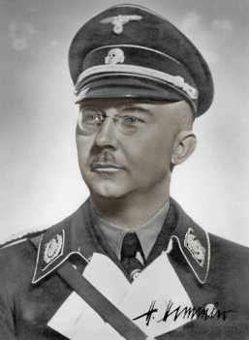
Heinrich Himmler
Member of Hitler’s SS
Leading member of the Nazi Party
Overseer of death camps
Main architect of the Holocaust: Coordinated the killing of 6 million Jews
Committed suicide before he could be questioned

Slide 6
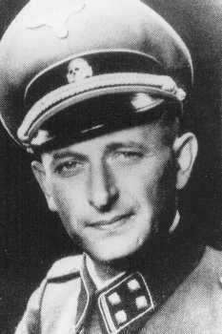
Adolf Eichmann
Member of Hitler’s SS
Was in charge of facilitating and managing the mass deportation of Jews to ghettos and extermination camps
Executed for crimes against humanity in 1962 in Israel

Slide 7
The Final Solution
Gas chambers became main mode of death
Thousands could be killed in mere minutes
Zyklon B gas pellets were dropped in
Bodies were moved to crematoriums were bodies were quickly burned
Often times, Sonderkommandos were used; Jews forced to put dead Jews into crematoriums

Slide 8
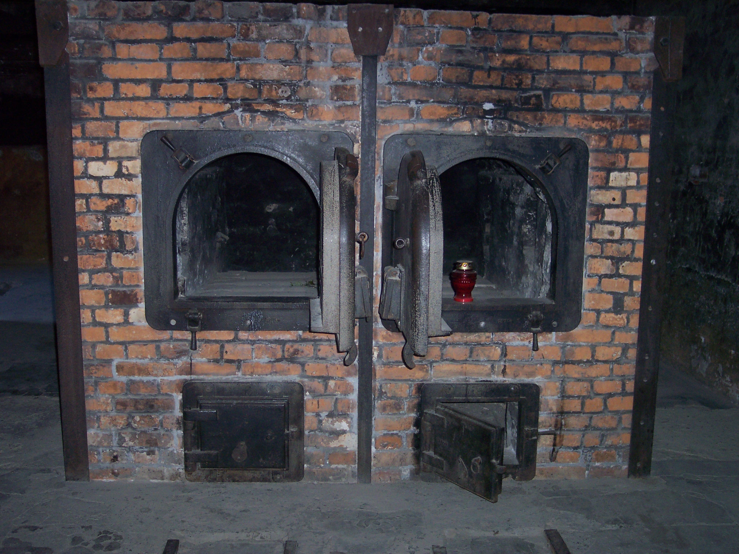
Crematorium at Auschwitz

Slide 9
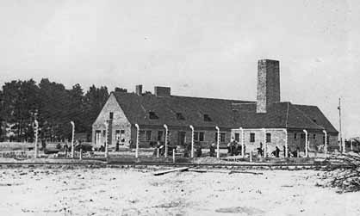
Gas Chamber & Crematorium

Slide 10
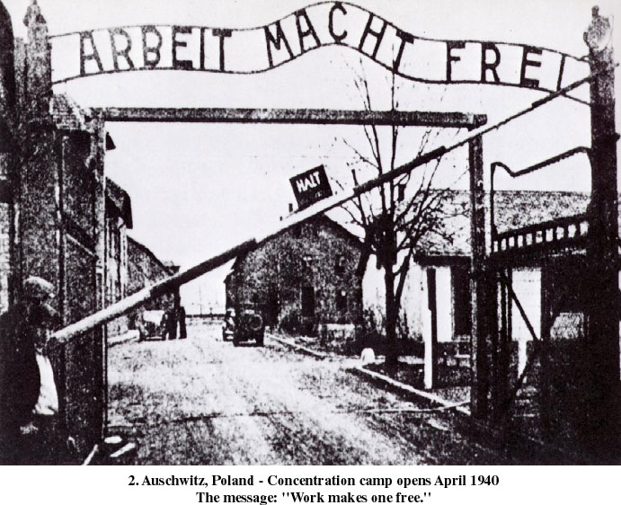
Auschwitz

Slide 11
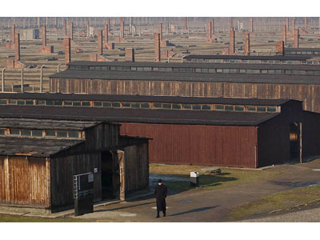
Prisoner Barracks

Slide 12
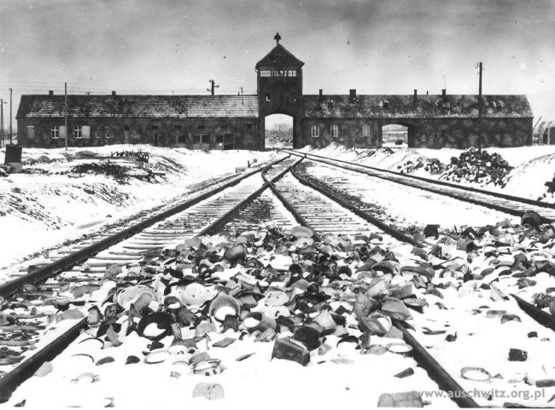
The Final Solution
Auschwitz was the worst of the death camps
Located in Poland
1,100,000 killed at Auschwitz; 200,000 children killed
Joseph Megele did medical experiments on Jews and children

Slide 13
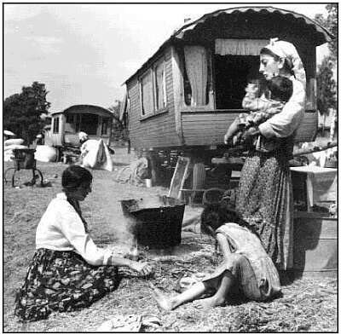
The Final Solution
Mauthausen in Austria (John Sagan story)
Others targeted in the Final Solution:
Gypsies
Communists
Political Prisoners (John Sagan)
Homosexuals
Jehovah’s Witnesses
Soviet Prisoners of War

Slide 14
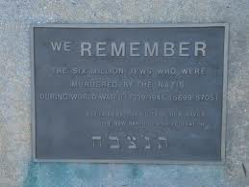
The Final Solution
Result: The Nazis were organized, systematic, and merciless. Most of the death camps were in Poland and over 11 million people were killed of which 6 million were Jews. Most of the world had no idea and those who did know, were powerless to stop Hitler and the Nazis.

Slide 15
Constructive Response Questions
Generalize the role propaganda played in Hitler’s quest to rid Europe of it’s Jewish population.
Describe how the Nazis systematically removed 6 million Jews from Europe.

