Slide 1
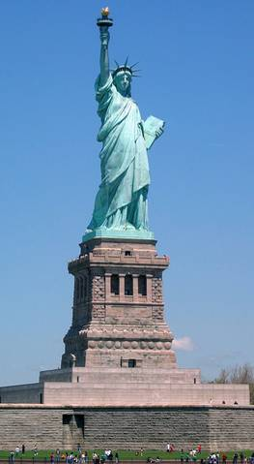
Essential Question:
What impact did immigration and urbanization have on American life during the Gilded Age (1870-1900)?
Warm-Up Question:
What is the significance of the following quote? “Give me your tired, your poor, Your huddled masses yearning to breathe free”

Slide 2
Gilded Age: Immigration & Urbanization
During the Gilded Age, the United States was a land of opportunity
The industrial revolution created jobs in Eastern factories
Millions of “new immigrants” swarmed to the U.S. from Eastern & Southern Europe, swelling American cities
The influx of urban workers helped boom industry & modernize cities, but also led to horrible working & living conditions, child labor, nativism towards immigrants

Slide 3
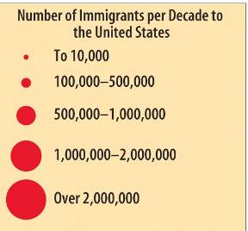
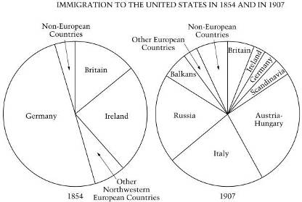
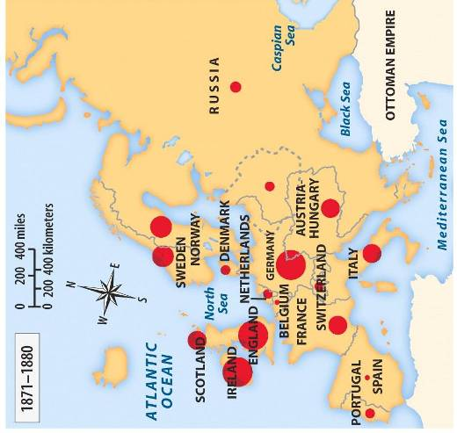
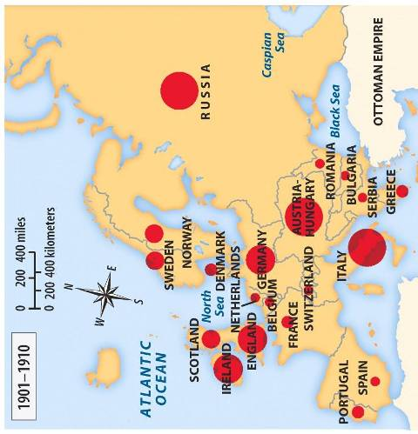

Slide 4
New Immigrants
From 1880 to 1921, a record setting 23 million immigrants arrived in the USA. At the time, the USA did not have quotas, or limits, on how many immigrants from a particular country could enter the country. Nor did it require immigrants to have a passport or special entrance papers.
Where immigrants were coming from changed dramatically. From the colonial era to 1880, most immigrants to America came from England, Ireland, or Germany in Northern Europe. Between 1880 and 1921, approximately 70% of all immigrants entering the USA came from southern and eastern Europe (Italy, Austria-Hungary, Russia, Poland).
These “new immigrants” were typically young, male, and either Catholic or Jewish. Most spoke little or no English. The majority were unskilled agricultural laborers with little money or education.

Slide 5
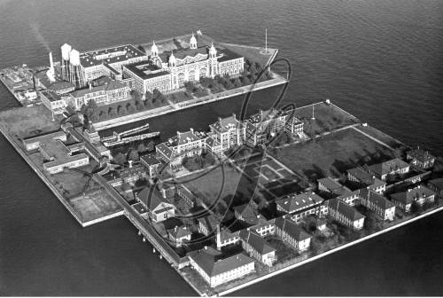
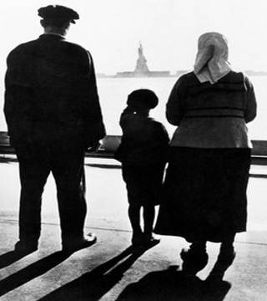
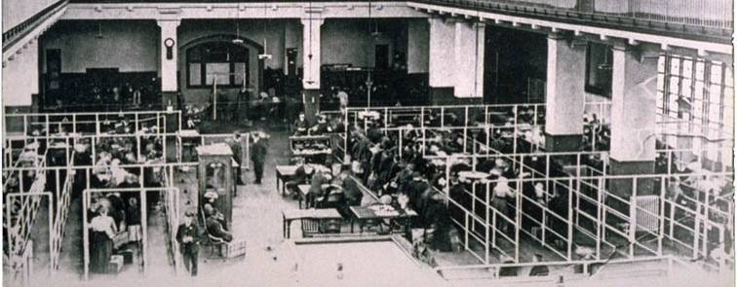

Slide 6
Ellis Island
From 1892 to the early 1920s, around 75% of all immigrants entered the USA through the immigration processing center at Ellis Island, located in New York Harbor.
The processing of immigrants on Ellis Island was an ordeal that might take five hours or more. First, they had to pass a physical examination by a doctor. Anyone with a serious health problem or a contagious disease, such as tuberculosis, was promptly sent home.
Those who passed the medical exam then reported to a government inspector. The inspector questioned immigrants to determine whether they met the legal requirements for entering the USA. The requirements included proving they had never been convicted of a felony, demonstrating that they were able to work, and showing that they had some money (at least $25 after 1909).

Slide 7
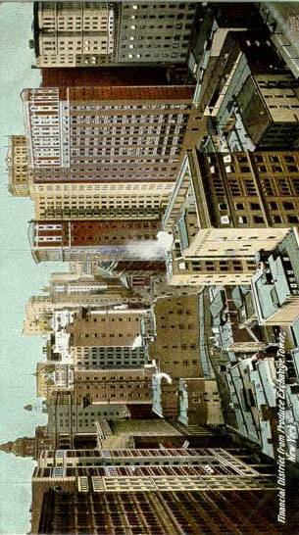
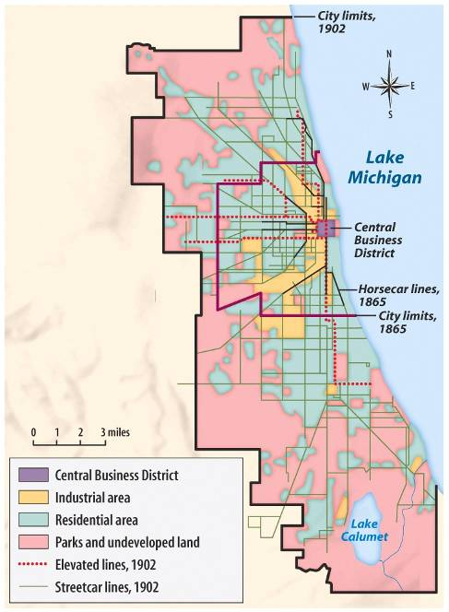

Slide 8
The Urban Environment
The Gilded Age experienced massive urbanization. In 1870, only 25 American cities had populations of 50,000 or more; by 1890, 58 cities could make that claim. By 1900, 40% of Americans lived in cities.
In response to these changes, technological advances began to meet the nation's needs. Engineering innovations, such as the Brooklyn Bridge and skyscrapers, laid the groundwork for modern American life. Cities in every industrial area of the country expanded outward from central business districts to suburbs as well as upward as steel allowed buildings to increase in size.
As cities grew larger and beyond walking distance, cities introduced new mass transit services, such as trolley lines, elevated rail lines, and subways.

Slide 9
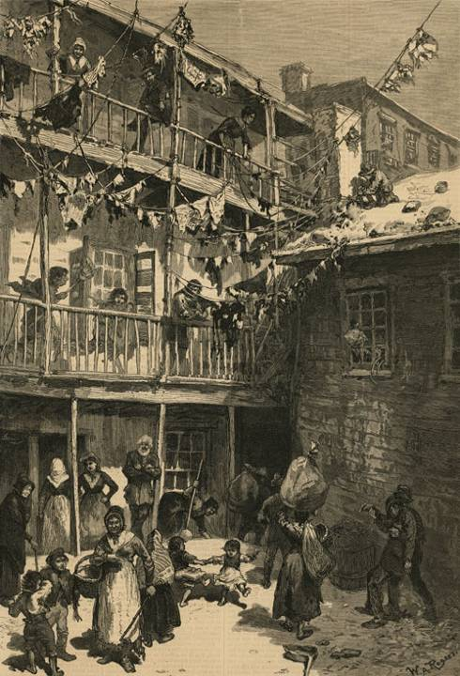
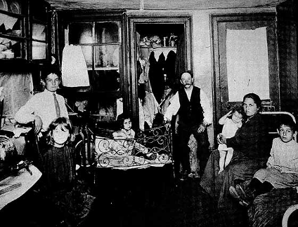

Slide 10
Urban Housing
Most cities weren’t prepared for such increasing populations. City streets were often flooded with waste due to inadequate sewage systems. Decent housing was scarce, most urban-dwelling immigrants lived in tenement buildings – rundown, low rent apartment buildings clustered together in the poorest parts of town.
Most tenements were filthy, run down and had little ventilation or light. Fires, disease and death were common among immigrant tenement communities. Half of Manhattan’s fires were in tenement buildings.
Many immigrants came down with contagious lung disease, tuberculosis, and about 60% of immigrant babies died before their first birthday.

Slide 11
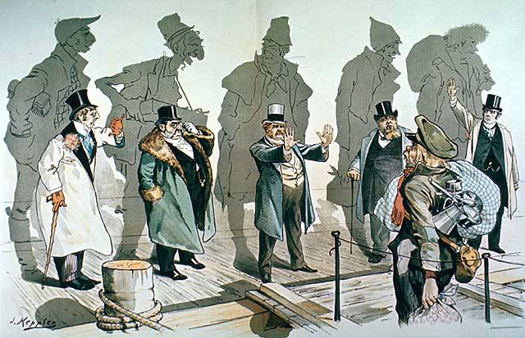

Slide 12
Nativism
Many native-born Americans viewed the new immigrants with a combination of fear, hostility and suspicion. Nativism was based on the belief that immigrants posed a threat to native-born Americans and their way of life. Nativists had deep-seated prejudices about immigrants based on ethnicity, religion, political and social beliefs.
Many American workers accused immigrants of taking jobs away from “real” Americans. Nativists worked to restrict the number of immigrants entering the United States.
In 1883, Congress passed the Chinese Exclusion Act which restricted Chinese immigration to America. In the 1890s, they called for laws restricting the number of new immigrants from Southern and Eastern Europe. They encouraged quotas that would limit the number of immigrants the US would accept from each nation.

Slide 13
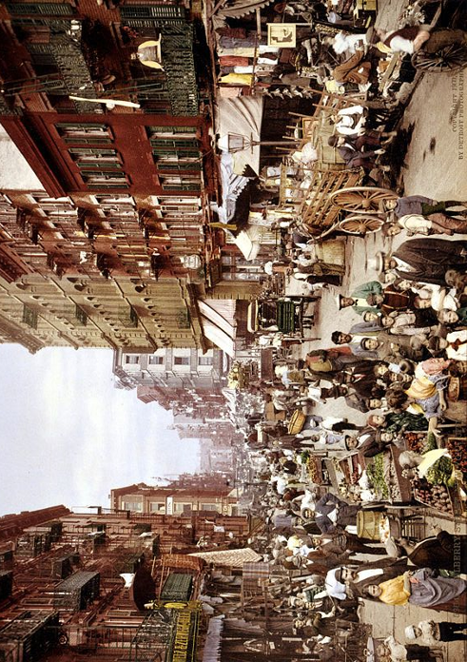
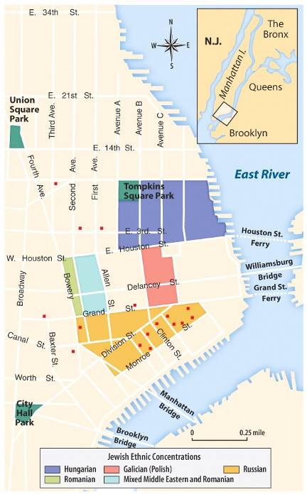

Slide 14
Ethnic Neighborhoods
After arriving in the USA, about 2/3 of immigrants settled in cities, such as NYC, Chicago, Boston & Philadelphia. The majority of immigrants lived in ethnic neighborhoods, or enclaves.
These neighborhoods provided new immigrants with a sense of community and security, as the immigrants were surrounded by the familiar customs, food and language of their homeland. As a result, many settled in the neighborhoods permanently.
Many enclaves were crowded and their streets teemed with local residents, peddlers and merchants, and horses and carriages. Immigrants often established businesses that catered to the needs of immigrants.

Slide 15
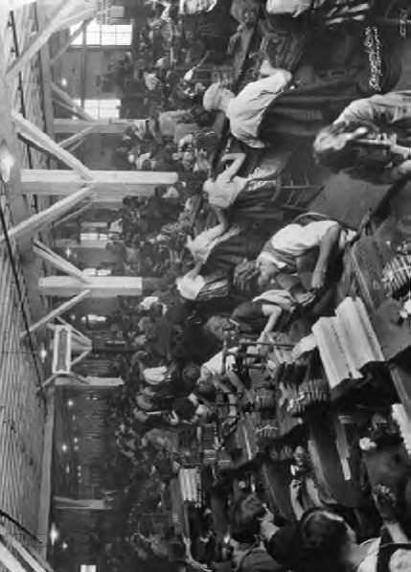
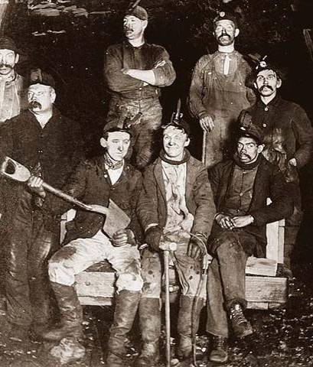

Slide 16
Working Conditions
The majority of immigrants worked in industrial jobs, for a variety of reasons. Most industries were rapidly growing and in need of workers. Most immigrants were unskilled laborers, were desperate for work, and were willing to accept almost any kind of job, no matter how un-attractive or low paying.
Immigrants were particularly vulnerable to exploitation and many worked under intolerable conditions. The average worker’s salary was about 10 cents an hour and child workers often made half that. Additionally, many workers were forced to work 12-16 hours per day.
Working conditions were often dangerous, unsanitary and uncomfortable.

Slide 17
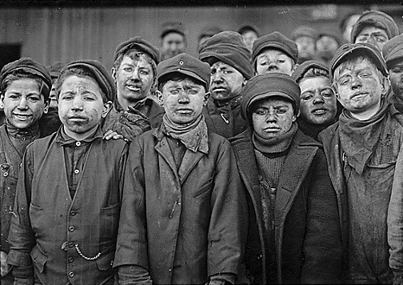
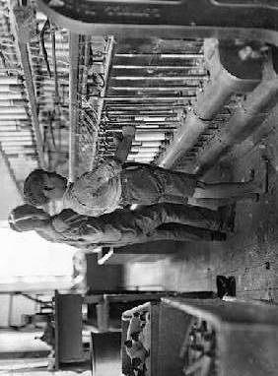
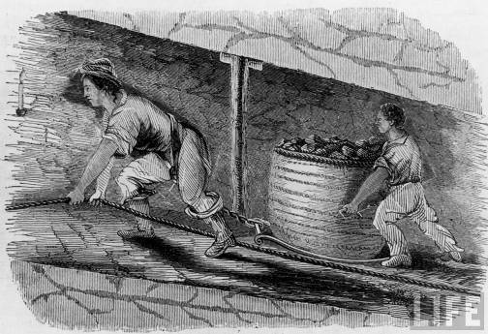

Slide 18
Child Labor
Because their poor families needed them and businesses welcomed them, around 1.75 million children joined the work force in the late 1800s.
These laborers were mostly between the ages of 10-15, but some were as young as 6. Children worked up to 15 hours a day in coal mines and factories.
Child labor was especially common in mining because their small size worked well in the cramped spaces. Common injuries in the mines included back deformities, asthma and crushed or broken fingers. Many other industries employed and similarly harmed children.

Slide 19
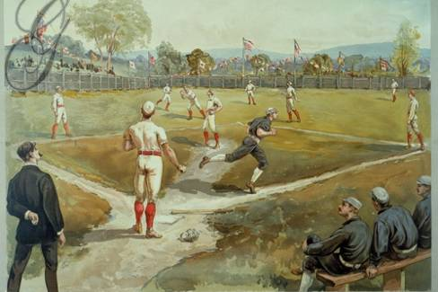
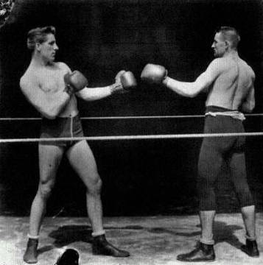

Slide 20
Leisure Time
While working and living conditions were difficult and dangerous for most poor immigrants, middle-class Americans actually saw their work time decrease.
Americans from all over the country shared experiences as new leisure activities, nationwide advertising campaigns, and the rise of a consumer culture began to level regional differences.
As the 19th century drew to a close, many Americans fought off city congestion and dull industrial work by enjoying amusement parks, bicycling, vaudeville theater (variety shows), and sports such as baseball and boxing.

Slide 21
Debriefing & Closure

