Slide 1
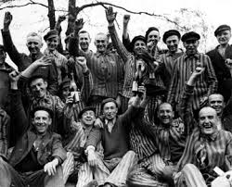
The Holocaust
Outcome: Healing

Slide 2
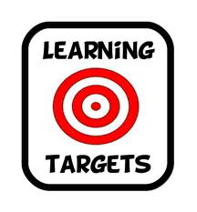
Constructive Response Questions
Evaluate the efforts made after the Holocaust to help heal the memories of the Holocaust.

Slide 3
What Will We Learn?
Liberation of the camps
Role of German citizens
Creation of Israel
Nuremberg Trials
Lessons for today

Slide 4
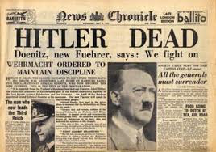
Healing
Setting the Stage
The Holocaust mostly ended with the German surrender in May 1945
6 million Jews had been murdered and survivors had to start over
Hitler committed suicide before Germany surrendered leaving countless others to take the blame and punishment for his orders

Slide 5
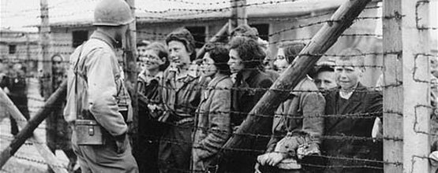
Healing
Liberation of the Camps
The Soviet Union liberated many of the camps as they pushed in from the East
When Allied troops found the camps, they had no idea what they were dealing with
Many remaining Nazi camp Commandants, or camp leaders, fled

Slide 6
Band of Brothers

Slide 7
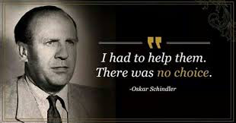
Healing
Role of the German citizens: Were they aware of the full situation?
Truth is: some knew, others did not
It was difficult and dangerous to question Hitler & the Nazis
Anti-Semitism was strong and many turned a blind eye
Some like Oskar Schindler risked their lives to help Jews find refuge

Slide 8
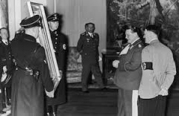
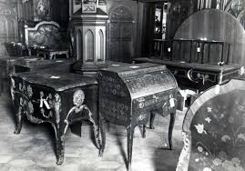
Healing
What was next for the Jews?
Wives, husbands, sons, daughters were gone; finding survivors was not easy
Just because the Holocaust was officially over didn’t mean Anti-Semitism was
Property rights of stolen goods and homes were not honored
Very few got wealth or property back; many were quite wealthy before relocation
Many Jews fled Europe

Slide 9
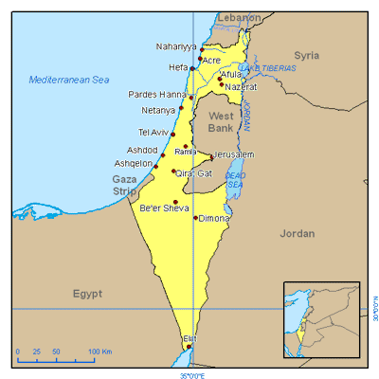
Healing
Creation of Israel
Israel is at the SE tip of the Mediterranean Sea; was the promised land of the Ancient Hebrews
Israel declared itself a nation in 1948; source of major conflict to this day
42% of the World’s Jewish population live in Israel today

Slide 10
Healing
Nuremberg Trials
Many camp leaders and Nazis were put on trial for crimes against humanity
Rudolph Hoss, Commandant of Auschwitz, was hanged after a 3 week trial
Adolf Eichmann escaped to South America and later snatched by Israeli troops 15 years later and sentenced to death after a 4 month trial
Heinrich Himmler committed suicide with a potassium cyanide capsule shortly after arrest and before he would stand trial at Nuremberg
Joseph Mengele escaped to Argentina; died years later under name Wolfgang Gerhard
Of over 7000 SS guards who worked at Auschwitz and survived, fewer than 800 were ever put on trial and 90% of those involved were never prosecuted

Slide 11
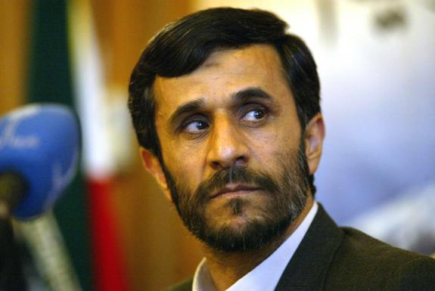
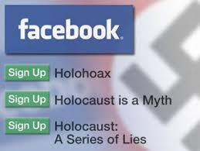
Healing
Deniers of the Holocaust
Proof that Anti-Semitism still exists, some deny the Holocaust ever happened
Holocaust deniers are often those upset about Israel’s independence and occupation of Palestinian lands
Mahmoud Ahmadinejad, former leader of Iran, is a denier of the Holocaust and is allegedly pursuing nuclear weapons for Iran

Slide 12
Healing
Lessons for Today
The power of a dictator is one our country is strongly opposed to
Democracy prevents such things; hopefully (Japanese internment camps??)
Genocide did not die with the Holocaust
Rwanda and Darfur in Africa have seen hundreds of thousands slaughtered at the hands of corrupt governments and rival tribes
Studying the Holocaust teaches us the power of unity and the atrocities that can be brought on by hatred and Xenophobia
The Holocaust Museum in Washington D.C. is great place to see real artifacts, stories, and to honor those who suffered at the hands of the Nazis

Slide 13
Student Reactions

Slide 14
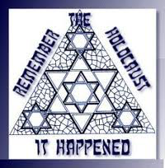
Healing
Conclusion: The Holocaust is not ancient history. These events are still possible in our world and if we take the time to understand how these events can unfold, then we have the power and knowledge to stop them from happening.

Slide 15
Constructive Response Questions
Evaluate the efforts made after the Holocaust to help heal the memories of the Holocaust.

