Slide 1
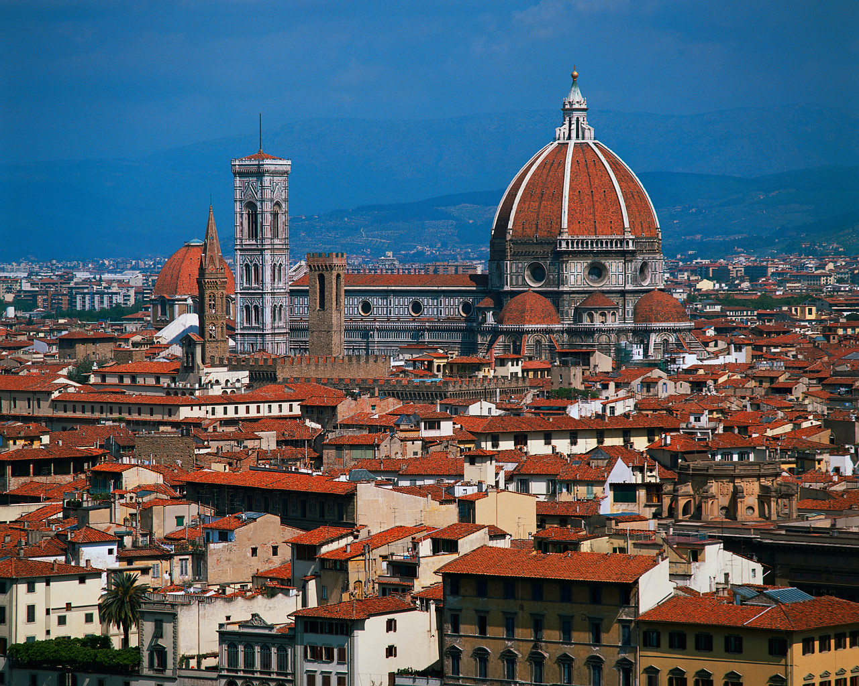
The Renaissance Outcome: Renaissance Painters/Sculptors
Florence

Slide 2
Constructive Response Question
Evaluate the accuracy of the following statement using specific examples: Michelangelo was a Renaissance Man.

Slide 3
What Will We Learn?
Michelangelo and his works
Donatello and his works
Leonardo da Vinci and his works
Raphael and his works

Slide 4
The Renaissance
Renaissance Art
Artists were supported by patrons like Isabella d’Este and the Medici
Medieval artists used religious subjects to convey a spiritual ideal
Renaissance artists will portray religious subjects but will use realistic styles copied from classical models & Greece and Rome
Renaissance painters used perspective which showed three dimensions on a flat surface with a vanishing point in the middle
Often times fresco was used: painting on wet plaster

Slide 5
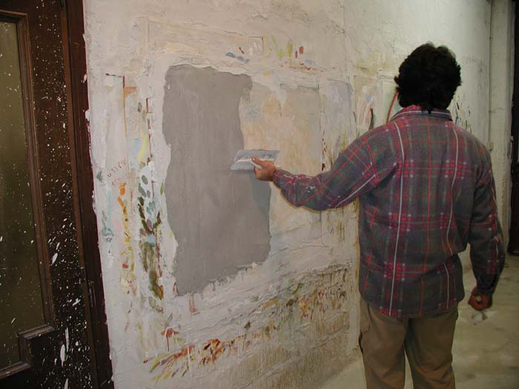
Fresco

Slide 6
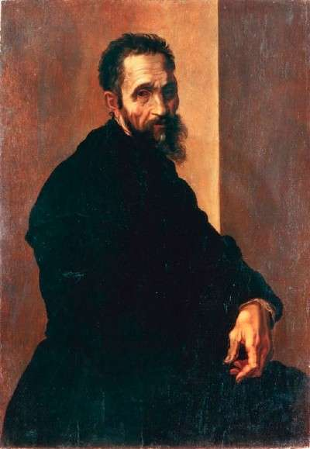
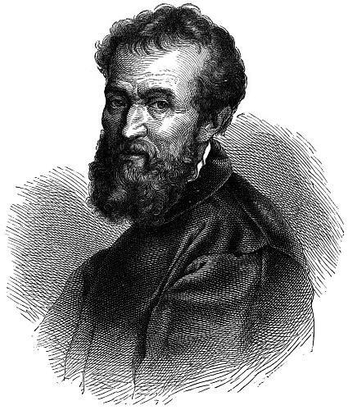
Michelangelo

Slide 7
Famous Artists
Michelangelo
Renaissance man: sculptor, painter, architect, and poet
Famous for way he portrayed the human body
Famous works:
Statue of David,
Ceiling of the Sistine Chapel,
Dome of St. Peter’s

Slide 8
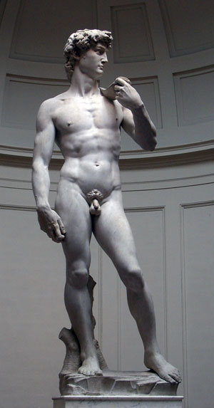
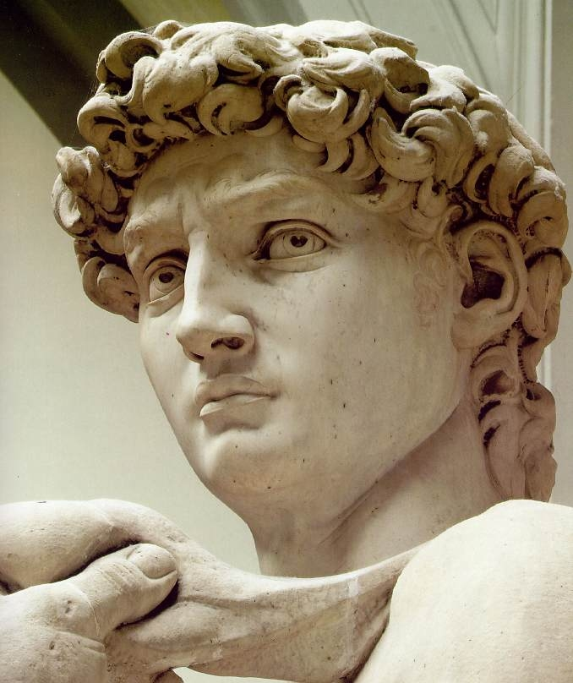
David

Slide 9
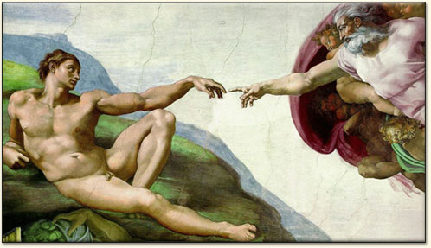
Sistine Chapel Ceiling

Slide 10
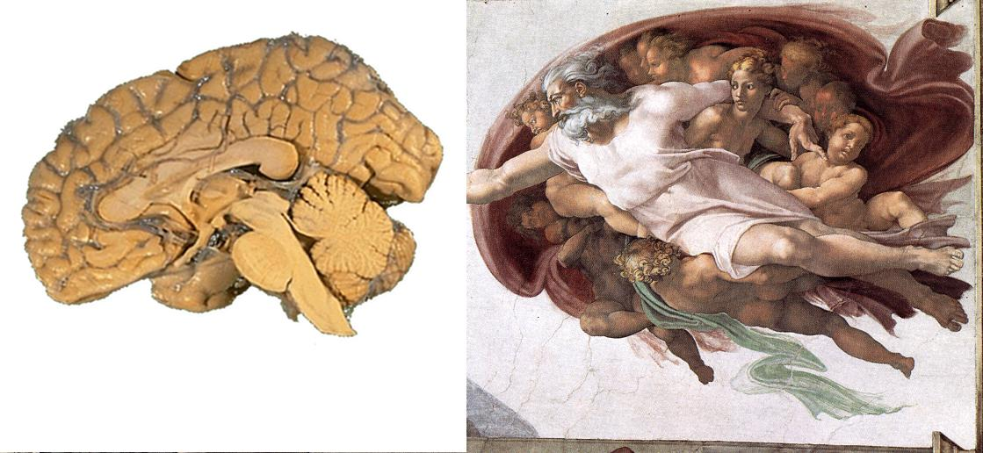

Slide 11
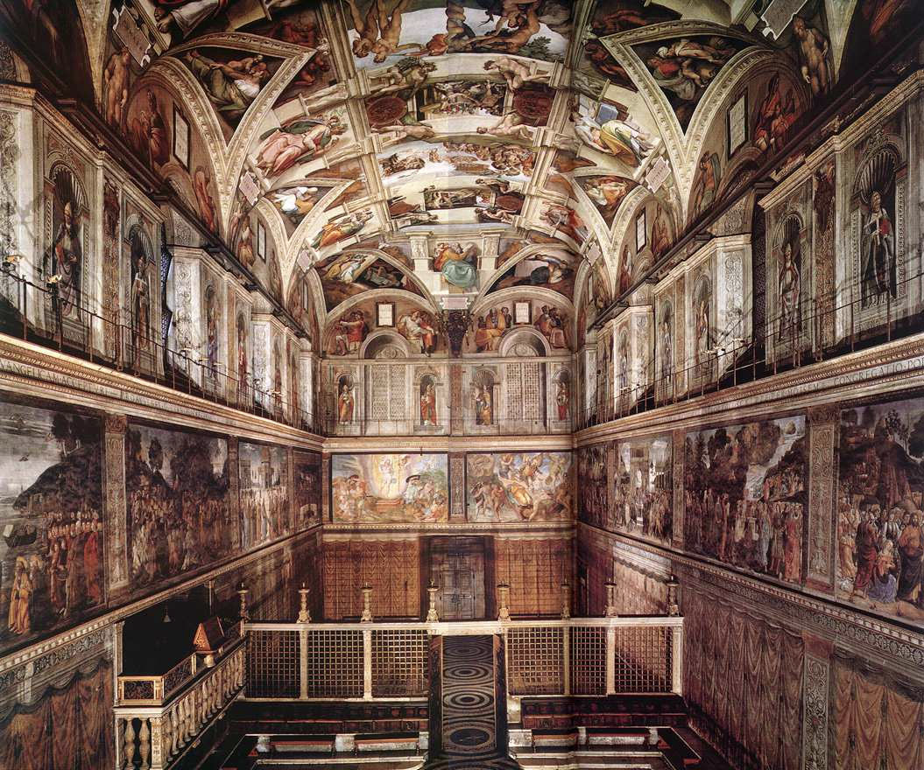

Slide 12
