Slide 2
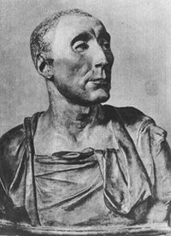
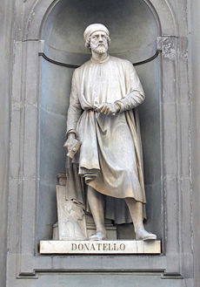
Donatello

Slide 3
Famous Artists
Donatello
Made sculpture more realistic by carving natural postures and expression that revealed personality.
Equestrian Statue of Gattamelata
Also sculpted a David- favorite subject of Renaissance sculptors

Slide 4
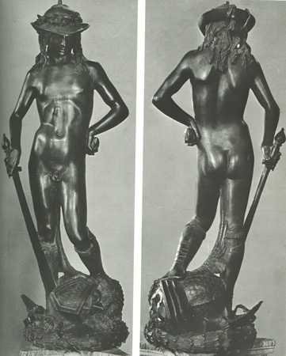
Donatello’s David

Slide 5
Equestrian Statue of Gattamelata

Slide 6
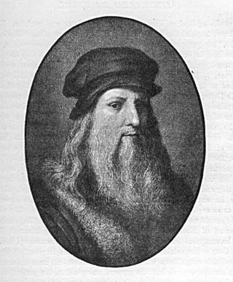
Leonardo da Vinci

Slide 7
Famous Artists
Leonardo da Vinci
Painter, sculptor, inventor, and scientist
Interested in how things work (veins in a leaf and muscle work)
Famous works:
The Mona Lisa
The Last Supper
Virgin on the Rocks
The Da Vinci Code featured many of his paintings

Slide 8
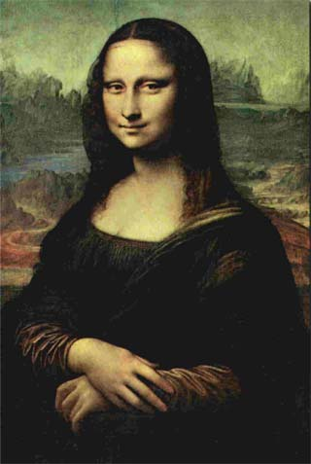
The Mona Lisa

Slide 9
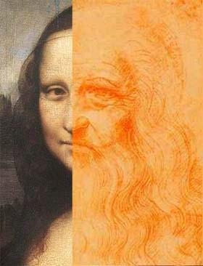

Slide 10
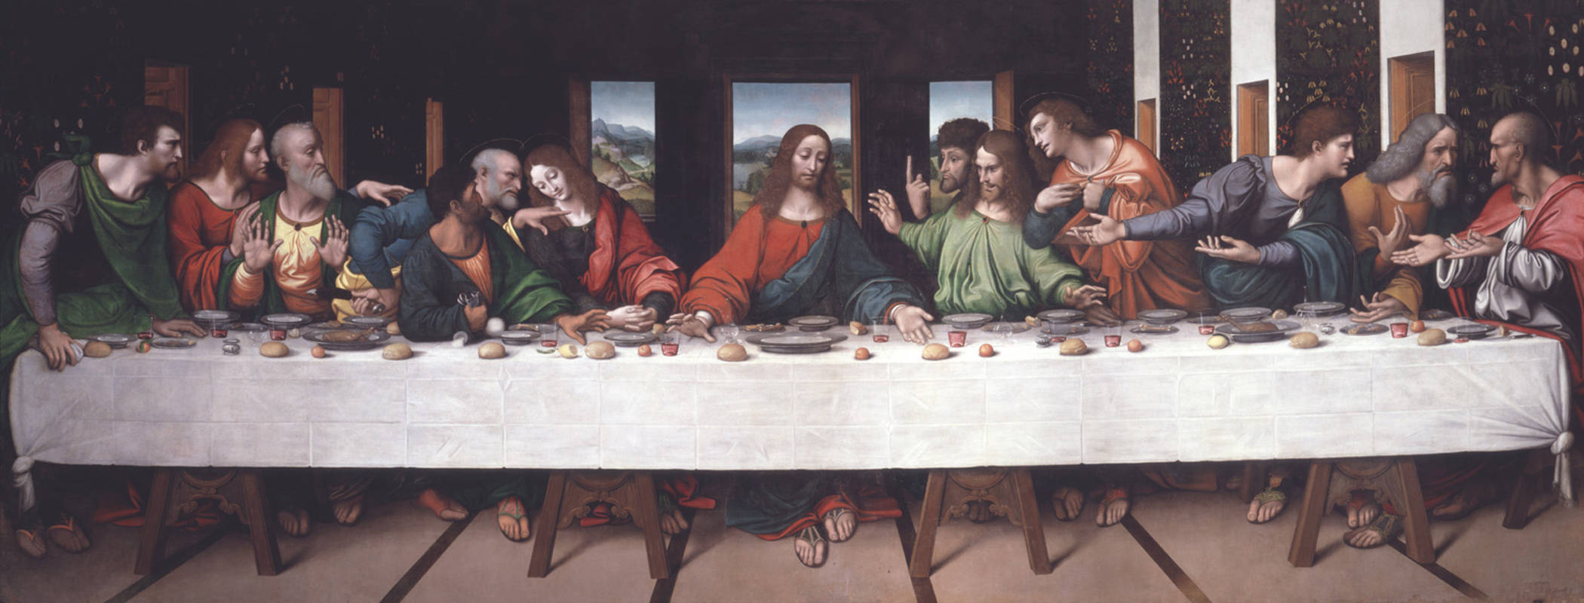

Slide 11
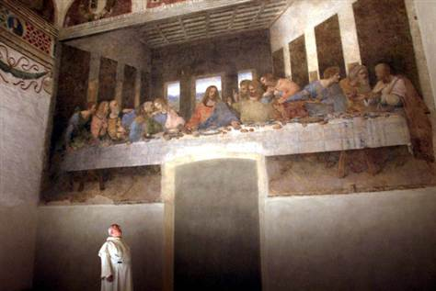

Slide 12
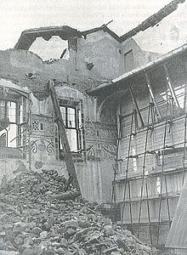

Slide 13
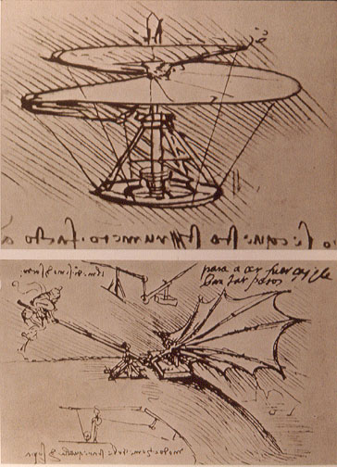
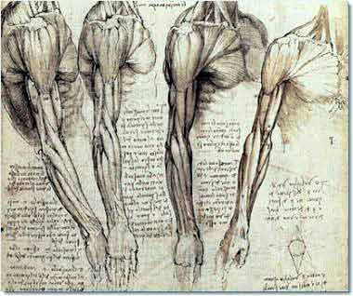
Da Vinci Sketches

Slide 14
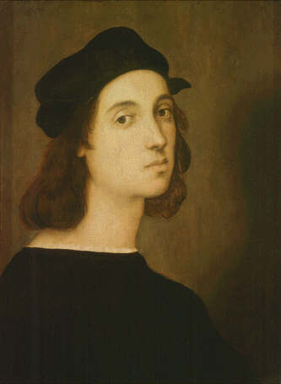
Raphael

Slide 15
Famous Artists
Raphael
Learned from studying Leonardo and Michelangelo
One of favorite subjects was Madonna and Child (Virgin mary)
Famous works:
School of Athens
Marriage of the Virgin

Slide 16
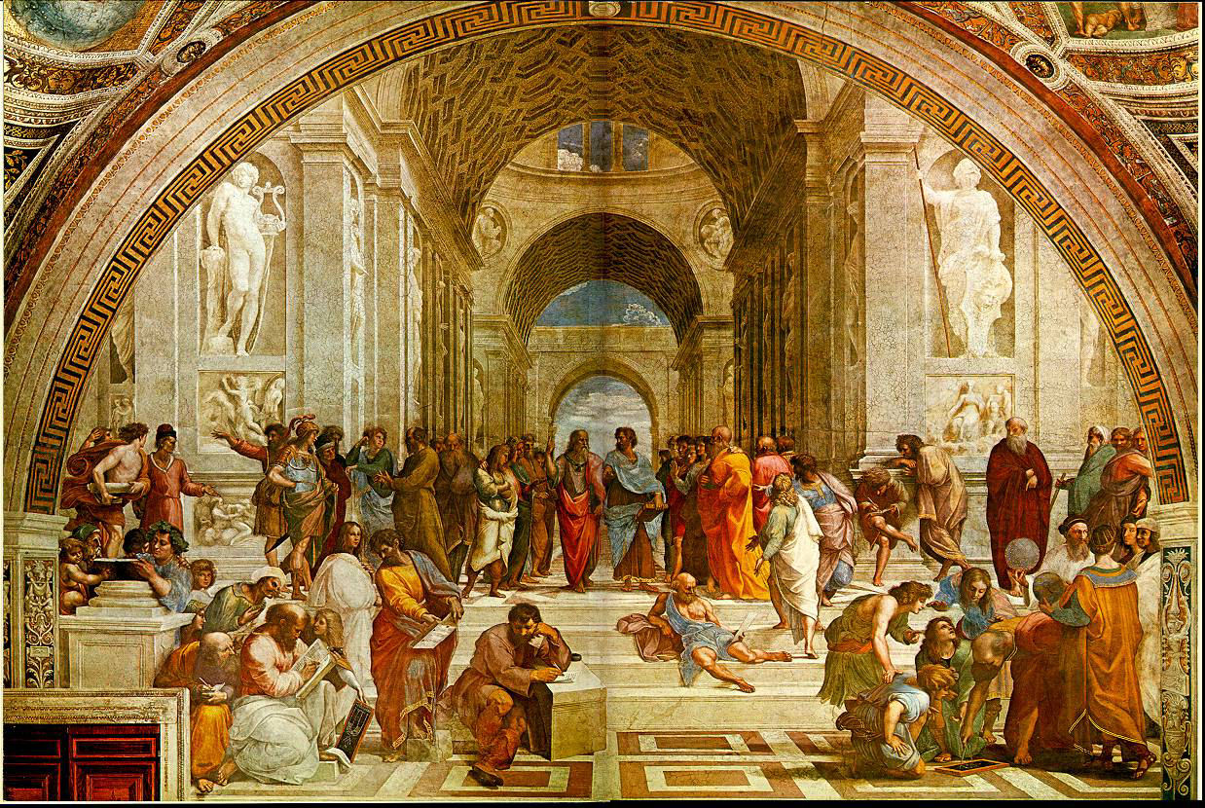

Slide 17
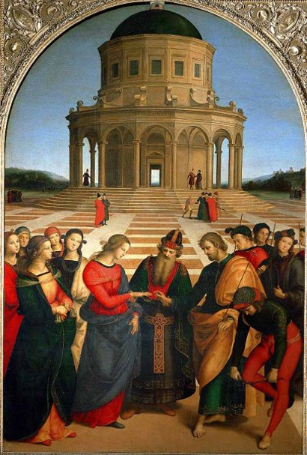
Marriage of the Virgin

Slide 18
Others: Botticelli’s Birth of Venus

Slide 19
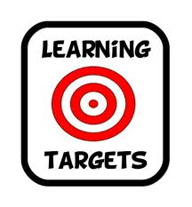
Constructive Response Question
Evaluate the accuracy of the following statement using specific examples: Michelangelo was a Renaissance Man.

