Slide 1
Essential Question:
How did problems in the Gilded Age contribute to “progressive” reforms in the early 20th century?

Slide 2
Quick Class Discussion: Problems of the Gilded Age
What problems existed in U.S. cities as a result of the Gilded Age?
http://www.youtube.com/watch?v=i7hapnYg8DU
Identify at least 4 examples from the film that expose problems associated with urbanization, industrialization, & immigration

Slide 3
Urban Reform During the Progressive Era (1890-1920)
From 1890 to 1920, reformers tried to clean up problems (“progress”) created during the Gilded Age:
Cities were plagued by slums, crime, disease, tenements
City, state, & national gov’ts were seen as corrupt & unresponsive to the needs of Americans
Corporate monopolies limited competition & workers’ wages

Slide 4
The Social Gospel Movement
In the 1880s, many middle-class Protestant Christians embraced the Social Gospel movement:
To honor God, people must put aside their own desires & help other people, especially the poor
These ideas helped inspire Progressive reform in U.S. cities
Notes:
To honor God, people must put aside their own earthly desires and help other people, especially the needy. The purpose of wealth was not to hoard it but to share it with other, less fortunate people. The ideas that originated from the Social Gospel would heavily influence the Progressive Movement.

Slide 5
Urban Progressive Reformers
One of the earliest progressive reforms was the settlement house movement led by Jane Addams
Addams’ Hull House in Chicago offered baths, cheap food, child care, job training, health care to poor citizens in the slums
Her efforts inspired reformers in other cities to build settlement houses to assist the poor
Notes:
Education also became a self-conscious instrument of social change. The ideas of the educator and philosopher John Dewey influenced the reformers. Progressive educational reformers broadened school curricula to include teaching about health and community life; called for active learning that would engage students' minds and draw out their talents; applied new scientific discoveries about learning; and tailored teaching techniques to students' needs. Progressive educators promoted compulsory education laws, kindergartens, and high schools. They raised the literacy rate of African Americans from 43 percent to 77 percent.
During the Progressive Era, public health officers launched successful campaigns against hookworm, malaria, and pellagra, and reduced the incidence of tuberculosis, typhoid, and diphtheria. Pure milk campaigns also slashed rates of infant and child mortality.
Urban Progressives created public parks, libraries, hospitals, and museums. They also constructed new water and sewer systems and eliminated "red-light" districts, such as New Orleans' Storyville, in most major cities.
Of all the changes that took place in women's lives during the 20th century, one of the most significant was women's increasing ability to control fertility. In 1916, Margaret Sanger, a former nurse, opened the country's first birth control clinic in Brooklyn. Police shut it down ten days later. "No woman can call herself free," she insisted, "until she can choose consciously whether she will or will not be a mother." Margaret Sanger coined the phrase "birth control" and eventually convinced the courts that the Comstock Act did not prohibit doctors from distributing birth control information and devices. As founder of Planned Parenthood, she aided in the development of the birth control pill, which appeared in 1960.

Slide 6
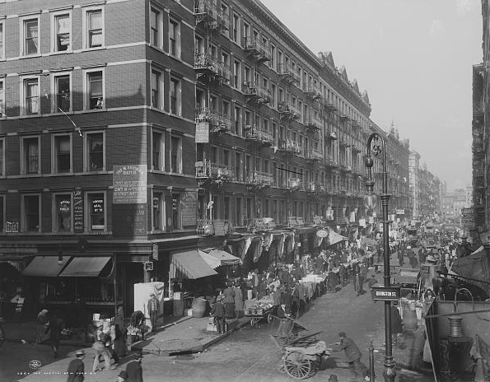
Urban Slums

Slide 7
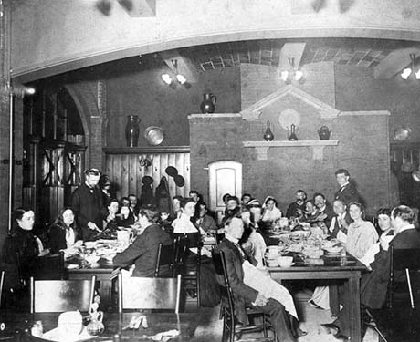
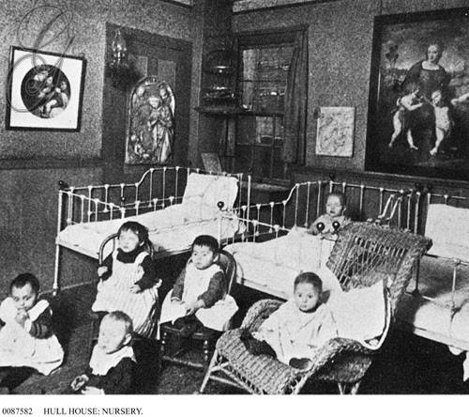
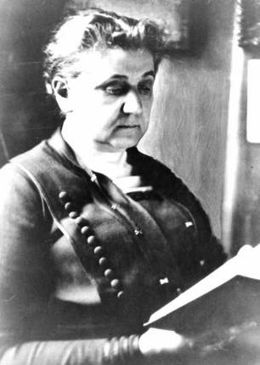
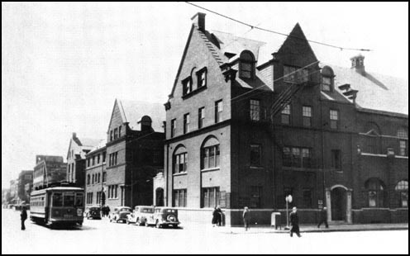
Jane Addams’ Hull House in Chicago

Slide 8
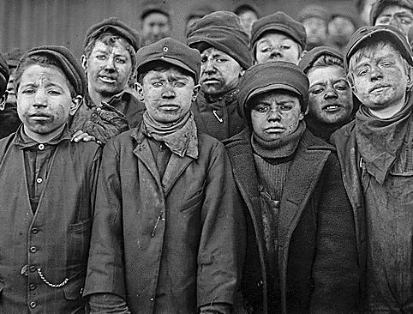
Urban Progressive Reformers
Urban reformers tried to improve the lives of poor workers & children
YMCA created libraries & gyms for young men & children
The Salvation Army created soup kitchens & nurseries
Florence Kelley fought to create child labor laws & laws limiting work hours for women
The Breaker Boys
Notes:
The Young Men’s Christian Association (YMCA), for example, opened libraries, sponsored classes, and built swimming pools and handball courts. The Salvation Army fed poor people in soup kitchens, cared for children in nurseries, and sent “slum brigades” to instruct poor immigrants in middle-class values of hard work and temperance. In addition, many women were inspired by the settlement houses to take action. Florence Kelley became an advocate for improving the lives of women and children. She was appointed chief inspector of factories for Illinois after she had helped to win passage of the Illinois Factory Act in 1893. The act, which prohibited child labor and limited women’s working hours, soon became a model for other states.

Slide 9
Urban Progressive Reformers
Many reformers saw alcohol abuse as serious urban problem:
Women’s Christian Temperance Union worked to end alcohol
Reformers gained prohibition laws in most states & outlawed alcohol throughout the USA with the 18th Amendment in 1919
Hoped prohibition would end corruption, domestic violence, & help “Americanize” immigrants

Slide 10
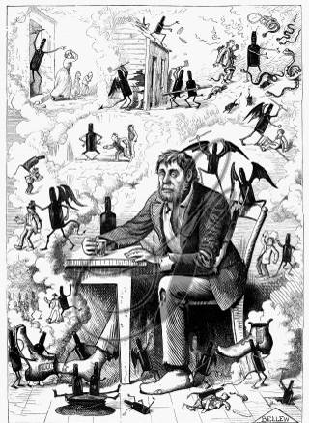
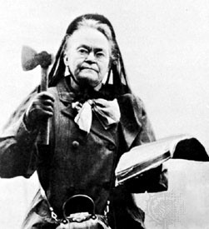
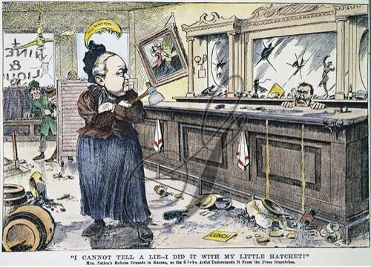
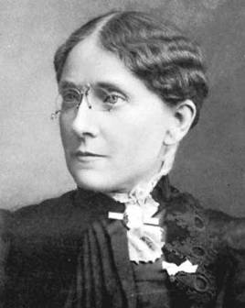
Carrie Nation
Frances Willard

Slide 11
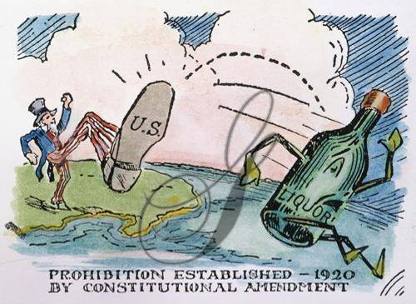
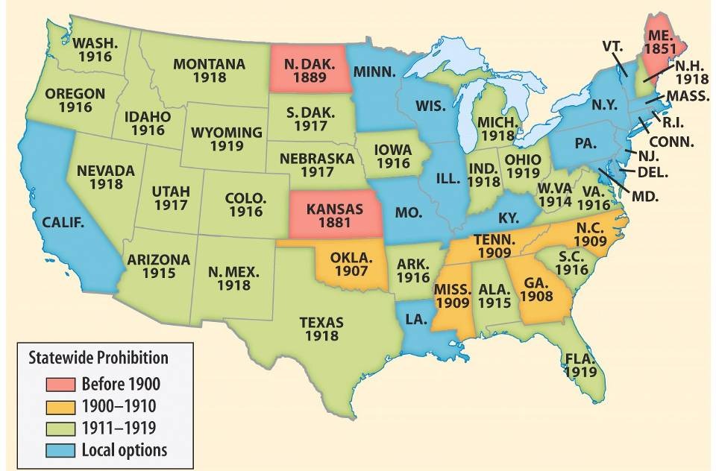
Prohibition of alcohol in the states prior to 1920

Slide 12
Muckrakers
In addition to the Social Gospel, progressive reformers were aided by a new, investigative journalism:
Muckrakers were journalists who exposed problems like poverty, corruption, monopolization (“Investigate, Educate, Legislate”)
Popular monthly magazines, like McClure’s & Colliers, used investigative journalism & photos

Slide 13
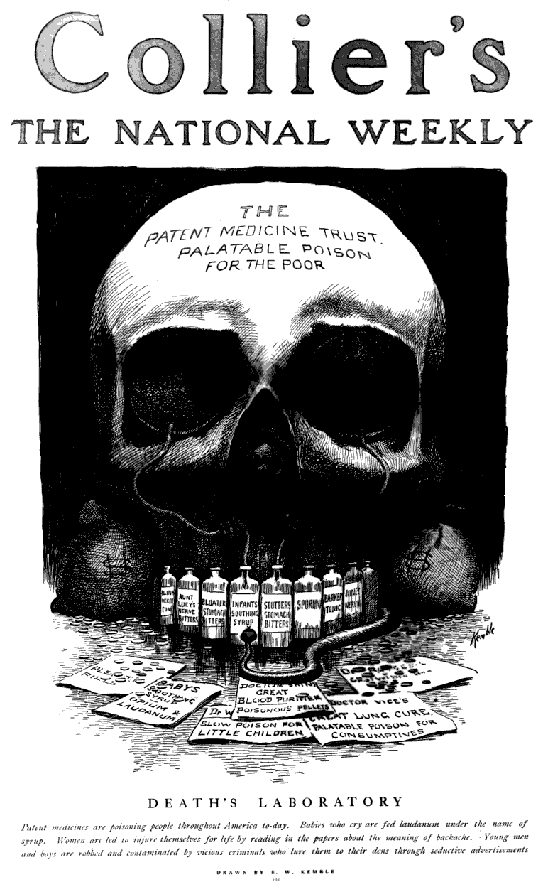
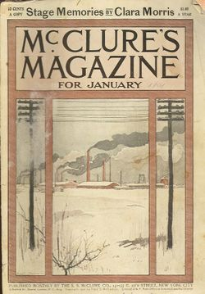

Slide 14
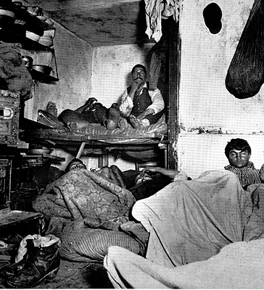
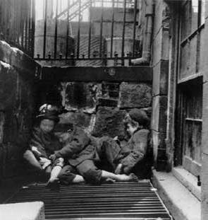
What did Jacob Riis’ How the Other Half Lives (1890) expose?
Jacob Riis’ How the Other Half Lives (1890) exposed urban poverty & life in the slums

Slide 15
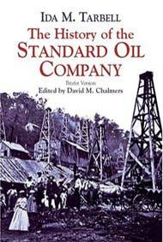
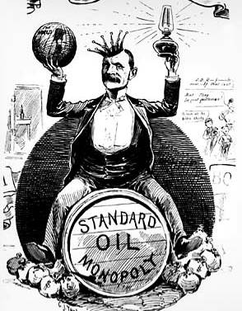
What did Ida Tarbell’s The History of Standard Oil (1904) expose?
Ida Tarbell’s The History of Standard Oil (1904) revealed Rockefeller’s ruthless business practices & called for the break-up of large monopolies

Slide 16
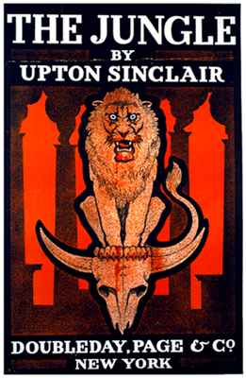
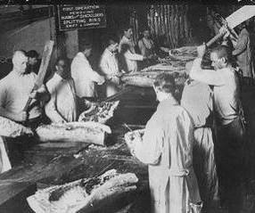
What did Upton Sinclair’s The Jungle (1906) expose?
Upton Sinclair’s The Jungle (1906) revealed the unsanitary conditions of slaughterhouses & led to gov’t regulation of food industries

Slide 17
Conclusions
The Progressive movement began as an attempt to fix urban problems
Reformers lacked unity & were dedicated to their own causes
But their efforts led to a shift: gov’t began to take responsibility for citizens & intervene in their lives
Unlike the Populists, these reform efforts led to real change

Slide 18
Essential Question:
How did Progressive reformers attempt to improve the lives of women & African-Americans?
Warm-Up Question: (write in your spiral)
What was the “Social Gospel”?
What was a “muckraker”?
Who was the more important reformer: Florence Kelley, Jane Addams, Carrie Nation (WCTU)?

Slide 19
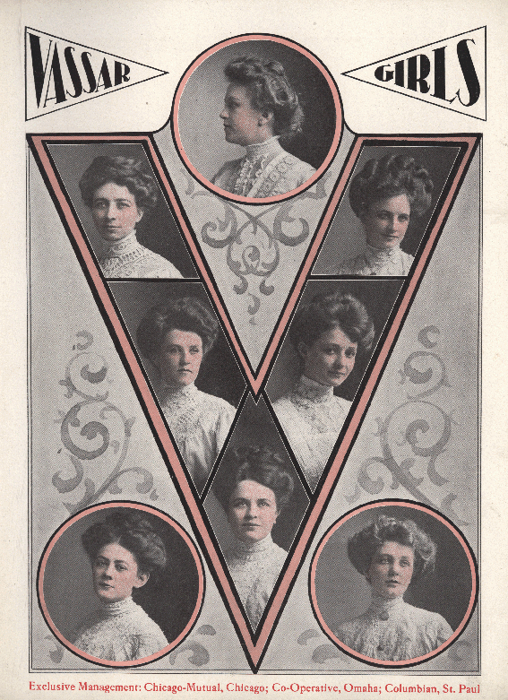
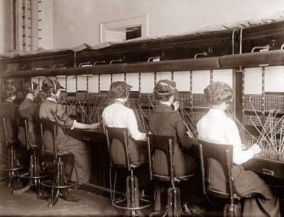
The Women’s Movement
In the Gilded Age, women had more opportunities beyond marriage:
New urban jobs as secretaries, store clerks, & telephone operators gave a sense of independence
More girls graduated from high school & attended universities

Slide 20
The Women’s Movement
Women played an important role as Progressive reformers:
Jane Addams led the settlement house movement
Muckraker Ida Tarbell exposed monopoly abuses of Standard Oil
Florence Kelley helped bring about child & women labor laws
Carrie Nation & Frances Willard helped push for prohibition

Slide 21
The Women’s Movement
Women reformers began to call attention to their own lack of rights:
In most states, married women could not divorce or own property
Women could not vote, but black, immigrant, & illiterate men could
Women workers were paid less than men for doing the same jobs
Middle & upper class women were expected to serve domestic & child rearing roles in the home

Slide 22
Reform for Women
Women reformers gained laws that banned prostitution & limited work hours for women to 10 hours
Margaret Sanger promoted birth control for women:
Her journals provided contraceptive information for poor & middle-class women
Sanger opened the 1st birth control clinic in the U.S. in 1915

Slide 23
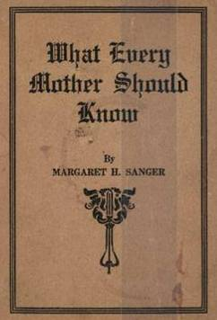
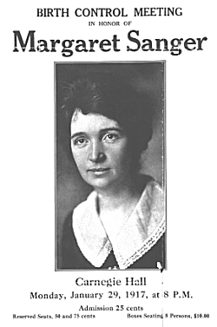

Slide 24
Women’s Suffrage (2.49)

Slide 25
Women’s Suffrage
The most significant reform for women was voting rights (suffrage)
Women demanded suffrage since Seneca Falls in 1848
Were frustrated in 1870 when the 15th Amendment gave black men the right to vote but not women
In 1890, the National American Women Suffrage Association (NAWSA) was formed

Slide 26
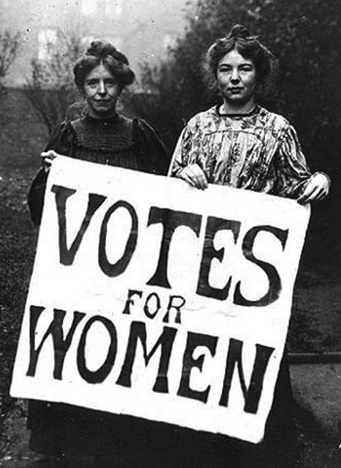
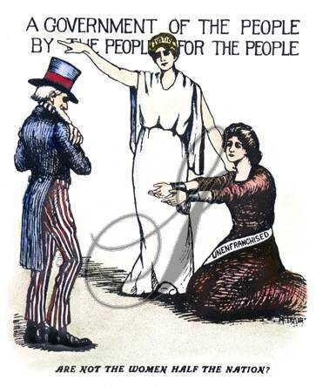
Suffragettes

Slide 27
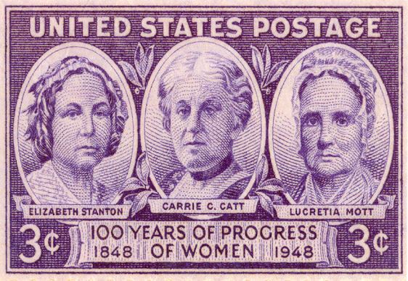
Women’s Suffrage
NAWSA leaders Susan B. Anthony & Carrie Chapman Catt pressured states to let women vote & called for a national suffrage amendment
By the early 1900s, most western states allowed women to vote
Finally in 1920, the states ratified the 19th Amendment giving women to right to vote

Slide 28
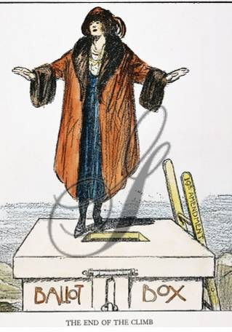
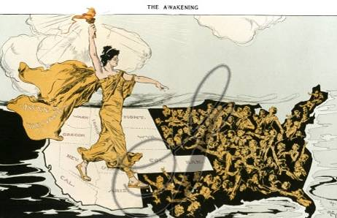
Women’s Suffrage Before 1900
19th Amendment:
The right of the citizens of the United States to vote shall not be denied or abridged by the United States or by any State on account of sex.

Slide 29
Reform for African-Americans
By 1900, African-Americans were in need of progressive reform
80% of lived in rural areas in the South, most as sharecroppers
Poll taxes & literacy tests limited black voting rights
Lynching & violence were common
Plessy v Ferguson (1896) allowed Jim Crow laws to segregate in restaurants, hotels, schools
Plessy v Ferguson (1896):
Segregation does not violate the 14th amendment & can be used as long as separate facilities are equal (“separate but equal”)
Notes:
By 1900, (& grandfather clauses)

Slide 30
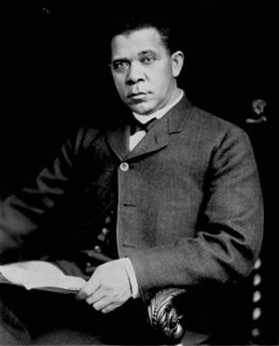
African-American Reforms
But, black leaders were divided on how to address racial problems
Booker T Washington was Harvard educated, studied black urban culture, & was 1st president of Tuskegee University
His “Atlanta Compromise” stressed black self-improvement & accommodation with whites
The wisest among my race understand that the agitation of questions of social equality is the extremist folly, and that progress in the enjoyment of all the privileges that will come to us must be the result of severe and constant struggle rather than of artificial forcing
—Booker T. Washington
Notes:
BTW was 1st prez of Tuskegee; WEBD was Harvard & Univ of Berlin educated, became sociologist who studied black urban pop of Phila & wrote The Souls of Black Folk (1903)

Slide 31
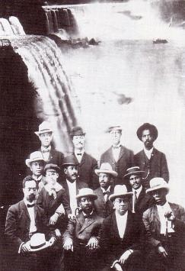
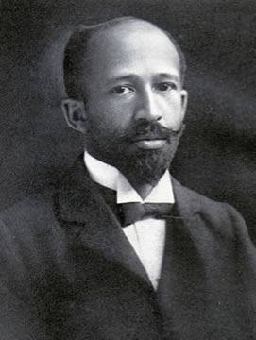
African-American Reforms
W.E.B. DuBois was more aggressive
DuBois led the Niagara Movement in 1905 calling for immediate civil rights, integrated schools, & promotion of the “Talented 10th” to be the next generation of black civil rights leaders
We claim for ourselves every single right that belongs to a free American, political, civil and social, and until we get these rights we will never cease to protest and assail the ears of America
—W.E.B. DuBois
Notes:
Washington vs. DuBois Reading
Compare view of Booker T Washington and WEB DuBois (CPUS book lesson 32): Have students read the passages and discuss their varying viewpoints on African-American civil rights

Slide 32
The NAACP
In 1909, reformers formed the National Association for the Advancement of Colored People (NAACP) to fight for black equality
DuBois was put in charge of The Crisis publication to call attention to the cause
The NAACP used lawsuits to fight segregation laws & voting restrictions
Notes:
CFL Lesson #33

Slide 33
Reforms for African-Americans
Unlike women, African-Americans did not see significant changes:
Black reformers failed to convince state or national politicians to offer equality
By the end of the Progressive Era, segregation & lynching were common throughout the South & in many parts of the U.S.

Slide 34
The Limits of Progressive Reform (2.40)

Slide 35
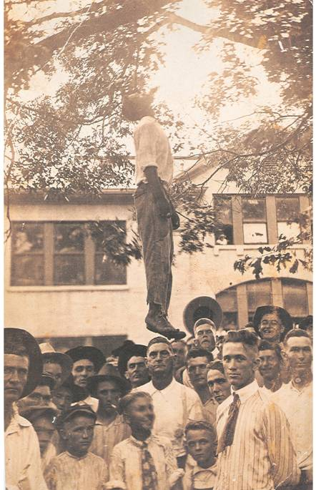
Examine the lyrics of “Strange Fruit” by Billie Holiday

Slide 36
Closure Activity
Examine excerpts of speeches by Washington & DuBois
What is the main idea of each?
In one sentence, summarize the approach of Washington & DuBois regarding civil rights
Whose approach was more appropriate for the early 20th century? Why?

