Slide 1
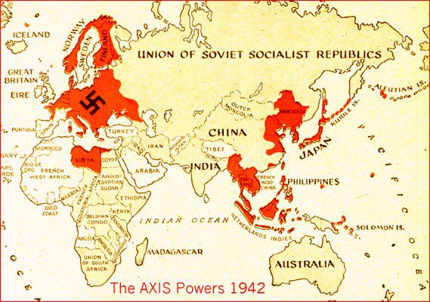
The 2 Theaters
European Theater Pacific Theater

Slide 2
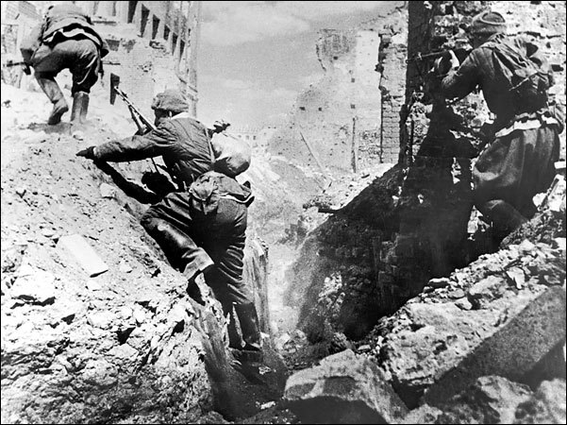
The European Theater

Slide 3
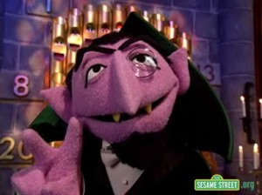
WAR OF 2
WWII = 2nd World War
2 Sides = Axis vs. Allies
2 Theaters = European and Pacific Theater
2 Fronts = Eastern and Western Front in Europe

Slide 4


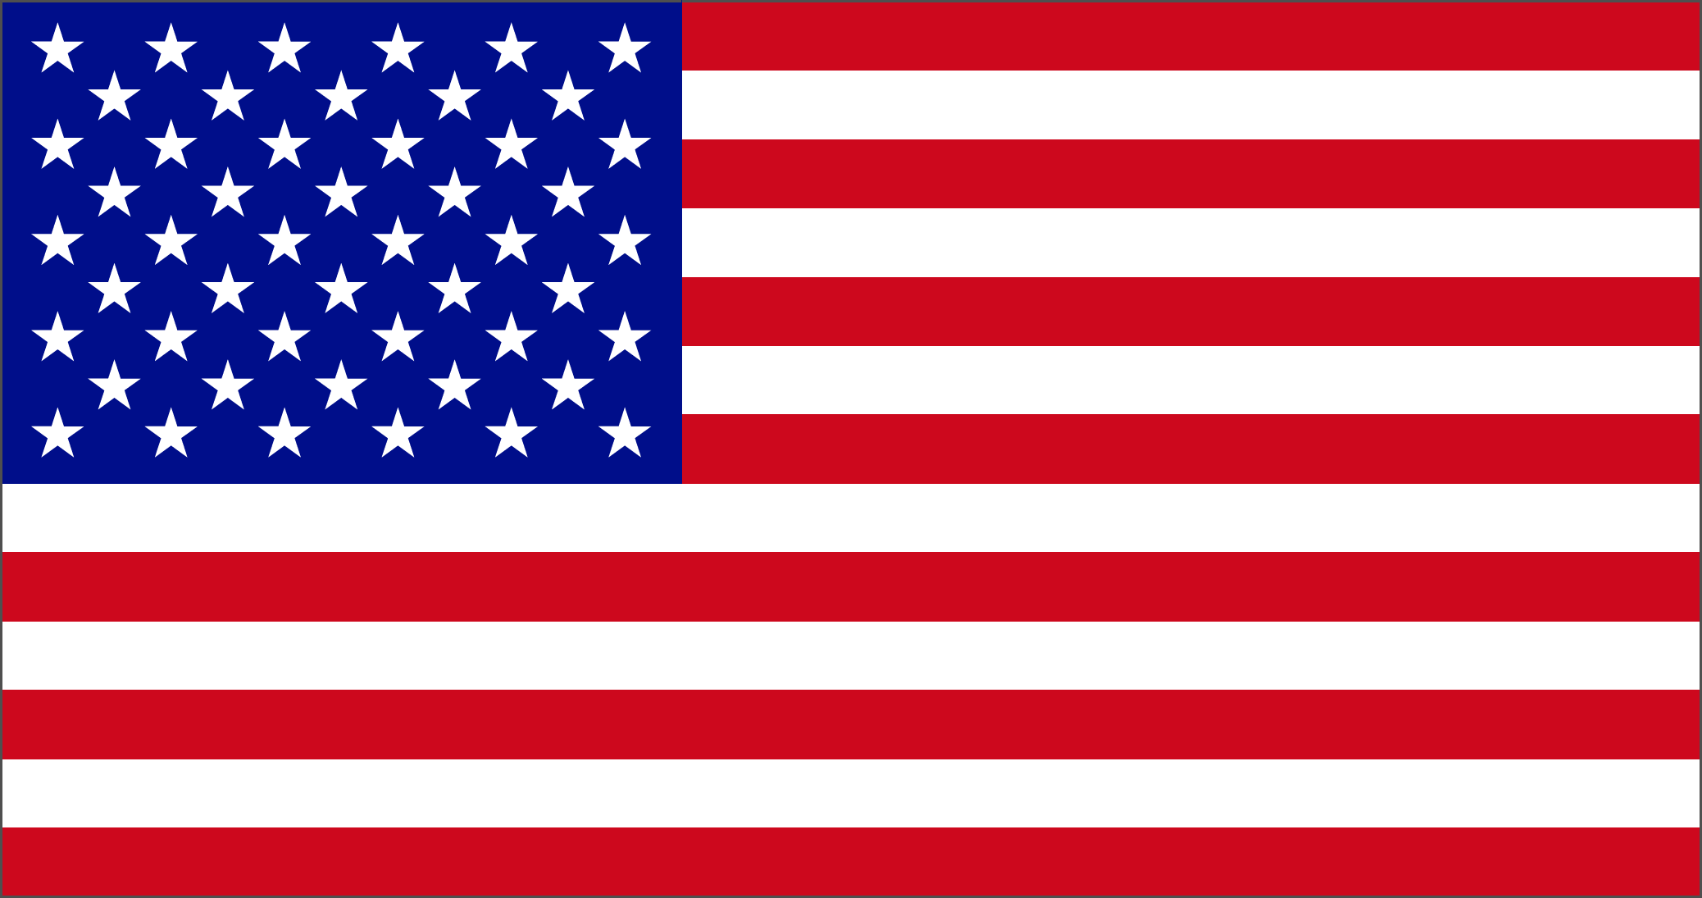


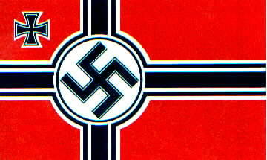

THE 2 SIDES
The Axis
VS.
The Allies
Japan
Italy
Germany
France
America
Britain
Soviet Union

Slide 5
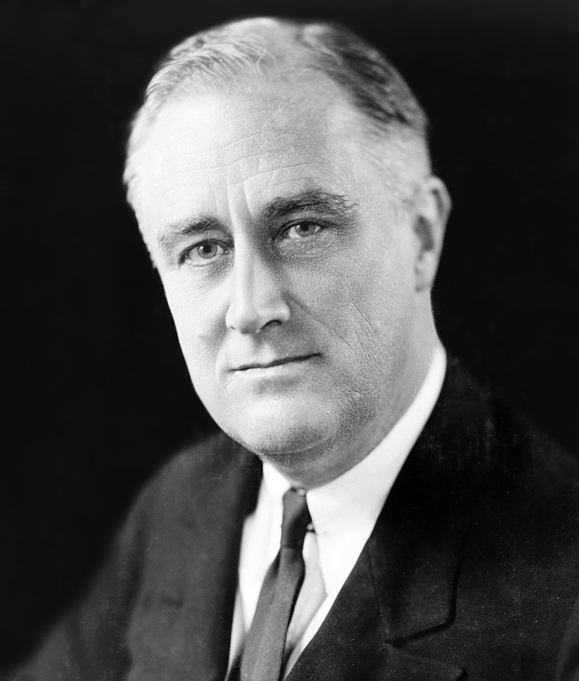
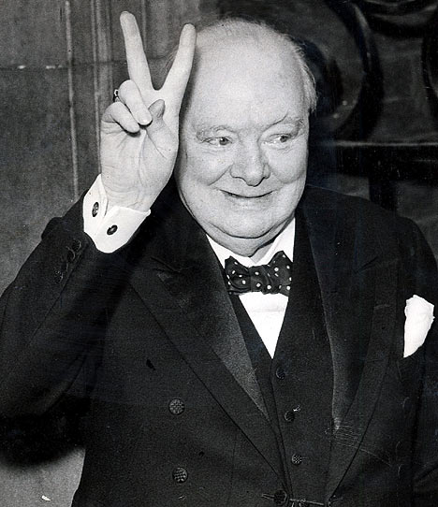
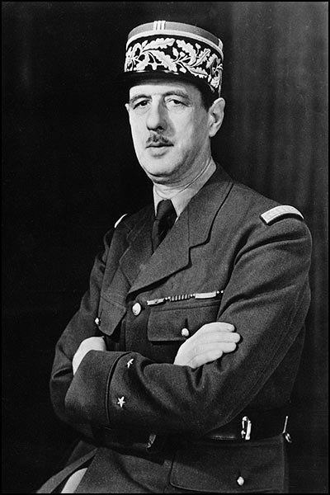
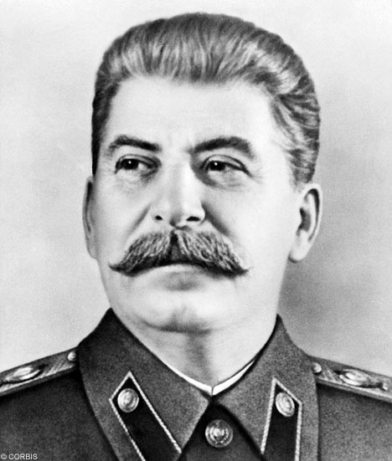
The Allied Leaders
FDR: Churchill: de Gaulle: Stalin:
USA Britain Free France Soviet Union
Lend-Lease

Slide 6
THE 2 SIDES
The Axis
VS.
The Allies
Japan
Tojo
Italy
Mussolini
Germany
Hitler
France
De Gaulle
America
FDR
Britain
Churchill
Soviet Union
Stalin

Slide 7
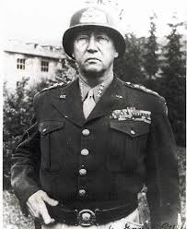
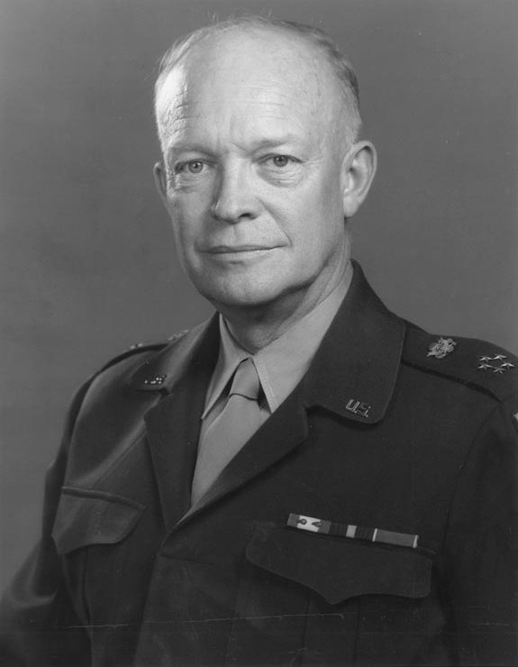
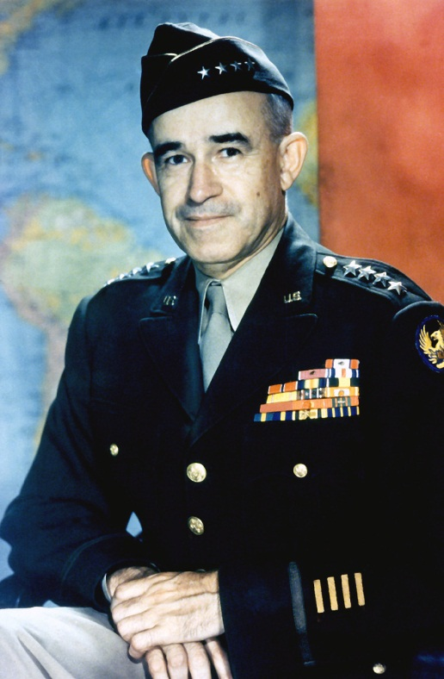
The Generals
George S. Patton
Dwight D. Eisenhower
Omar Bradley

Slide 8
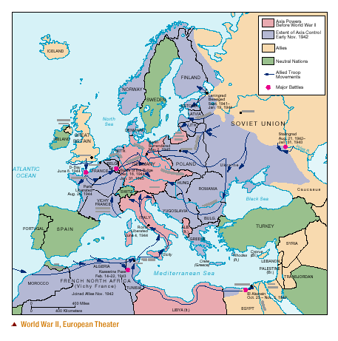
Annotated Map Time!

Slide 10
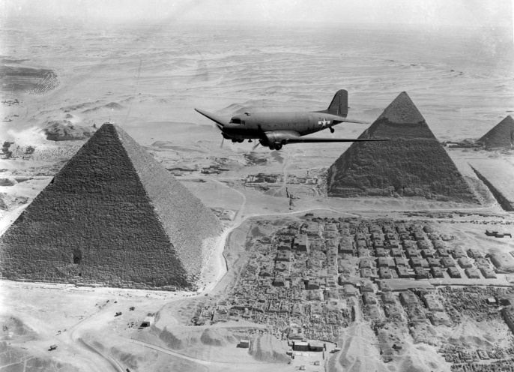
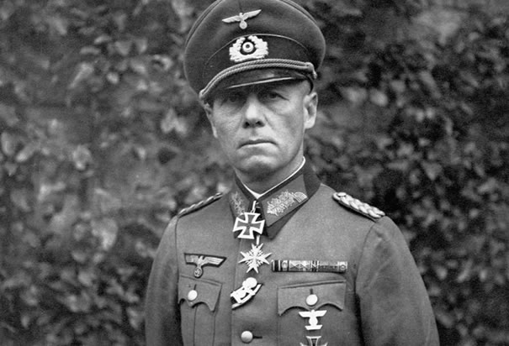
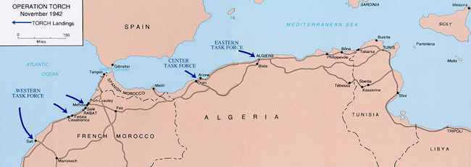
North Africa 1942
Eisenhower leads US invasion of Morocco and Algeria
Give US army experience
Help British Troops in Egypt
Against German Erwin Rommel the “Desert Fox”
By 1943, Germans surrender

Slide 11
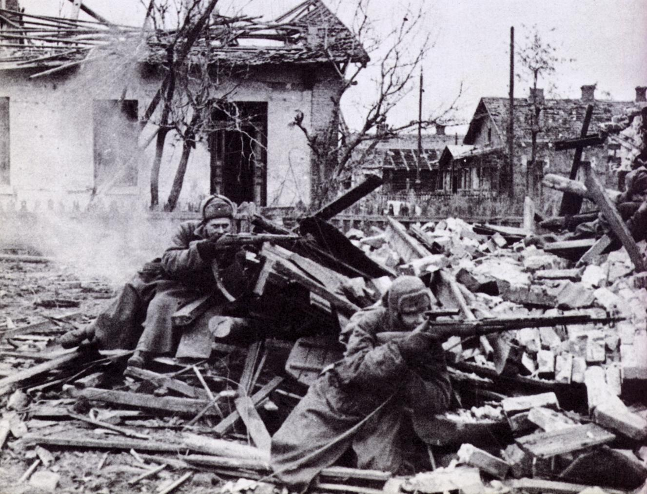
Stalingrad (July 1942)
3 million German Troops invade Soviet Union in 1941
Both sides ordered not to surrender/retreat (May-November)
91,000 Germans surrendered only 5,000 make it out of Soviet Prison Camps
Puts the Germans on the defensive
Soviets are motivated for revenge.

Slide 12
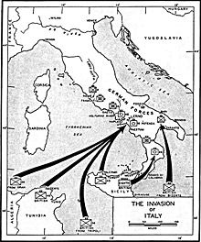
Striking the Soft Underbelly (Italy)
(Sept 1943)
Mussolini is arrested and put on trial in July 1943- Italy begins secret talks with Allies
British and Americans push up through Sicily using amphibious attacks
General George Patton leads the Americans
Sept 1943- Italy surrenders but Hitler continues to fight the allies, sending in more troops
300,000 allied troops die before victory in Italy

Slide 13
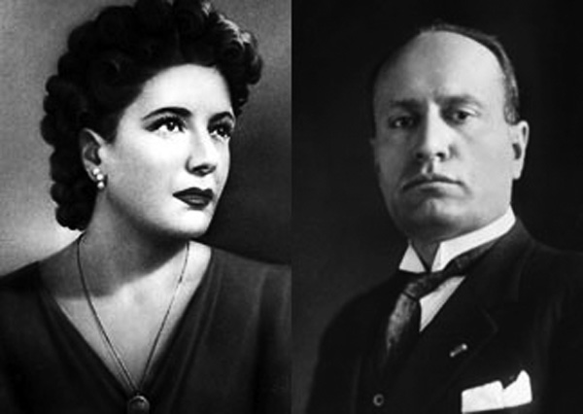
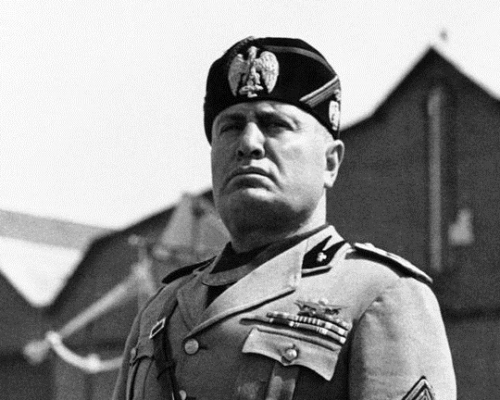
Death of Benito Mussolini
Mussolini had been rescued from prison Sept. 12, 1943, by German special forces.
During the last days of war in Italy, Mussolini tries to escape by hiding in a German convoy that is headed to the Alps.
The convoy is stopped and searched by Italian partisans, who discover Mussolini in the back of a truck with a private’s overcoat over his striped generals’ pants.
He is arrested and the partisans secretly execute him, 15 other Fascist leaders and his mistress, Clara Petacci.
Mussolini is shot by a firing squad and hung upside down from a service station in a town square in Milan, Italy – April 29, 1945

Slide 14
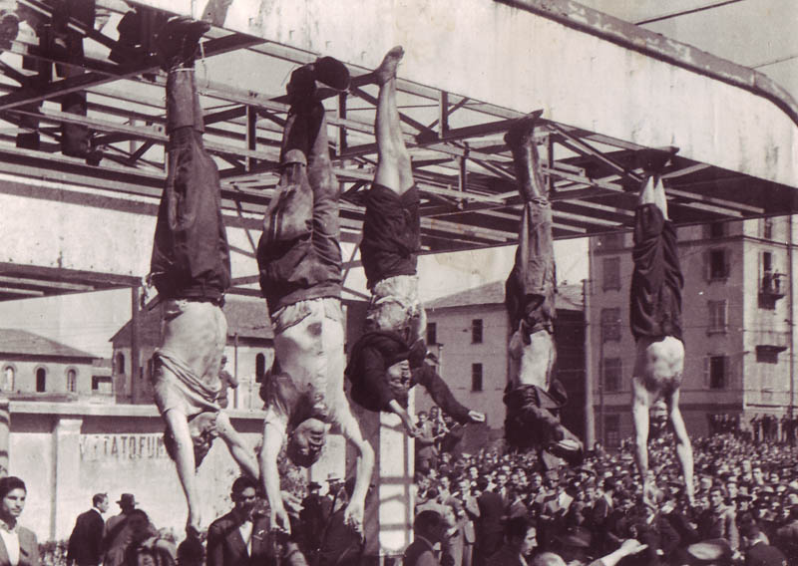
The dead body of Mussolini (second from left) next to Petacci (middle) and other executed fascists in Piazzale Loreto, Milan, 1945

Slide 15
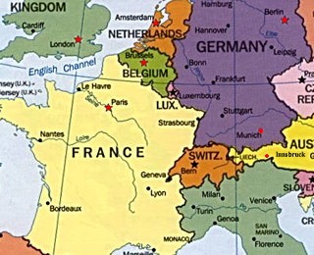
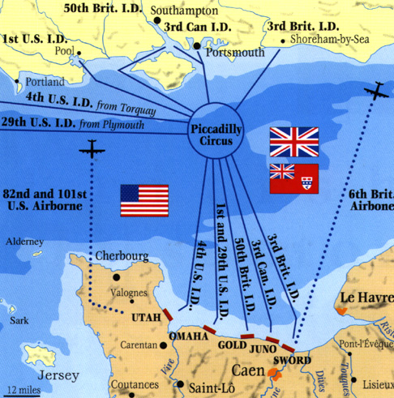
D-Day: Setting the Scene

Slide 17
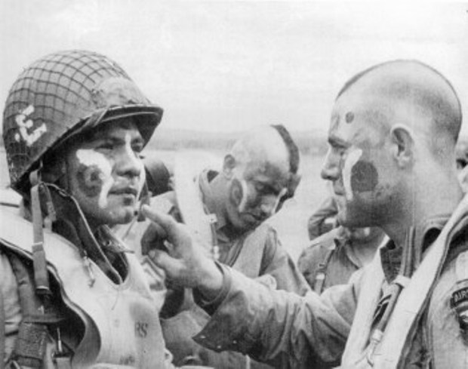
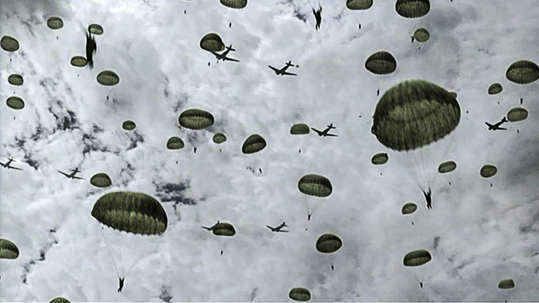
Paratroopers
*Paratroopers were created during WWII as the first ‘special forces’ of the Army. They were vital in preparing an area for invading troops.*
Hitler created paratroopers and used them for the invasion of Crete and Russia.
The British created paratroopers in 1940 and made it part of the Army.
America created the 101st as a parachute test platoon in June 1940 under the control of the Infantry.
Trained at Fort Benning in Georgia.
The role of the airborne troops simply as to seize strategic sites (such as bridges) and to hold them until ground troops arrived.

Slide 18
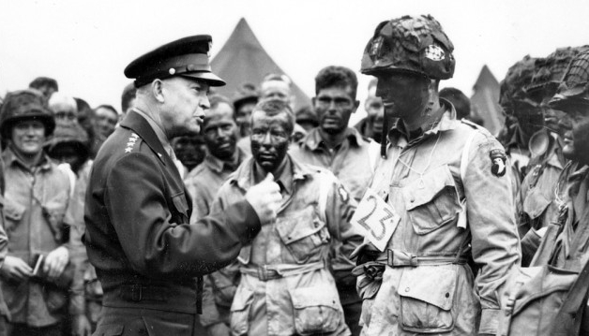
Band of Brothers-Company E “Easy”/506th of the 101st Airborne Division
101st Airborne Division drops meeting with Eisenhower day before they are dropped behind enemy lines as part of the invasion of Normandy, France or D-Day, June 6, 1944.

Slide 19
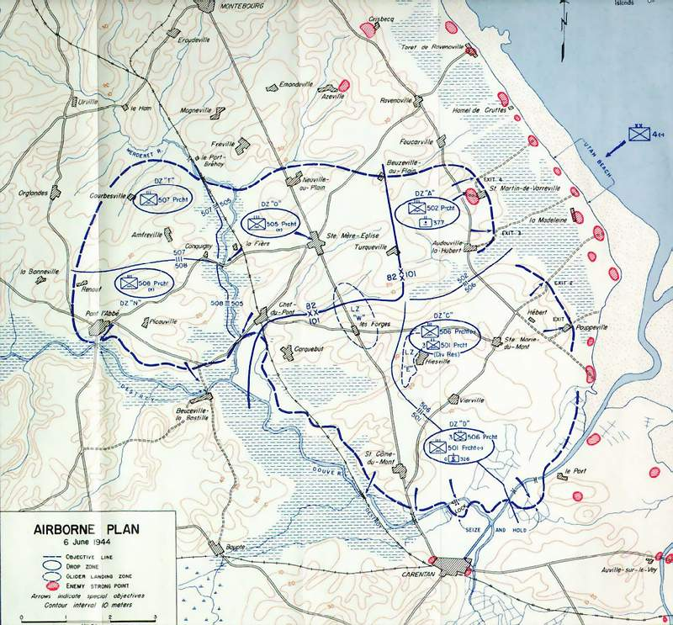
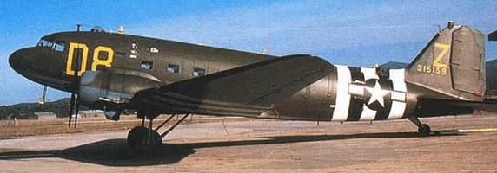

Slide 20
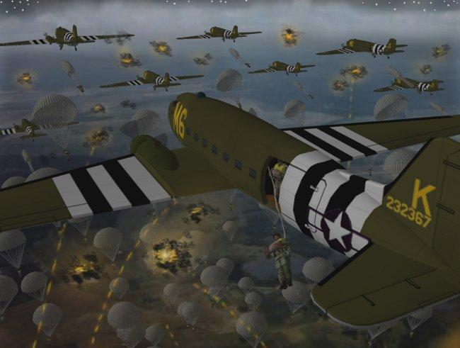
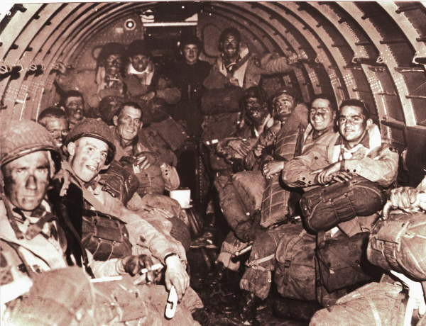
Around 13,100 paratroopers of the U.S. 82nd Airborne and 101st Airborne Divisions made night parachute drops early on D-Day, June 6, 1944.
Because of the unexpected German artillery barrage, many paratroopers were killed before they landed or landed miles away drop their designated drop zone behind enemy lines.
Easy Company – Waiting to leave for D-Day jump – June 6, 1944 -1:00am

Slide 21
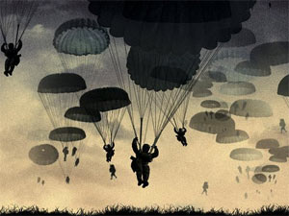
D-Day Jump

Slide 22
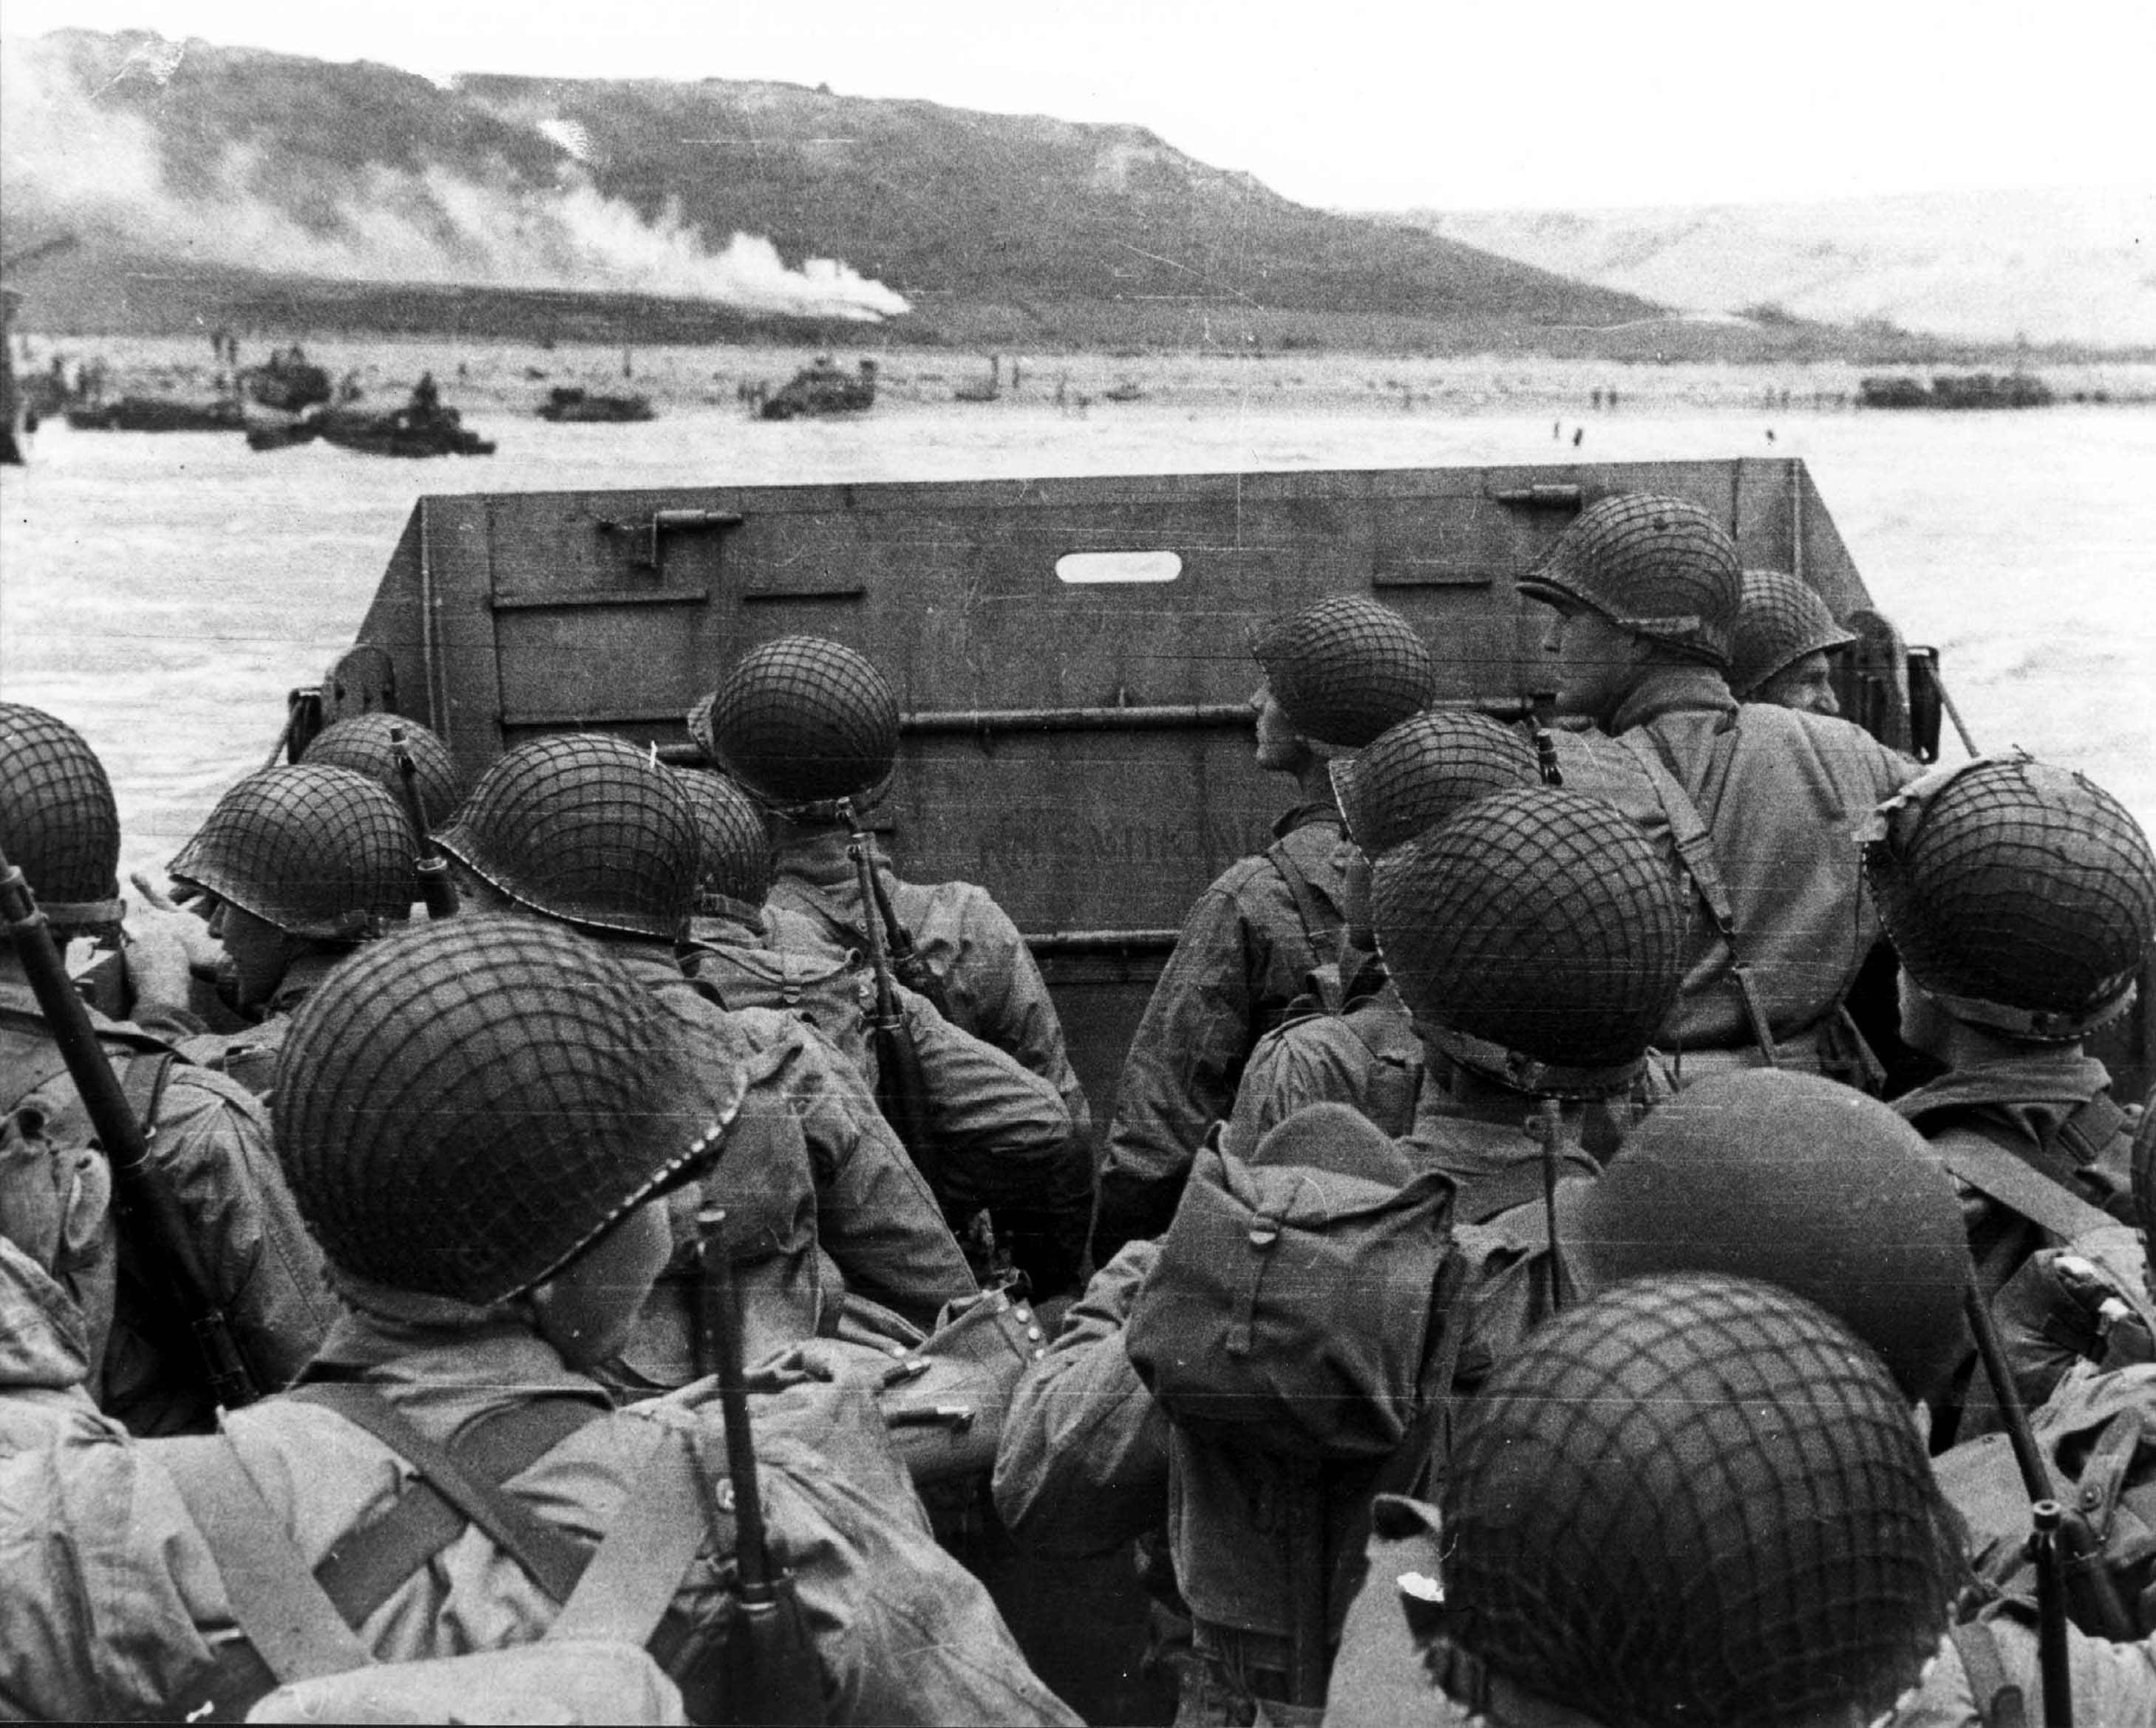
D-Day June 6, 1944

Slide 23
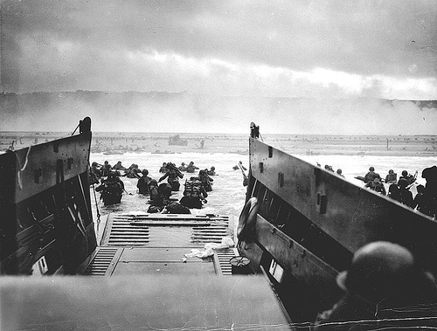

Slide 24
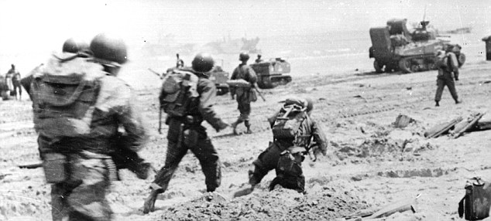

Slide 25
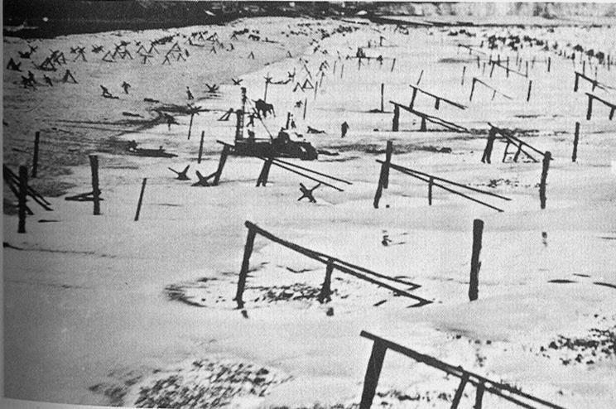

Slide 26
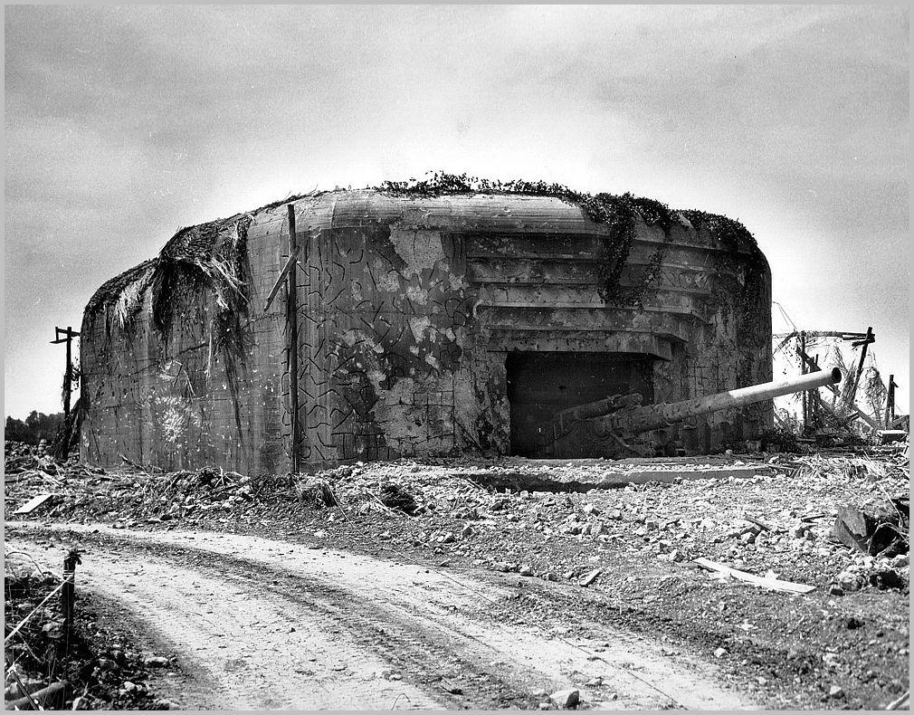

Slide 27
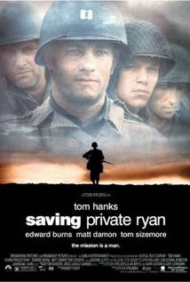
D-Day Invasion – Omaha Beach

Slide 28
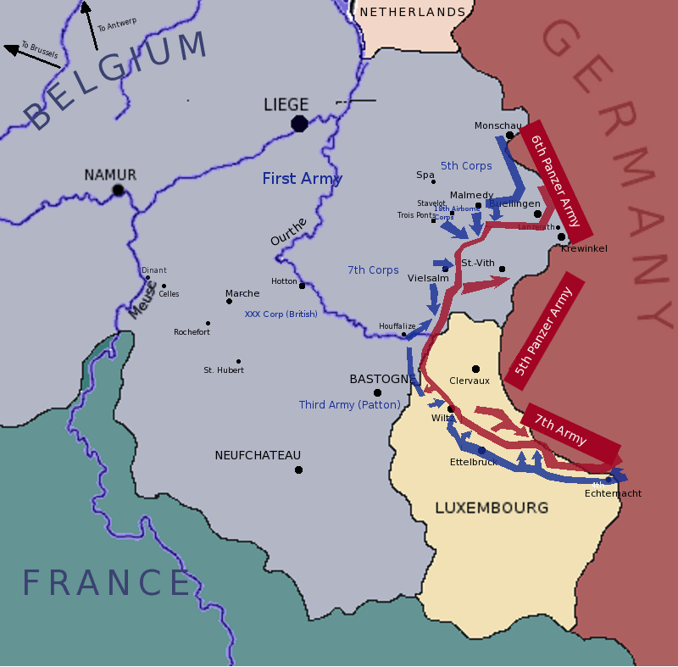
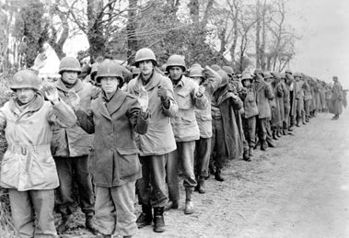
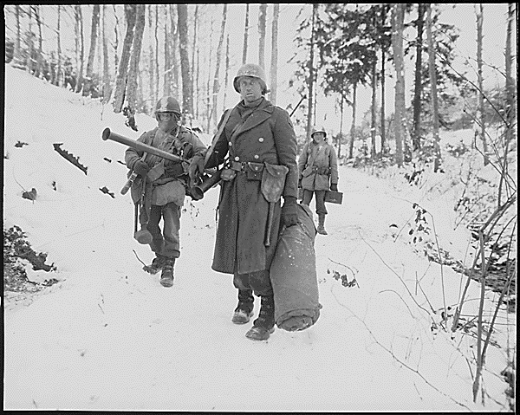
Battle of the Bulge
December 16,1944 – January 25, 1945
Last desperate German offensive
Germans suffer 100,000 casualties
U.S. suffered 81,000 casualties.
Allies then enter Germany and take Berlin by May 2, 1945.
The Soviets reach Berlin before other Allied forces and are involved in the battle for Berlin, one of the worst battles ever fought.

Slide 29
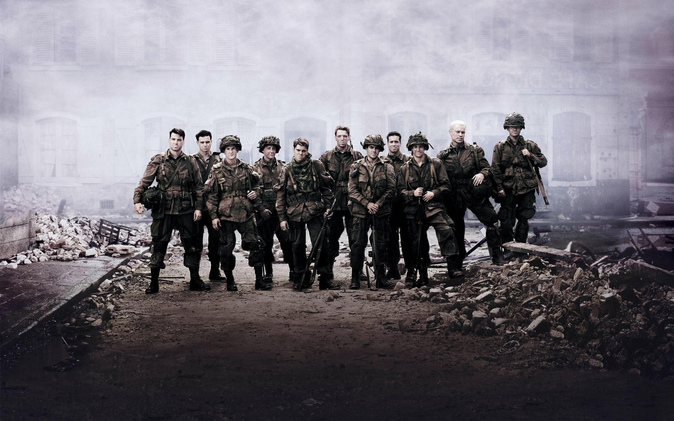
Battle of the Bulge

Slide 30
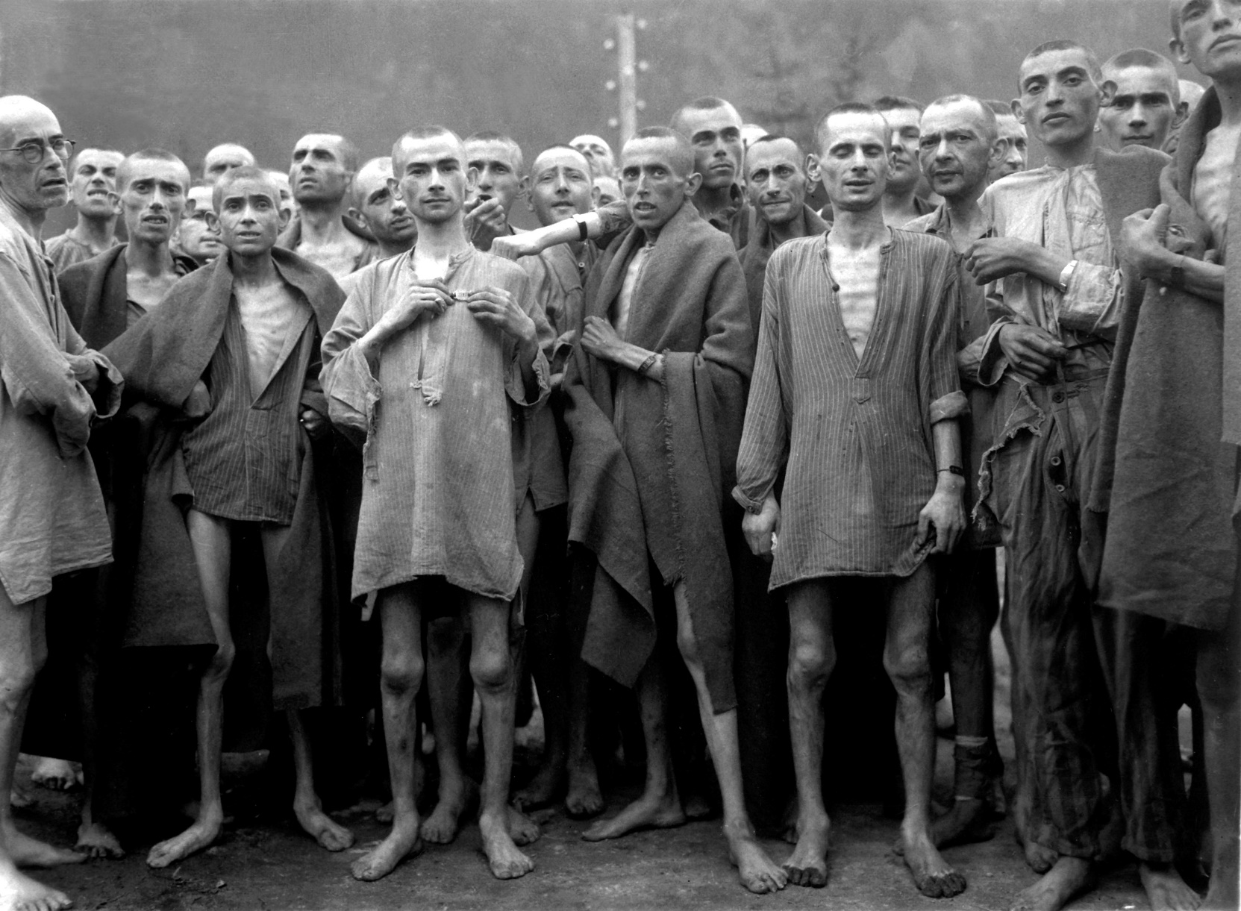
Liberation of the Concentration Camps

