Slide 1
Essential Question:
How did America’s role in the world change by 1900?

Slide 2
America’s Changing Role in the World
From 1790 to 1900, the U.S. expanded its role in world affairs:

Slide 3
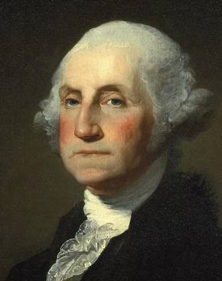
America’s Changing Role in the World
From 1790 to 1900, the U.S. expanded its role in world affairs:
In 1796, George Washington promoted a policy of neutrality & warned against alliances with foreign nations (especially Europe)

Slide 4
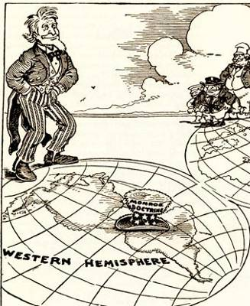
America’s Changing Role in the World
From 1790 to 1900, the U.S. expanded its role in world affairs:
In 1823, the Monroe Doctrine asserted neutrality but proclaimed that the U.S. would protect the western hemisphere from European influence

Slide 5
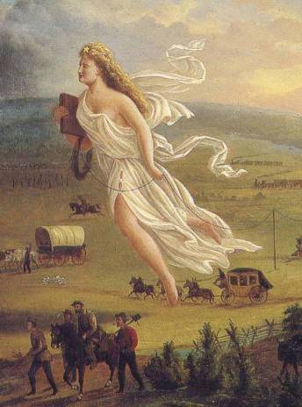
America’s Changing Role in the World
From 1790 to 1900, the U.S. expanded its role in world affairs:
In 1845, the U.S. used treaties & wars to pursue its “Manifest Destiny” & expand to the Pacific Ocean

Slide 6
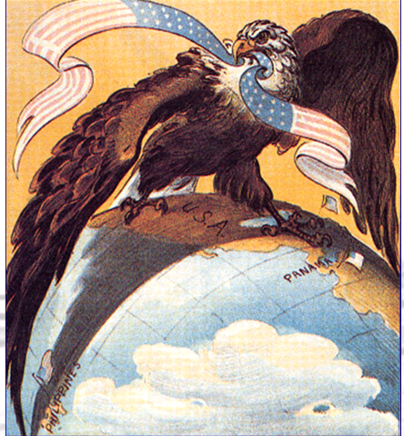
America’s Changing Role in the World
From 1790 to 1900, the U.S. expanded its role in world affairs:
By the 1890s, the U.S. gained new overseas colonies & developed a more active foreign policy

Slide 7
Reasons for U.S. Imperialism
In the late 1800s, the United States emerged as an imperialist nation:
Imperialism is the act of strong nations exerting their power over weaker nations, often by gaining new colonies
From 1867 to 1904, the U.S, annexed Alaska, Hawaii, Guam, Puerto Rico, the Philippines & built the Panama Canal

Slide 8
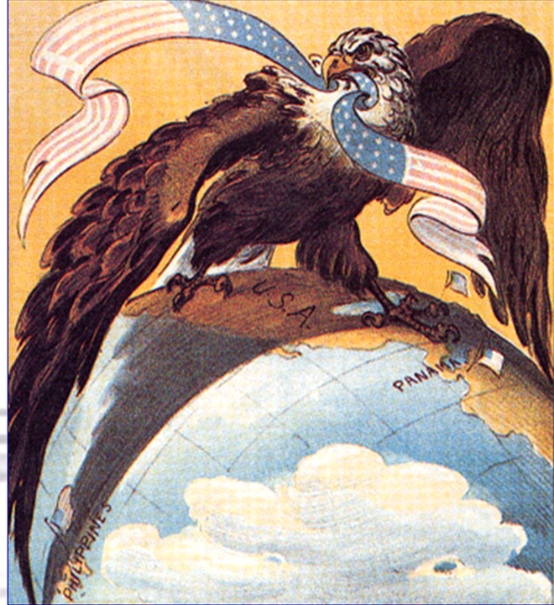
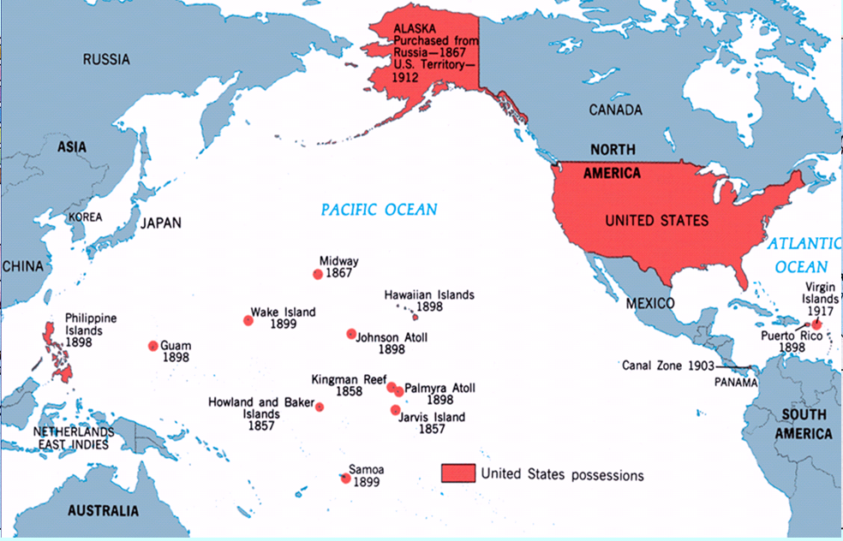
American Imperialism

Slide 9
Reasons for U.S. Imperialism
Americans were motivated by a variety of factors to imperialize:
In 1890, the U.S. census declared that the frontier was closed & there were no new lands in the “west” for Americans to expand into
During the Gilded Age, American industry grew so large that new overseas markets & new sources of raw materials were needed

Slide 10
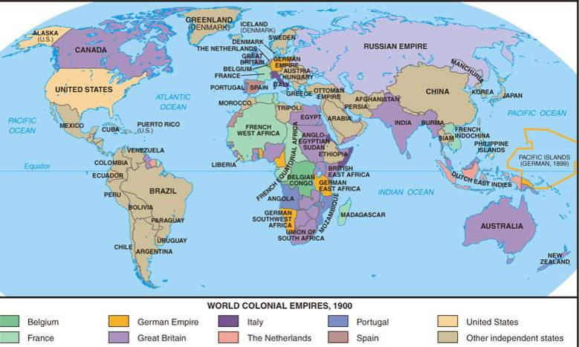
European powers had acquired colonies & many Americans believed that the USA had to imperialize in order to keep up

Slide 11
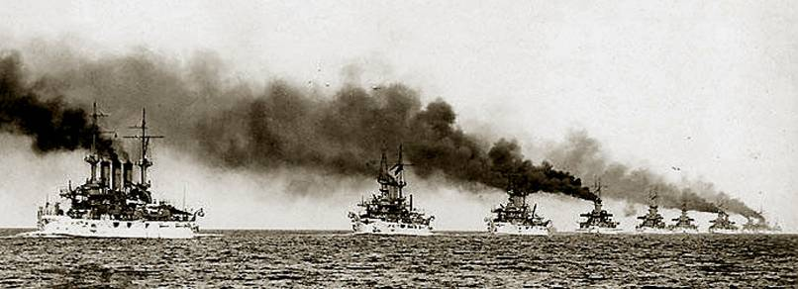
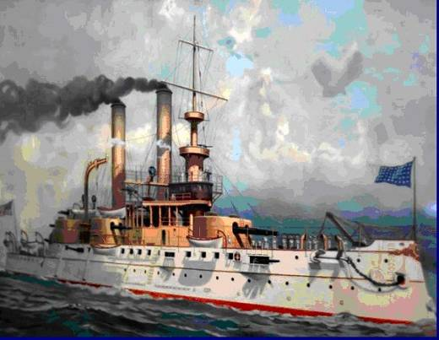
Reasons for U.S. Imperialism
At the urging of Admiral Alfred Mahan, the USA developed a modern navy, allowing the U.S. to compete with other powerful nations
Many believed that Social Darwinism gave Americans a duty to “civilize” the “inferior races” of the world by introducing medicine, technology, Christianity, & democracy

Slide 12
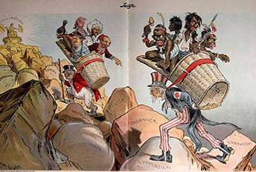
The White Man’s Burden
Civilization
Superstition
Ignorance
Barbarism
Oppression

Slide 13
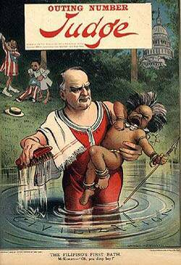
The Debate over American Imperialism
Not all Americans supported imperialism:
The Anti-Imperialist League formed in 1899 to fight U.S. annexation of the Philippines
Many argued that the U.S. had no right to force American culture upon others

Slide 14
The U.S. Becomes a World Power
By the 20th century, the USA was a world power:
Built the world’s 3rd largest navy
Annexed Hawaii, the Philippines, Puerto Rico, many Pacific islands
Asserted itself in Latin America (Spanish-American War, Panama Canal, & Roosevelt Corollary
Influenced Asia (Open Door Policy)

Slide 15
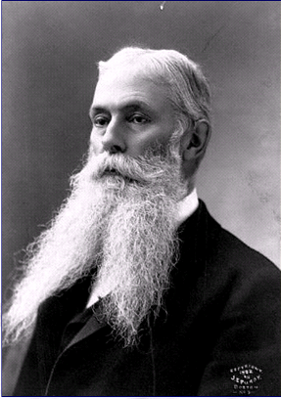
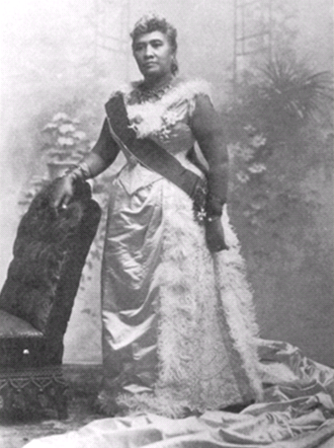
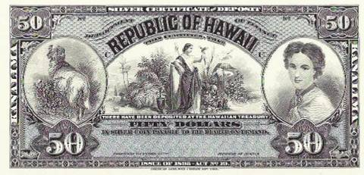
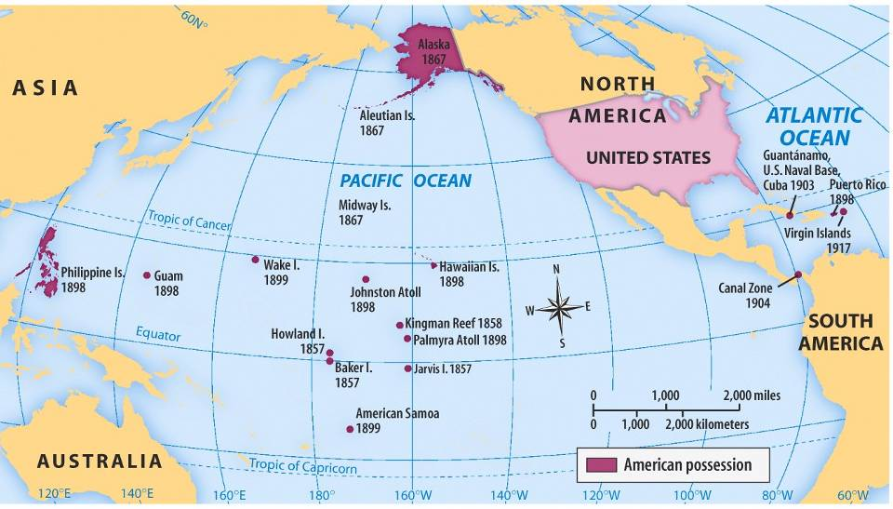
U.S. Imperialism: HAWAII
From 1820 to 1890, Americans moved to Hawaii as missionaries & fruit plantation owners
In 1891, Queen Liliuokalani came to power & tried to reduce the power of Americans living in Hawaii
Americans overthrew Queen Liliuokalani in 1893 & Hawaii was annexed by the USA in 1898

Slide 16
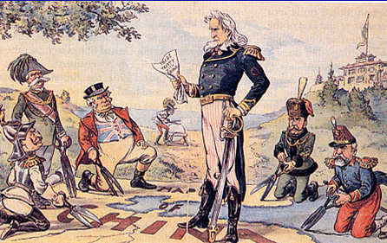
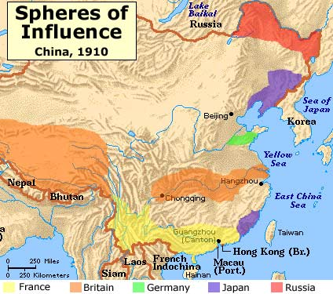
U.S. Imperialism: CHINA
By the 1890s, European imperial powers carved China into spheres of influence, giving them exclusive trade rights in Chinese ports
In 1899, the USA declared an Open Door Policy in China to allow free trade by any nation in any port

Slide 17
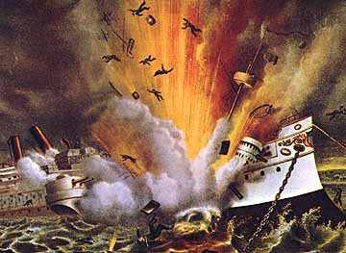
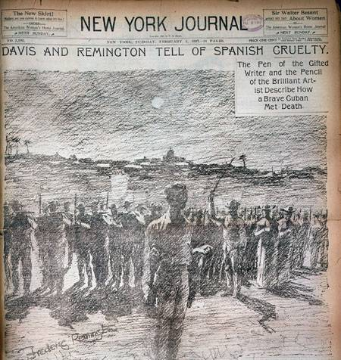
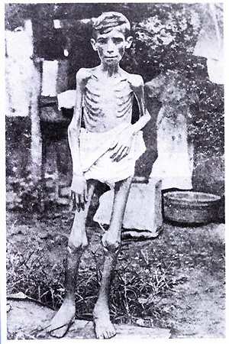
U.S. Imperialism: CUBA
In 1895, Cubans declared their independence from Spain; To put down the revolution, Spain used brutal tactics (like starvation)
U.S. newspapers sensationalized the events in Cuba (known as “yellow journalism”)
In 1898, the U.S. sent the USS Maine to Cuba to protect American interests there; After the ship mysteriously exploded, Americans declared war on Spain

Slide 18
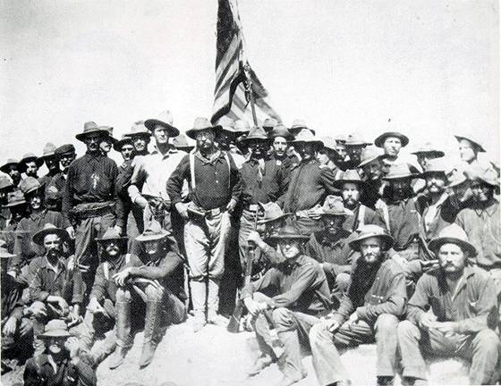
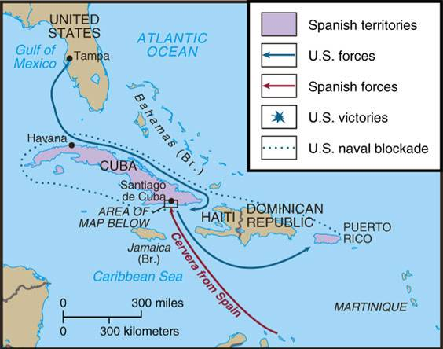
The Spanish-American War was fought to liberate Cuba & the Philippines from Spanish control; The war lasted only 113 days
Teddy Roosevelt & the Rough Riders

Slide 19
As a result of the Spanish-American War, Cuba was liberated & the USA annexed the Philippines, Guam, Puerto Rico
Under the Platt Amendment, Cuba became a US Protectorate, a country whose affairs are partially controlled by a stronger power.
The US recognized Cuba’s newly formed government. The US forced Cuba to add provisions, known as the Platt Amendment, to their Constitution.

Slide 20
U.S. Imperialism: PUERTO RICO
After the Spanish-American War, Puerto Rico was placed under military control and then became a territory of the US. The people of Puerto Rico are US citizens. Puerto Rico is still a U.S. territory; Lots of poverty & unemployment.

Slide 21
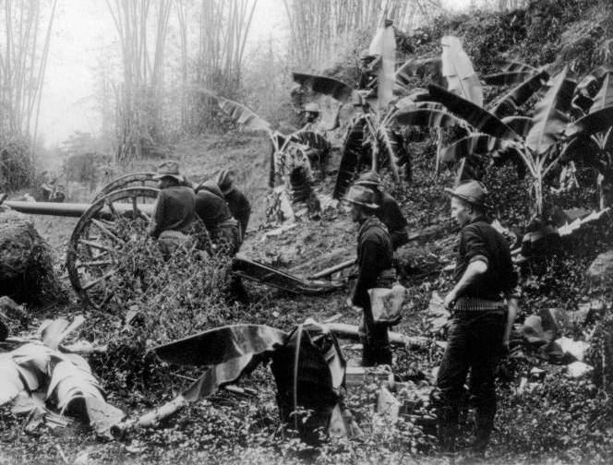
U.S. Imperialism: PHILIPPINES
When the Philippines were annexed by the USA & not granted independence after the Spanish-American War, the Filipino-American War began in 1898
The Filipino-American War lasted 3 years & cost more in money & American lives than the Spanish-American War

Slide 22
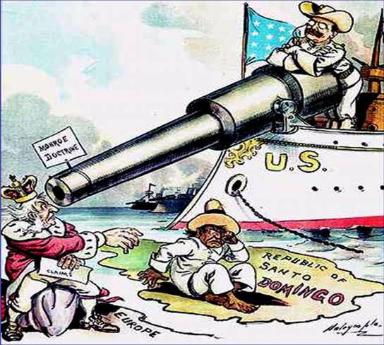
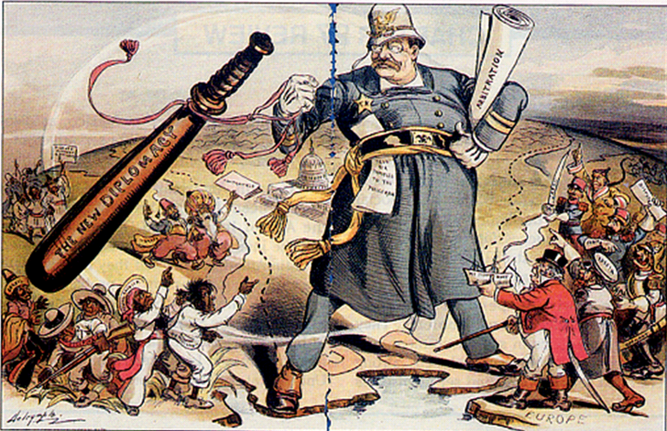
U.S. Imperialism: DOMINICAN REPUBLIC
TR added the Roosevelt Corollary to the Monroe Doctrine, giving the United States “police powers” to protect Latin America from European imperialism
When Theodore Roosevelt became president, he used “Big Stick Diplomacy”: Develop an active U.S. foreign policy with a strong navy to accomplish goals
Taft used Dollar Diplomacy to give bank loans to foreign countries to keep European powers out of the Caribbean.

Slide 23
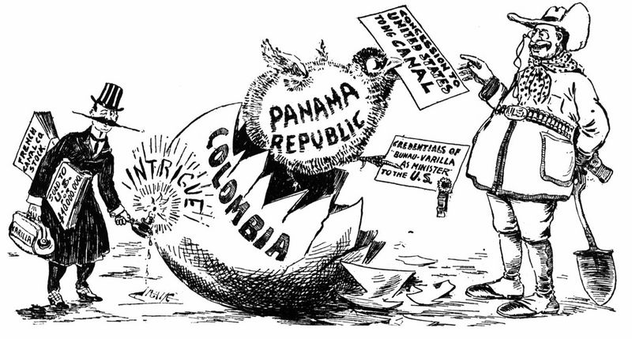
U.S. Imperialism: PANAMA
TR used “Big Stick Diplomacy” to build the Panama Canal by encouraging the Panamanians to rebel from Colombia
Panamanians declared their independence from Columbia with the support of more than a dozen American Warships.

Slide 24
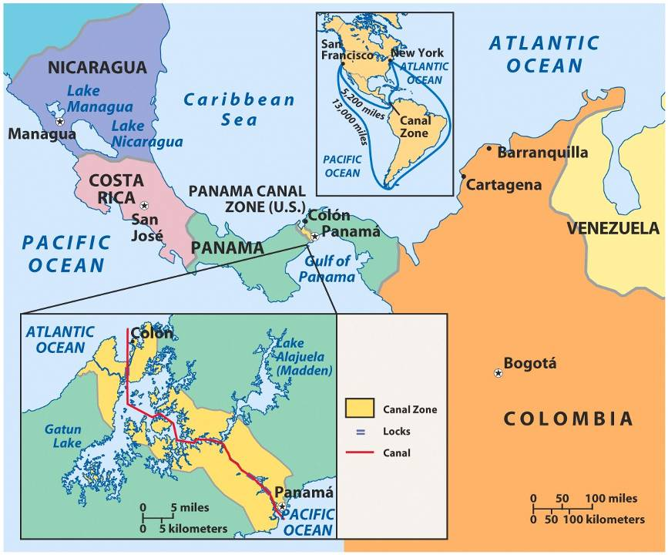
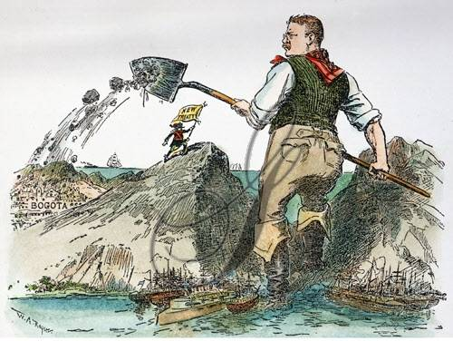

Slide 25
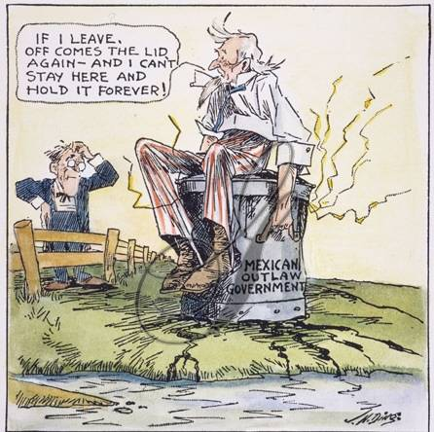
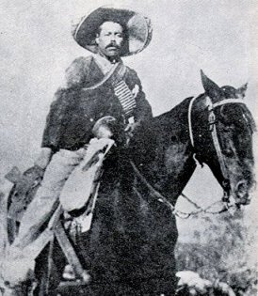
U.S. Imperialism: MEXICO
The USA tried to intervene in Mexican affairs when Huerta overthrew Diaz & again when Carranza overthrew Huerta
Under Wilson “Missionary diplomacy” the US denied recognition to governments it considered hostile to it’s interest.
Mexico & the USA almost went to war when Mexican rebel Pancho Villa killed 33 Americans

