Slide 1
World War II
Outcome: The Atom Bombs and the Decision to Use Them

Slide 2
The Atom Bombs
The A-Bomb Project
1939: German scientists split uranium atoms, creating a nuclear reaction
May ’42: FDR created a secret $2B A-bomb program ---> Manhattan Project
600,000 workers and world famous scientists contributed (a race was underway)
Albert Einstein – German refugee (Jewish)
Enrico Fermi – Italian refugee
J.R. Oppenheimer – American Jew (Scientific Director)
Dec. 1942: The U.S. program successfully created a nuclear reaction
The actual bombs were constructed in a lab in Los Alamos, New Mexico

Slide 3
Albert Einstein & JR Oppenheimer

Slide 4
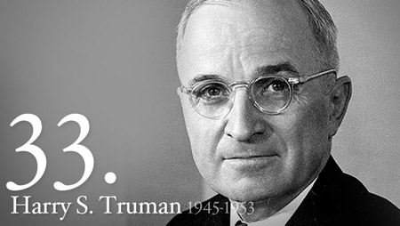
The Atom Bombs
Upon FDR’s death (April 12, 1945) even Truman was unaware of the project

Slide 5
Meeting at Potsdam, Germany

Slide 6
The Atom Bombs
Following V-E Day (May 8, 1945) Allied leaders agreed to meet in Potsdam, Germany
Purpose: To decide the fate of post-war Europe and how to defeat Japan
July 16, 1945: While at the Potsdam Conference, Truman received news that:
The “Trinity Test” in Alamogordo, New Mexico had succeeded
2 more bombs had been produced, and others were on the way
Stalin did not seem surprised when Truman told him. Why? He knew
July 26, 1945: Allies warned Japan to surrender or face prompt & utter destruction

Slide 7
Trinity Test

Slide 8
The Atom Bombs
President Truman relied on advisers, but Truman made the final decision
Over 70 project scientists and Gen. Eisenhower advised against using the bombs
The decision was based on:
Saving U.S. lives & $ and shorten the war by 12-18 months
The fact that conventional warfare had not forced a Japanese surrender, despite high casualties
Estimates that Japan still had 4 million soldiers ready to fight and die
Gaining an upper hand on the Soviet Union in the post-war negotiations (*The Soviet Union was scheduled to enter the war against Japan on Aug 8, 1945)
Preventing its future use by using it now (deterrent)

Slide 9
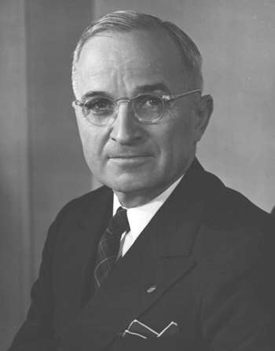
The Atom Bombs
Truman never questioned or apologized for his decision

Slide 10
The Atom Bombs
The Defeat of Japan in 1945
Aug 6: Little Boy was dropped from the B-29 bomber nicknamed the Enola Gay, exploding 2000 feet above Hiroshima (100,000 died)
Aug 9: Fat Man was dropped on Nagasaki (100,000 died)
Aug 14: V-J Day; Sept 2, ;45: Japan signed the unconditional surrender!

Slide 11
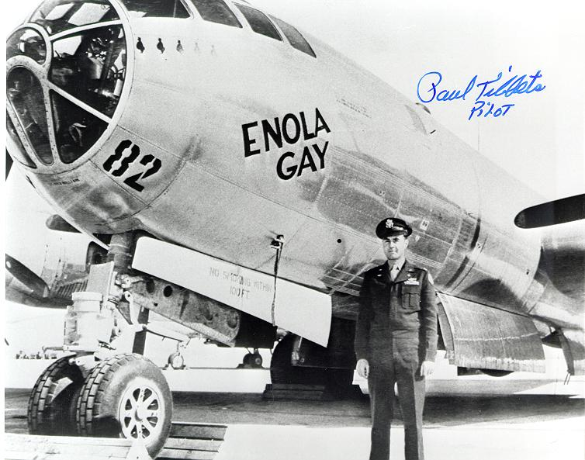
The Enola Gay

Slide 12
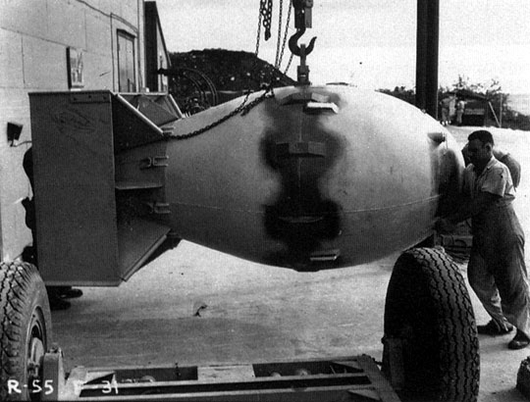
Fat Man

Slide 13
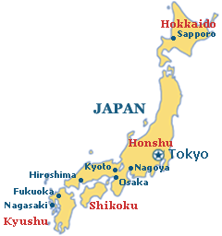
Hiroshima

Slide 14
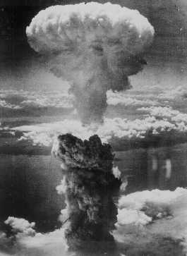
Fat Man Explodes…

Slide 15
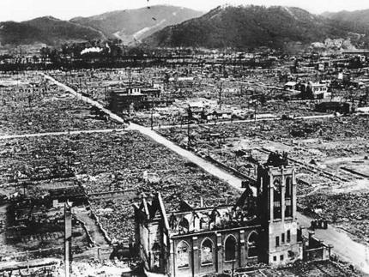

Slide 16
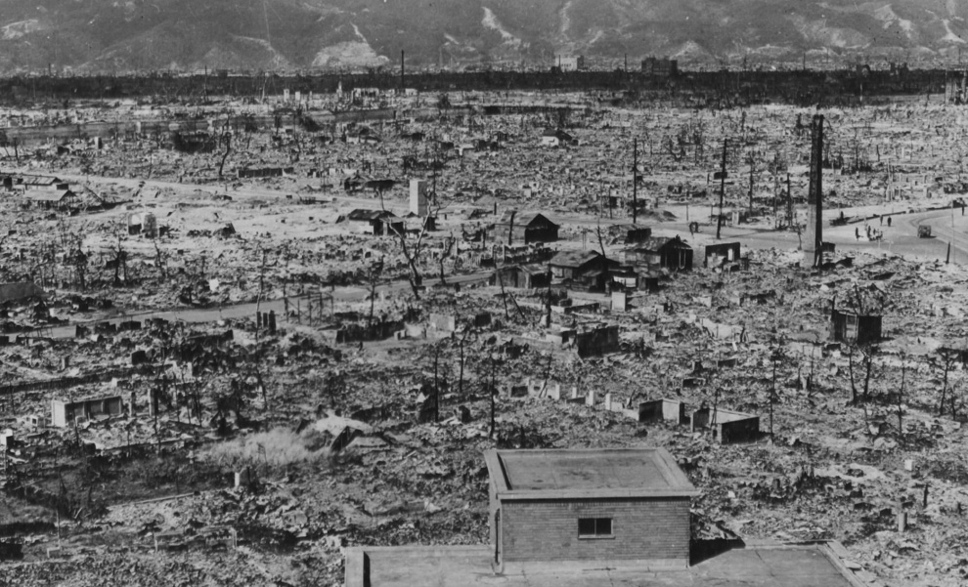

Slide 17
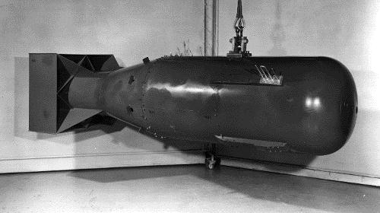
Little Boy

Slide 18
Nagasaki

Slide 19
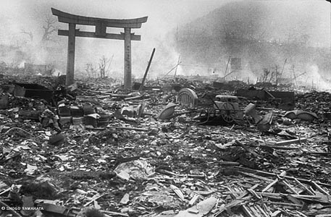

Slide 20
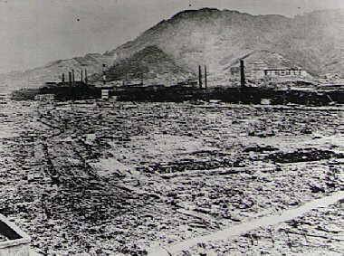

Slide 21
The Atom Bombs
Result: The Allies had won World War II. The war literally ended with a bang and no country has used the atomic bomb since Nagasaki. Peace would be short lived, however, as tensions with the Soviet Union were on the rise which would begin the Cold War.

